Slide 1
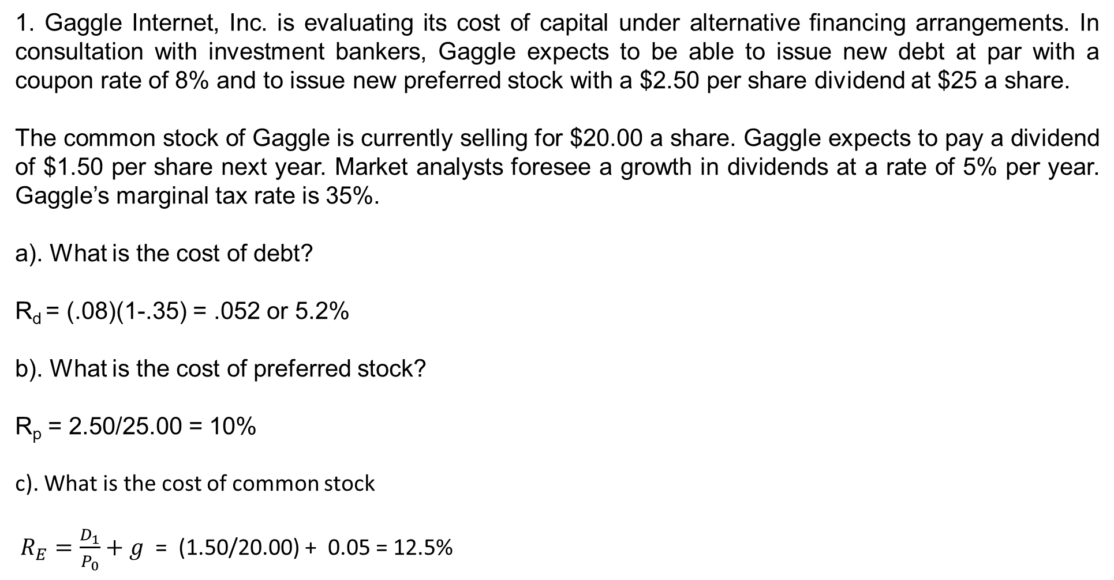
1. Gaggle Internet, Inc. is evaluating its cost of capital under alternative financing arrangements. In consultation with investment bankers, Gaggle expects to be able to issue new debt at par with a coupon rate of 8% and to issue new preferred stock with a $2.50 per share dividend at $25 a share.
The common stock of Gaggle is currently selling for $20.00 a share. Gaggle expects to pay a dividend of $1.50 per share next year. Market analysts foresee a growth in dividends at a rate of 5% per year. Gaggle’s marginal tax rate is 35%.
a). What is the cost of debt?
R_{d} = (.08)(1-.35) = .052 or 5.2%
b). What is the cost of preferred stock?
R_{p} = 2.50/25.00 = 10%
c). What is the cost of common stock
$R_{E}=\frac{D_{1}}{P_{0}}+g$ = (1.50/20.00) + 0.05 = 12.5%

Slide 2
d). If Gaggle raises capital using 45% debt, 5% preferred stock, and 50% common stock, what is Gaggle's cost of capital?
WACC = [0.45 (0.052)] + [0.05 ( 0.10)] + [0.50 (0.125)]WACC = 0.0234 + 0.005 + 0.0625 = 0.0909 = 9.09%
e). Gaggle raises capital using 30% debt, 5% preferred stock, and 65% common stock, what is Gaggle’s cost of capital?
WACC = [0.30 (0.052)] + [0.05 ( 0.10)] + [0.65 (0.125)]WACC = 0.0156 + 0.005 + 0.08125 = 0.10185 = 10.185%

Slide 3
2. ECG company sells lightweight tables. One table is sold for $45. Variable and fixed expenses data is given below:
  Variable expenses per unit: $18
  Fixed expenses per year: $540,000
a). Compute contribution margin
Contribution margin = Selling price – Variable expenses = $45 – $18 = $27
b). Compute break-even point in units and dollars.
Q_{BE} = TFC / (P – AVC) = $540,000/($27) = 20,000 units
Breakeven sales = $45 X 20,000 = $900,000
c). Calculate increase in net operating income if sales are increased by $135,000.
Sales increase by $135,000 implies selling 3000 more units ($135,000/.$45 = 3,000.
Increase = $3,000 x $27 = $81,000

Slide 4
3. During the last year, ECG company sold 24,000 lightweight tables. Remember, One table is sold for $45. Variable and fixed expenses data is given below:
  Variable expenses per unit: $18
  Fixed expenses per year: $540,000
a). Compute the degree of operating leverage at the last year’s level of sales.
DOL = Q(P-AVC) / (Q(P-AVC) – TFC) = 24,000($27)/ [24,000($27) - $540,000
= $648,000/ ($648,000 - $540,000) = $648,000/$108,000 = 6
b). If ECG company manages to increase the sales by 15% next year, by how much should net operating income increase? (Use degree of operating leverage for your answer).
The degree of operating leverage is 6. It means if sales are increased by 15%, there will be a 90% increase in net operating income as computed below: 15% × 6 = 90%

Slide 5
4. You are given the following information for Company A and Company B
 | Company A (millions $) | Company B (millions $)
Sales | 55,632 | 29,318
Variable Costs (TVC) | 29,993 | 16,376
Fixed Costs (TFC) | 11,281 | 5,473
For each company, calculate the DOL – degree of operating leverage.
DOL = Q(P-AVC) / (Q(P-AVC) – TFC)
Sales or (PQ) - TVC = 55,632 – 29,993 = | 25,639 29,318 - 16,376 = | 12,942
Sales or (PQ) - TVC – TFC = 55,632 – 29,993 – 11,281 = | 14,358 29,318 - 16,376 -5,473 = | 7,469
Degree of Operating Leverage = 25,639/14,358 = | 1.785694 12,942/7,469 = | 1.732762

Slide 6
5. Chick 'N Fish is considering two different capital structures. The first option is an all-equity firm with 22,500 shares of stock. The second option consists of 18,750 shares of stock plus $120,000 of debt at an interest rate of 7.8 percent. Ignore taxes. What is the break-even level of earnings before interest and taxes (EBIT) between these two options?
We set EBIT₁ = EBIT₂

