Slide 1
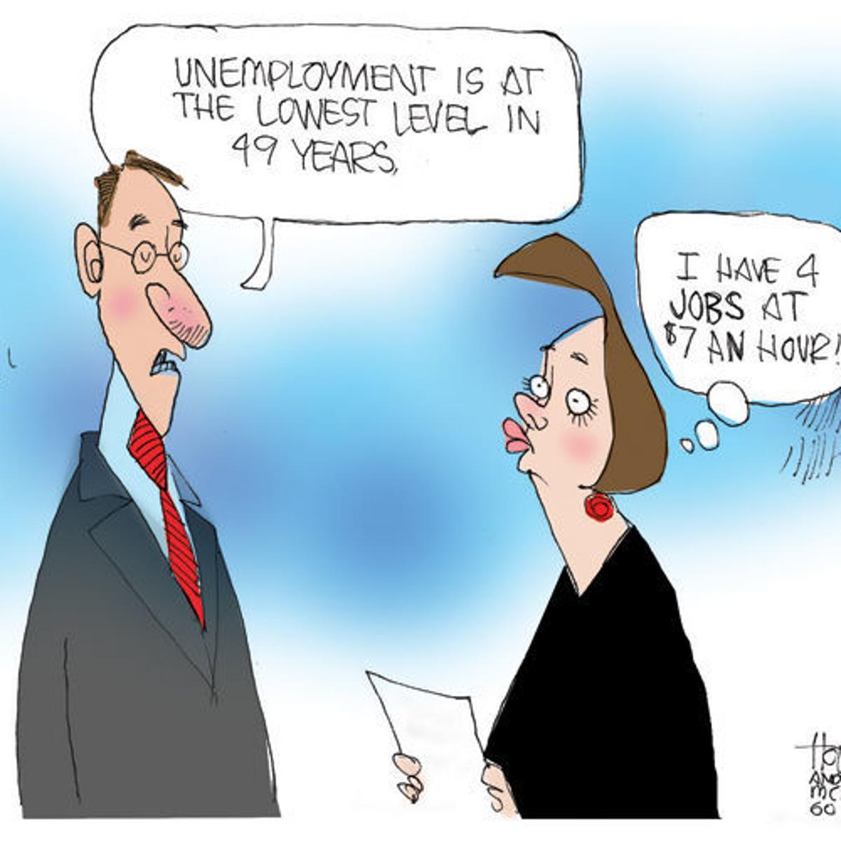
CHAPTER 8 LECTURE - UNEMPLOYMENT AND INFLATION

Slide 2
WHAT YOU WILL LEARN IN THIS CHAPTER
How is unemployment measured and how is the unemployment rate calculated?
What is the significance of the unemployment rate for the economy?
What is the relationship between the unemployment rate and economic growth?
What factors determine the natural rate of unemployment?
What are the economic costs of inflation?
How do inflation and deflation create winners and losers?
Why do policy makers try to maintain a stable rate of inflation?

Slide 3
Employment and Unemployment
Why Unemployment Is a Problem
Unemployment results in
Lost incomes and production
Lost human capital
The loss of income is devastating for those who bear it. Employment benefits create a safety net but don’t fully replace lost wages, and not everyone receives benefits.
Prolonged unemployment permanently damages a person’s job prospects by destroying human capital.
http://www.bls.gov/eag/eag.us.htm

Slide 4
Employment and Unemployment
The working-age population is divided into two groups:
1. People in the labor force
2. People not in the labor force
The labor force is the sum of employed and unemployed workers.
To be counted as unemployed, a person must be in one of the following three categories:
1. Without work but has made specific efforts to find a job within the previous four weeks
2. Waiting to be called back to a job from which he or she has been laid off
3. Waiting to start a new job within 30 days

Slide 5
DEFINING UNEMPLOYMENT
Measuring the labor force participation rate: The % of the adult (16+) noninstitutionalized civilian population who are working or actively looking for work
Measuring unemployment: The unemployment rate is the percent of the labor force without a job

Slide 6
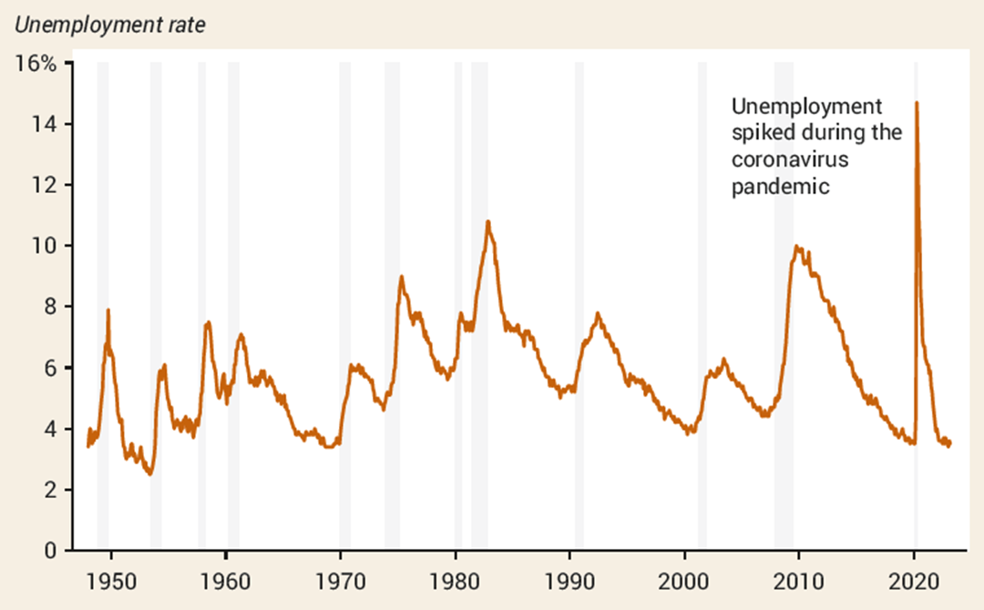
THE U.S. UNEMPLOYMENT RATE, 1948-2023
Unemployment always rises during recessions and usually (but not always) falls during periods of economic expansion.
https://www.imf.org/external/datamapper/LUR@WEO/OEMDC/ADVEC/WEOWORLD
http://www.bls.gov/eag/eag.us.htm
https://www.statista.com/statistics/808890/unemployment-rate-in-qatar/

Slide 7
PROBLEMS WITH UNEMPLOYMENT STATISTICS
Discouraged workers: nonworking people who have given up looking for work for the time being; not considered unemployed
The deeper the recession, the more discouraged workers there are.
Marginally attached workers: those who were available and actively looked for work recently, but are not currently looking (looked in the past 12 months but NOT in the past 4 weeks)
Underemployed workers: people who work part time because they cannot find full-time jobs

Slide 8
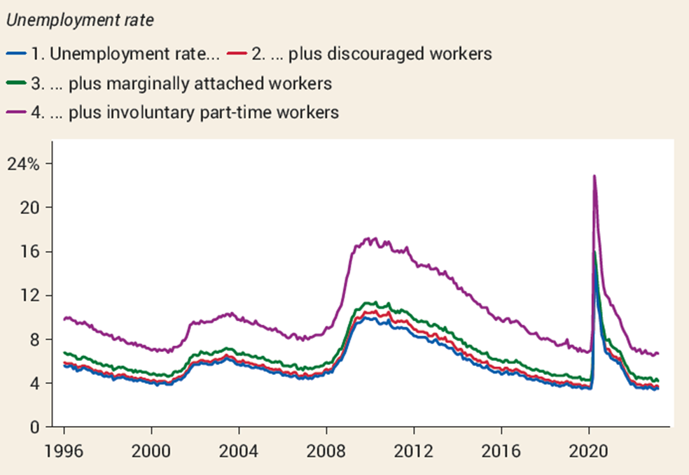
Six Alternative Measures
U-1: Those unemployed for 15 or more weeks
U-2: Unemployed job losers
U-3: The official unemployment rate
Broader measures are
U-4: U-3 + Discouraged workers
U-5: U-4 + Marginally attached workers
U-6: U-4 + Part-time workers who want full-time jobs
All measures increase together in recession.
https://www.bls.gov/cps/lfcharacteristics.htm#unemp

Slide 9
LEARN BY DOING: PRACTICE QUESTION 2
Adult population | 200 million
Labor force | 150 million
Employed persons | 138.75 million
Discouraged workers | 10.5 million
According to the table, the unemployment rate is _____%, and the labor force participation rate is _____%.
7; 60.4
0.7; 99.3
5.6; 69.4
7.5; 75

Slide 10
LEARN BY DOING: PRACTICE QUESTION 2 (Answer)
Adult population | 200 million
Labor force | 150 million
Employed persons | 138.75 million
Discouraged workers | 10.5 million
According to the table, the unemployment rate is _____%, and the labor force participation rate is _____%.
7; 60.4
0.7; 99.3
5.6; 69.4
7.5; 75 (correct answer)

Slide 11
LEARN BY DOING: PRACTICE QUESTION 3
Which of these individuals can be counted as unemployed?
Darren, a 10-year-old child
Nazma, a stay-at-home mom
Moesha, a full-time college student
Carl, who works part time at the Olive Garden but would prefer more hours
None of the answers is correct.

Slide 12
LEARN BY DOING: PRACTICE QUESTION 3 (Answer)
Which of these individuals can be counted as unemployed?
Darren, a 10-year-old child
Nazma, a stay-at-home mom
Moesha, a full-time college student
Carl, who works part time at the Olive Garden but would prefer more hours
None of the answers is correct. (correct answer)

Slide 13
THE SIGNIFANCE OF THE UNEMPLOYMENT RATE (4/4)
So how good an indicator is the unemployment rate?
It isn’t perfect.
It doesn’t measure the quality of jobs or how well people are matched to their jobs.
Economists also look at other indicators:
Labor force participation rate
Number of full-time jobs
Average wages

Slide 14
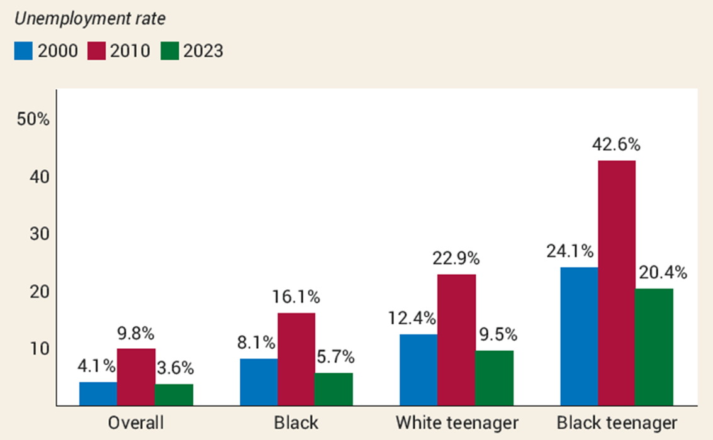
UNEMPLOYMENT RATES AND DEMOGRAPHICS
Data show that unemployment rates vary greatly between groups.

Slide 15
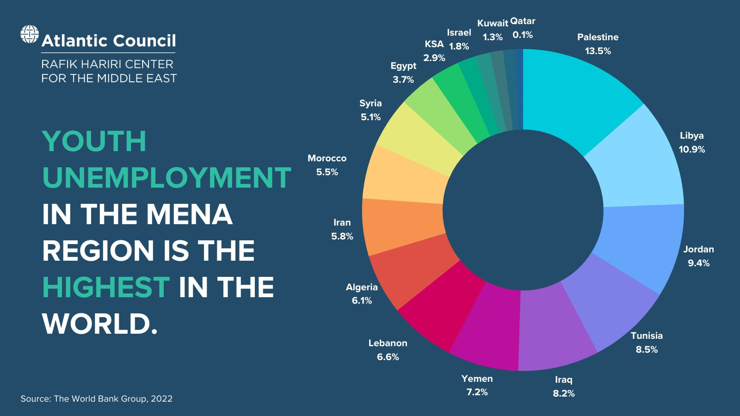
Youth Unemployment Rates by Country MENA

Slide 16
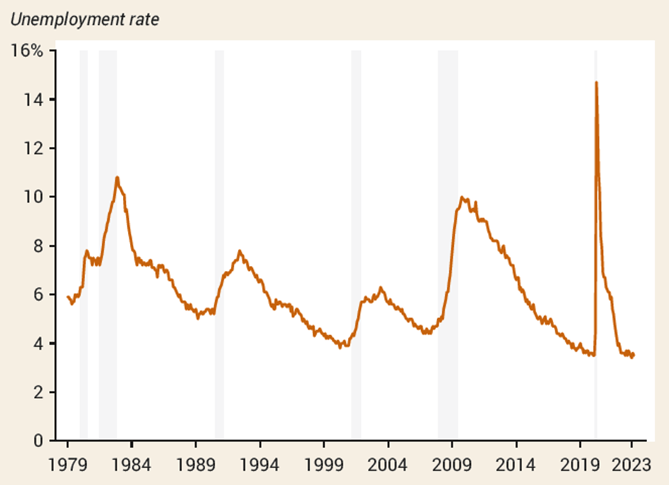
GROWTH AND UNEMPLOYMENT
During every recession, the unemployment rate rose.
During economic expansion, the unemployment rate usually falls but not always: Look at the periods following the recessions of 1990–1991 and 2001.

Slide 17
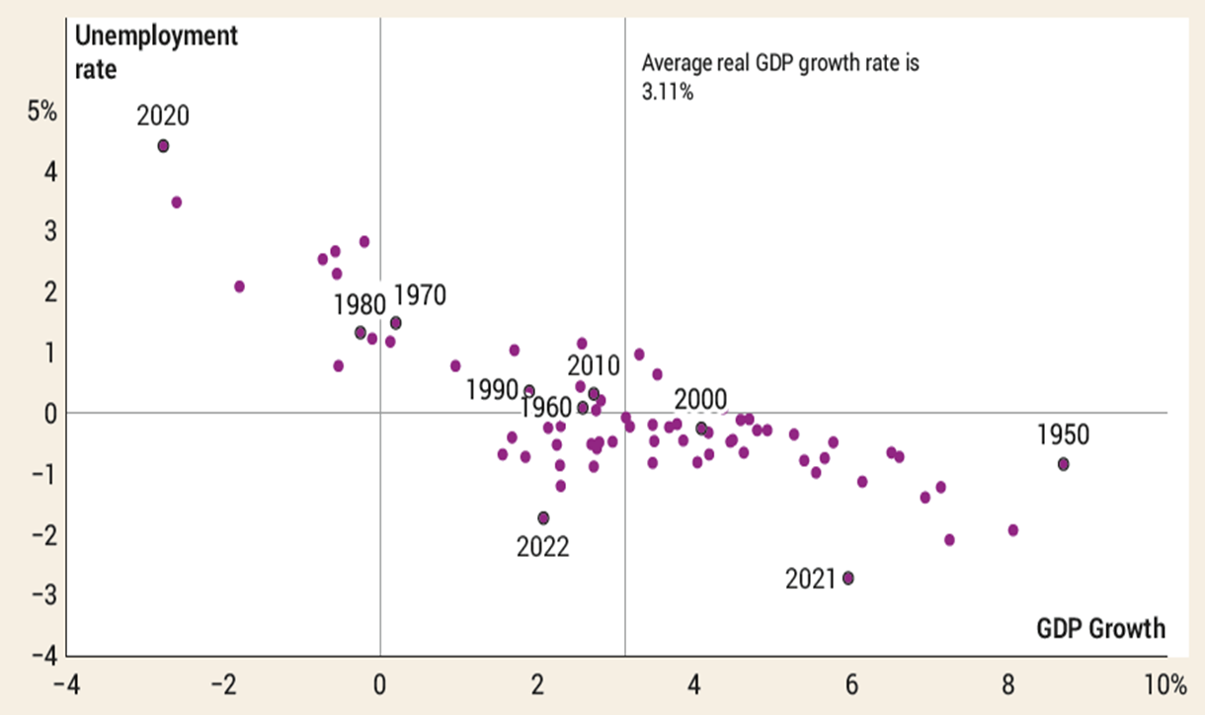
GROWTH AND CHANGES IN UNEMPLOYMENT, 1949–2019
There is a generally strong negative relationship between growth and unemployment.
There is a generally strong negative relationship between growth and unemployment.
In general, the unemployment rate fell when growth was above its average of 3.11% a year and rose when growth was below average.

Slide 18
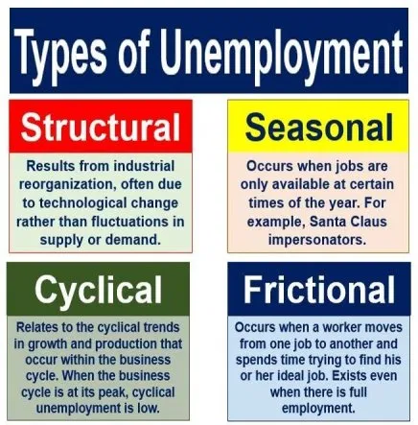
Unemployment and Full Employment

Slide 19
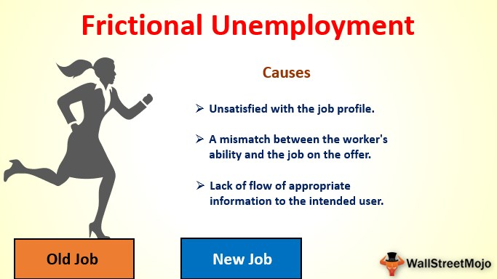
Frictional Unemployment
Frictional Unemployment is unemployment that arises from normal labor market turnover.
The creation and destruction of jobs requires that unemployed workers search for new jobs.
Increases in the number of people entering and reentering the labor force and increases in unemployment benefits raise frictional unemployment.
Frictional unemployment is a permanent and healthy phenomenon of a growing economy

Slide 20
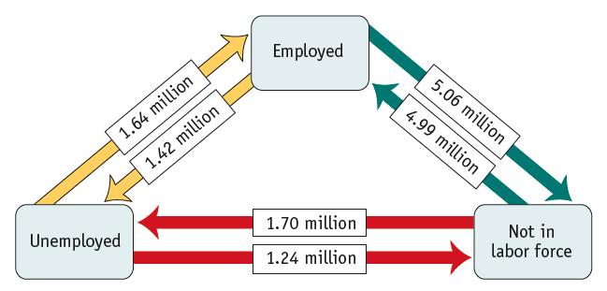
LABOR MARKET FLOWS, FEBRUARY 2023
Even in low-employment months, many workers move into and out of both employment and unemployment.

Slide 21
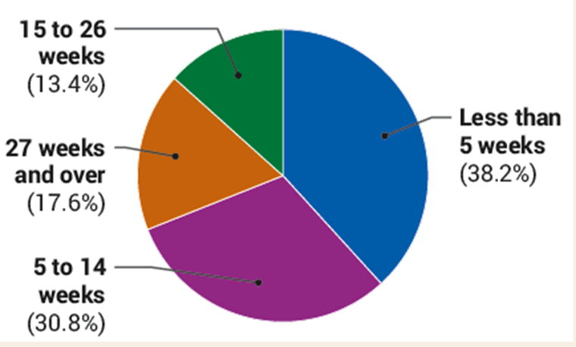
DURATION OF UNEMPLOYMENT, FEBRUARY 2023
The short duration of unemployment for most workers suggests that unemployment in early 2023 was mostly frictional.

Slide 22
Unemployment and Full Employment
Structural Unemployment is unemployment created by changes in technology and foreign competition that change the skills needed to perform jobs or the locations of jobs. More people are seeking jobs in a particular labor market than there are jobs available at the current wage rate, even when the economy is at the peak of the business cycle
Structural unemployment lasts longer than frictional unemployment.

Slide 23
STRUCTURAL UNEMPLOYMENT
Some causes of structural unemployment:
Labor unions
Union: an association of workers that bargains collectively with employers over wages, benefits, and working conditions
Unions take many forms: some act to increase wages simply by restricting entry into a profession with licensing requirements.
Efficiency wages: wages that employers set above the equilibrium rate as an incentive for better employee performance
Side effects of government policies
Mismatches between employees and employers

Slide 24
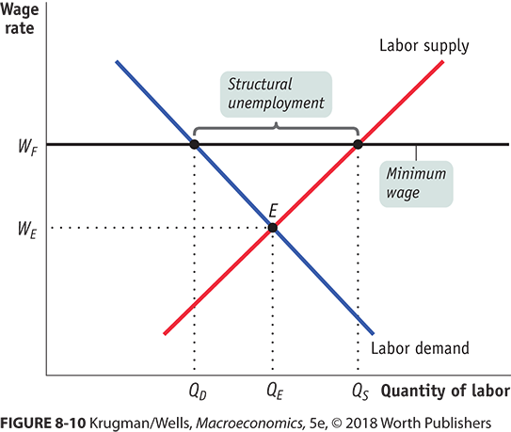
STRUCTURAL UNEMPLOYMENT
The traditional argument: minimum wage creates low-skilled unemployment; the higher the wage, the more structural unemployment

Slide 25
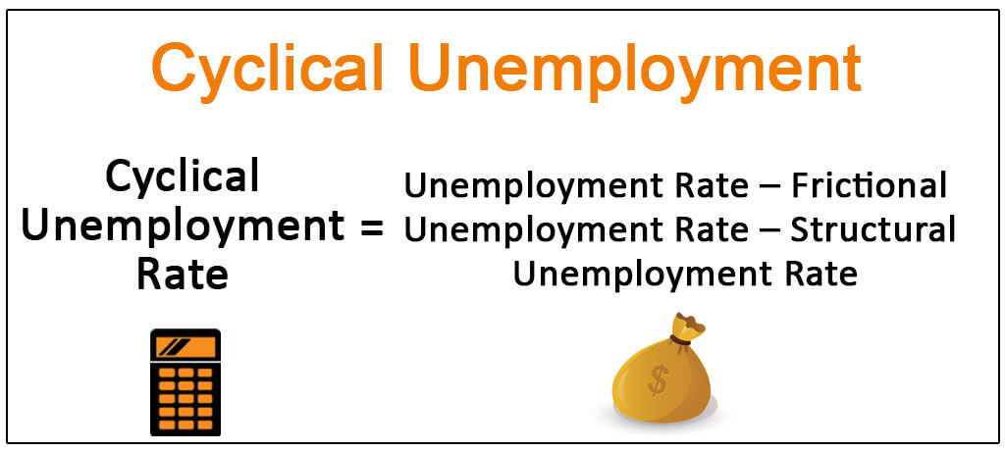
Cyclical Unemployment
Cyclical Unemployment is the higher than normal unemployment at a business cycle trough and lower than normal unemployment at a business cycle peak.
A worker laid off because the economy is in a recession and is then rehired when the expansion begins experiences cycle unemployment.

Slide 26
LEARN BY DOING: PRACTICE QUESTION 4
Jasmine has recently moved to Florida because she loves the warm climate there. Being new to the area, she will need to spend a few weeks looking for a new job. This is an example of:
frictional unemployment.
cyclical unemployment.
structural unemployment.
underemployment.

Slide 27
LEARN BY DOING: PRACTICE QUESTION 4 (Answer)
Jasmine has recently moved to Florida because she loves the warm climate there. Being new to the area, she will need to spend a few weeks looking for a new job. This is an example of:
frictional unemployment. (correct answer)
cyclical unemployment.
structural unemployment.
underemployment.

Slide 28

Unemployment and Full Employment
“Natural” Unemployment is the unemployment that arises from frictions and structural change when there is no cyclical unemployment.
Frictional and structural unemployment are always present; they are “natural.”
Natural unemployment = frictional unemployment + structural unemployment
Actual unemployment = natural unemployment + cyclical unemployment

Slide 29
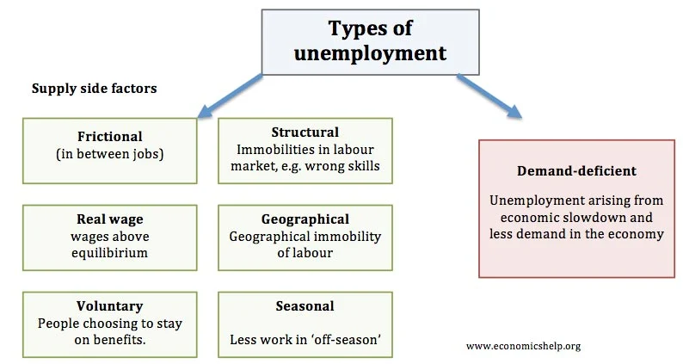
Expanded definitions

Slide 30
Unemployment and Full Employment
The natural unemployment rate changes over time and is influenced by many factors.
Key factors are
The age distribution of the population
The scale of structural change
The real wage rate
Unemployment benefits
Real GDP and Unemployment Over the Cycle
Potential GDP is the quantity of real GDP produced at full employment.
Potential GDP corresponds to the capacity of the economy to produce output on a sustained basis.
Real GDP minus potential GDP is the output gap.
Over the business cycle, the output gap fluctuates and the unemployment rate fluctuates around the natural unemployment rate.

Slide 31
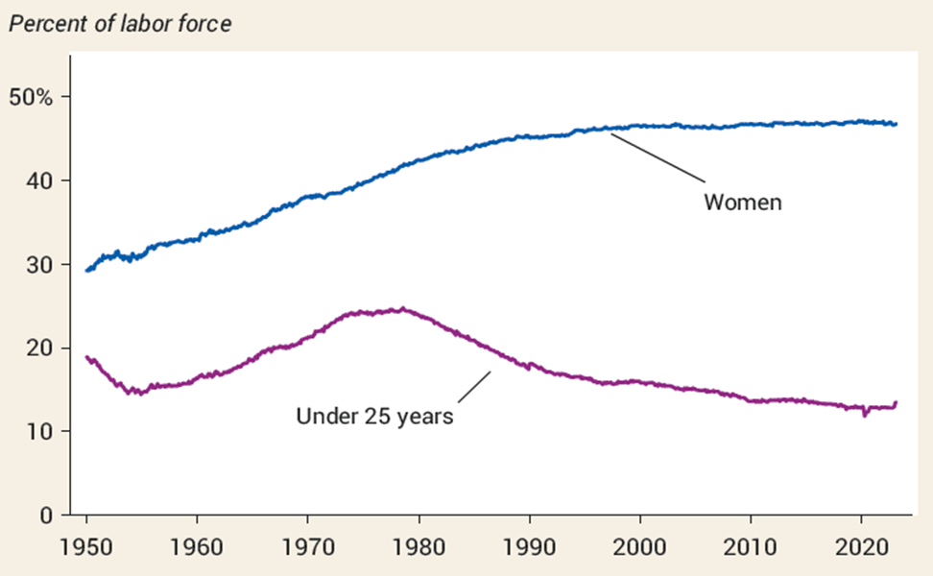
THE CHANGING MAKEUP OF THE U.S. LABOR FORCE, 1950–2020
Changes in the 1970s:
Large numbers of women joined the labor force.
Baby boomers were reaching the working age.

Slide 32
LEARN BY DOING: PRACTICE QUESTION 5
Which of these statements is true?
The natural rate of unemployment equals a country’s unemployment rate during a recession.
The natural rate of unemployment is the sum of frictional and structural unemployment.
The natural rate of unemployment is the sum of frictional and cyclical unemployment.
The natural rate of unemployment is the sum of structural and cyclical unemployment.

Slide 33
LEARN BY DOING: PRACTICE QUESTION 5 (Answer)
Which of these statements is true?
The natural rate of unemployment equals a country’s unemployment rate during a recession.
The natural rate of unemployment is the sum of frictional and structural unemployment. (correct answer)
The natural rate of unemployment is the sum of frictional and cyclical unemployment.
The natural rate of unemployment is the sum of structural and cyclical unemployment.

Slide 34
Price Level, Inflation, and Deflation
The price level is the average level of prices and the value of money.
A persistently rising price level is called inflation.
A persistently falling price level is called deflation.
We are interested in the price level because we want to
1. Measure the inflation rate or the deflation rate
2. Distinguish between money values and real values of economic variables.
What is disinflation?

Slide 35
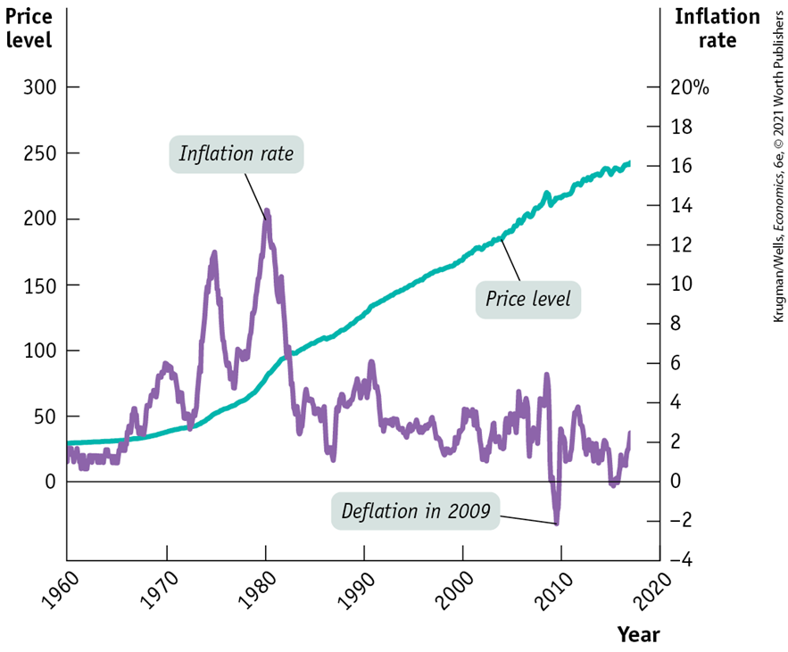
INFLATION AND DEFLATION
Inflation hurts the economy, but most people misunderstand how.
The consumer price index has continuously increased, but the inflation rate fluctuates.

Slide 36
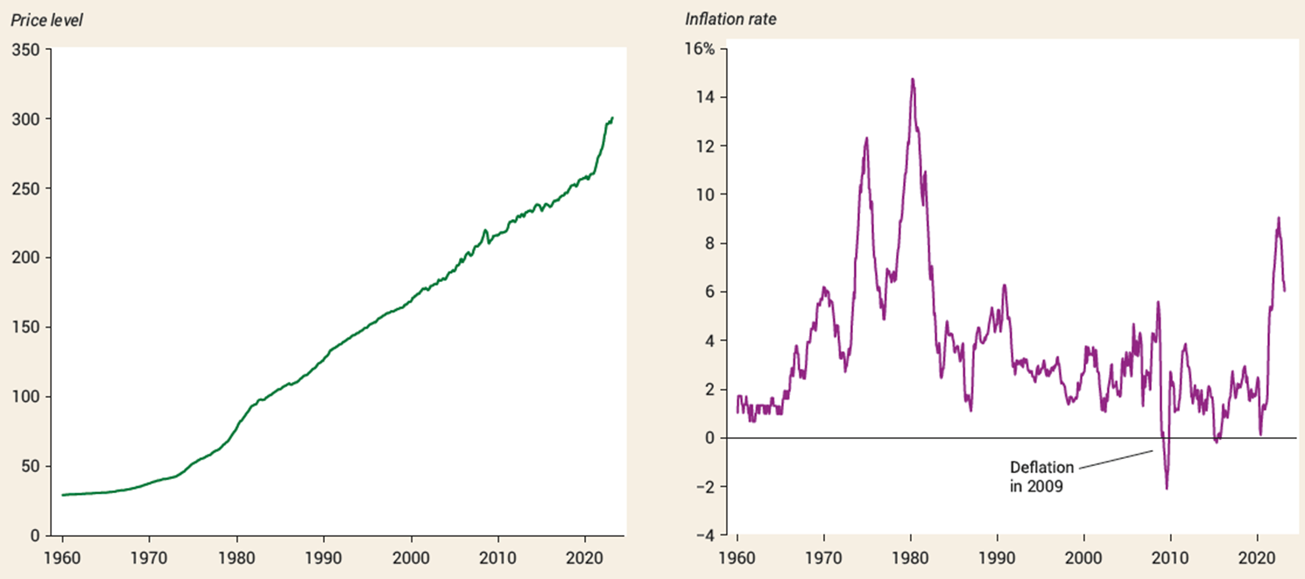
INFLATION AND DEFLATION

Slide 37
Why Inflation and Deflation Are Problems
Low, steady, and anticipated inflation or deflation is not a problem.
Unpredictable inflation or deflation is a problem because it
Redistributes income and wealth
Lowers real GDP and employment
Diverts resources from production
Unpredictable changes in the inflation rate redistribute income in arbitrary ways between employers and workers and between borrowers and lenders.
At its worse, inflation becomes hyperinflation—an inflation rate that is so rapid that workers are paid twice a day because money loses its value so quickly.

Slide 38
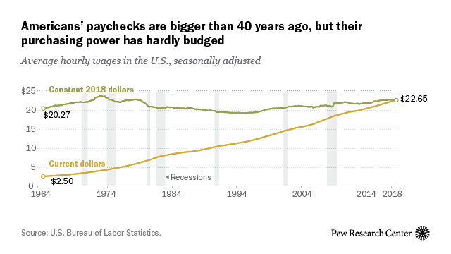
THE LEVEL OF PRICES DOESN’T MATTER
Inflation does not make everyone poorer because incomes often rise with prices.
A better measure? Real wages.
Real wage is the wage rate divided by the price level.
Real income is income divided by the price level.

Slide 39
Consumer Price Index Once Again
Consumer price index (CPI)
Market basket
300 goods and services
Typical urban consumer
2 year updates
Price of the Most Recent Market
Basket in the Particular Year
CPI
=
x
100
Price estimate of the Market
Basket in 1982-1984
The next slides show how a CPI is calculated.

Slide 40
In order to properly measure the rate of inflation or deflation it is necessary establish a base year from which to make a comparison. Once the base is established, future (or past) price level changes can then be compared to this base.
The easiest way see this is to look at how the consumer price index or CPI is calculated. The formula for CPI is:
CPI = Σ P₁Q₀ x 100
Σ P₀Q₀
P₀ is the price of the good in time period 0.
Q₀ is the quantity of the good in time period 0.
P₁ is the price of the good in time period 1.
Suppose your were given a shopping list of a number of different items (or a basket of items) and told to find out how much it would cost to purchase this basket at a given point in time.
In time period 0 you purchase a market basket which includes:
2 haircuts at 2.50 per haircut = 5.00
4 shirts at 10.00 per shirt = 40.00
10 apples at .50 per apple = 5.00
______________________________________________
Total cost = 50.00

Slide 41
One year late (time period 1) you go out and purchase the same market basket.
Time period 1
2 haircuts at 3.50 per haircut = 7.00
4 shirts at 11.25 per shirt = 45.00
10 apples at .40 per apple = 4.00
__________________________________________
Total cost = 56.00
As shown, the market basket which cost 50.00 in time period 0 costs 56.00 in time period 1. It is important to note that the index looks at the price of a market basket of goods, not just one good's price.
In general form, to calculate the CPI in any given year, other than the base year which is always equal to 100, the following formula is used:
CPI = Cost of Market Basket in given year X 100.
Cost of Market Basket in base year
Using a little bit of algebra,
56.00 X 100 = 1.12 X 100 = 112
50.00 1
Since the base is 100, the index, 112, can be interpreted as what costs 100 in time period 0 will cost 112 in time period 1.

Slide 42
THE RATE OF CHANGE DOES MATTER
Remember, it’s crucial to distinguish between the level of prices and the inflation rate.
Example: If the CPI increases from 120 to 135 over 1 year, what is the inflation rate?

Slide 43
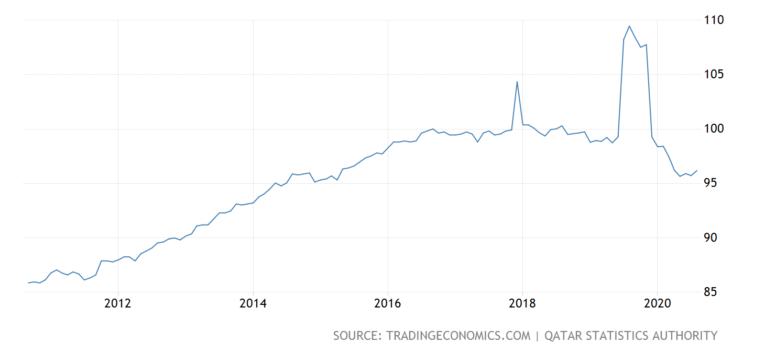
Qatar Consumer Price Index (CPI) Base Year = 100

Slide 44
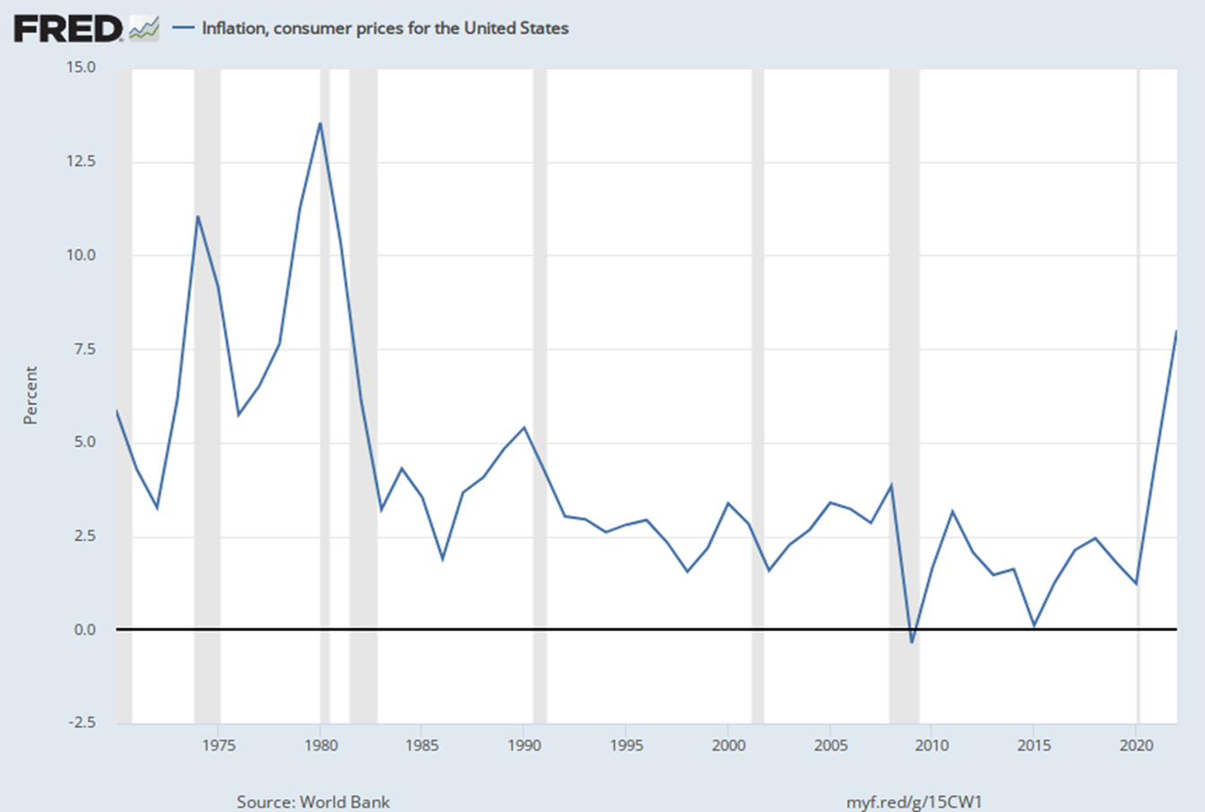

Slide 45
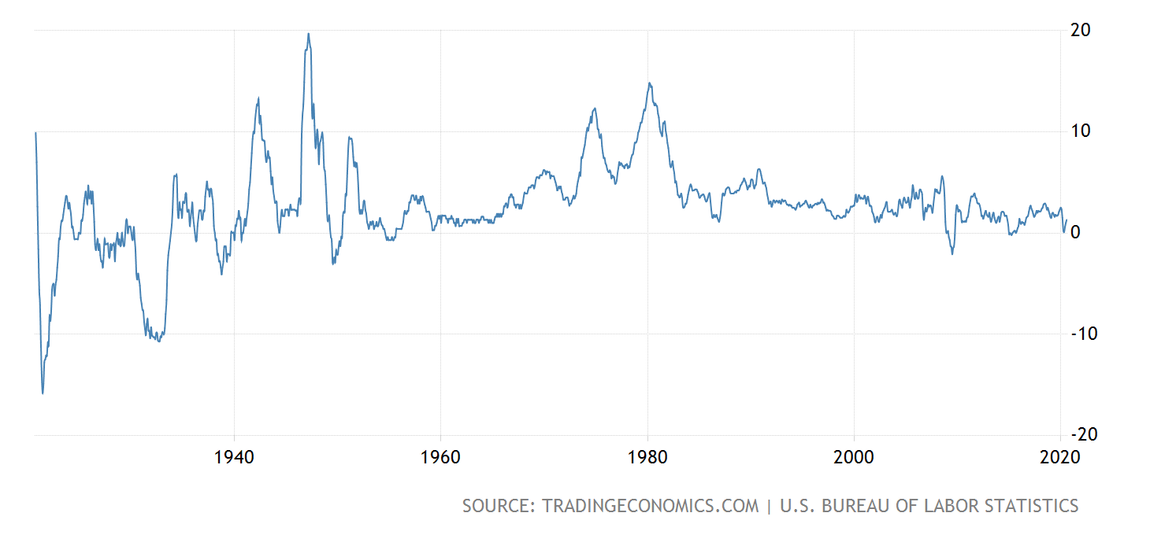
Inflation Rates Around the World
https://www.imf.org/external/datamapper/PCPIPCH@WEO/WEOWORLD/VEN
http://www.usinflationcalculator.com

Slide 46
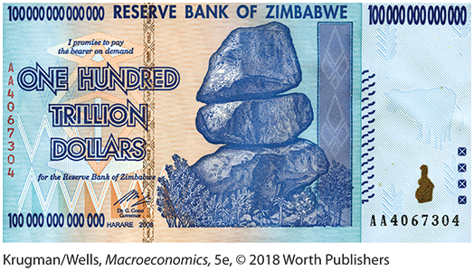
THE COSTS OF INFLATION
Shoe-leather costs: the increased costs of transactions caused by inflation
Since cash loses its value quickly during high inflation, people waste more time running around to spend it as fast as they can
Menu cost: the real cost of changing listed prices
Unit-of-account costs: costs arising from the way inflation makes money a less reliable unit of measurement

Slide 47
The Biased CPI
New Goods Bias
New goods that were not available in the base year appear and, if they are more expensive than the goods they replace, they put an upward bias into the CPI.
Quality Change Bias
Quality improvements occur every year. Part of the rise in the price is payment for improved quality and is not inflation.
The CPI counts all the price rise as inflation.
Commodity Substitution Bias
The market basket of goods used in calculating the CPI is fixed and does not take into account consumers’ substitutions away from goods whose relative prices increase.
Outlet Substitution Bias
As the structure of retailing changes, people switch to buying from cheaper sources, but the CPI, as measured, does not take account of this outlet substitution.

Slide 48
LEARN BY DOING: PRACTICE QUESTION 6
Mary expects the inflation rate to be 5%, and she is willing to pay a real interest rate of 3%. Joe expects the inflation rate to be 5%, and he is willing to lend money if he receives a real interest rate of 3%. If the actual inflation rate is 6% and the loan contract specifies a nominal interest rate of 8%, then:
Joe is glad he lent out funds even though his real interest rate has fallen.
Joe is sorry he lent out funds, since his real interest rate is now 9%.
Mary is glad she borrowed the funds because her real interest rate has fallen.
Mary is sorry she borrowed funds, since her real interest rate is now 9%.

Slide 49
LEARN BY DOING: PRACTICE QUESTION 6 (Answer)
Mary expects the inflation rate to be 5%, and she is willing to pay a real interest rate of 3%. Joe expects the inflation rate to be 5%, and he is willing to lend money if he receives a real interest rate of 3%. If the actual inflation rate is 6% and the loan contract specifies a nominal interest rate of 8%, then:
Joe is glad he lent out funds even though his real interest rate has fallen.
Joe is sorry he lent out funds, since his real interest rate is now 9%.
Mary is glad she borrowed the funds because her real interest rate has fallen. (correct answer)
Mary is sorry she borrowed funds, since her real interest rate is now 9%.

Slide 50

Types of Inflation
Demand-pull inflation: increases in aggregate demand outpace increases in aggregate supply.
Cost-push inflation: increases in production costs cause firms to raise prices.
Hyperinflation: extremely high rate of inflation.

Slide 51
WINNERS AND LOSERS FROM INFLATION
If inflation is different from predictions, some will win and some will lose.
Interest rate: the price (calculated as a percentage of the amount borrowed) that a lender charges for the use of his or her savings for one year
Nominal interest rate: the interest rate expressed in dollar terms
Real interest rate: the nominal interest rate minus the rate of inflation

Slide 52
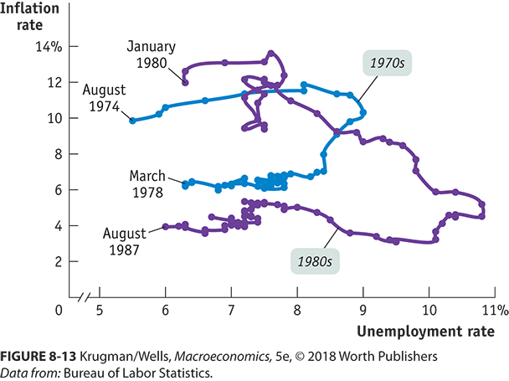
INFLATION IS EASY, DISINFLATION IS HARD
The policies needed to slow prices usually cause unemployment.
Disinflation: the process of bringing down the inflation rate

Slide 53
LEARN BY DOING: PRACTICE QUESTION 7
You have just been awarded a cost-of-living increase tied to the CPI. The CPI has gone from 110 to 112. If your salary is $30,000 per year before the increase, what will it be after the CPI increase is factored in?
$29,464
$30,545
$30,600
$33,600

Slide 54
LEARN BY DOING: PRACTICE QUESTION 7 (Answer)
You have just been awarded a cost-of-living increase tied to the CPI. The CPI has gone from 110 to 112. If your salary is $30,000 per year before the increase, what will it be after the CPI increase is factored in?
$29,464
$30,545 (correct answer)
$30,600
$33,600

Slide 56

