Slide 1
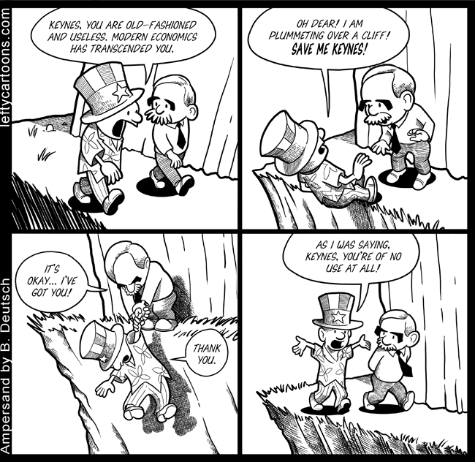
Chapter 6 Lecture - MACROECONOMICS: THE BIG PICTURE

Slide 2
WHAT YOU WILL LEARN IN THIS CHAPTER
What makes macroeconomics different from microeconomics
What a business cycle is and why policy makers seek to diminish the severity of business cycles
How long-run economic growth determines a country’s standard of living
The meaning of inflation and deflation and why price stability is preferred
The importance of open economy macroeconomics and how economies interact through trade deficits and trade surpluses
2

Slide 3
Macroeconomics versus Microeconomics
Microeconomic Questions | Macroeconomic Questions
Should I go to business school or take a job right now? | How many people are employed in the economy as a whole this year?
What determines the salary Google offers to Cherie Camajo, a new MBA? | What determines the overall salary levels paid to workers in a given year?
What determines the cost to a university or college of offering a new course? | What determines the overall level of prices in the economy as a whole?
What government policies should be adopted to make it easier for low-income students to attend college? | What government policies should be adopted to promote employment and growth in the economy as a whole?
What determines whether Citibank opens a new office in Shanghai? | What determines the overall trade in goods, services, and financial assets between the United States and the rest of the world?
3

Slide 4
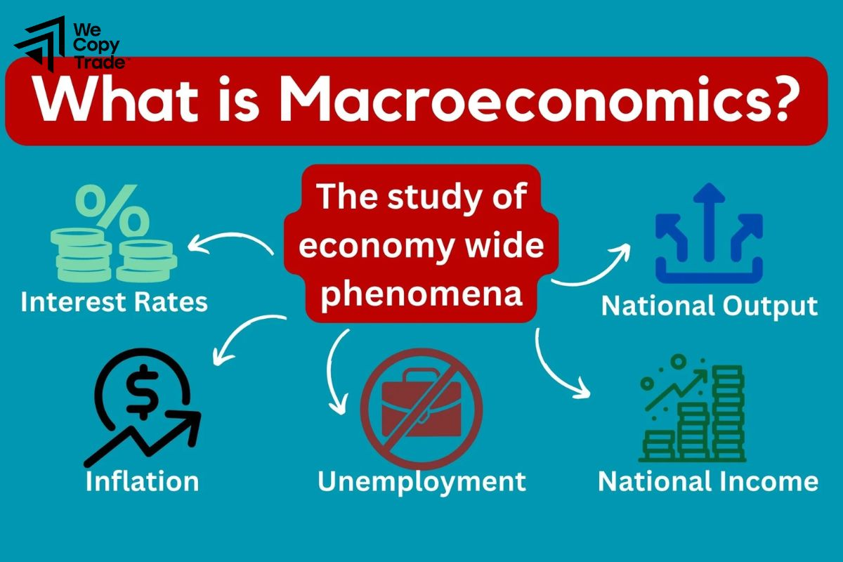
Macroeconomics versus Microeconomics
Macroeconomics examines the aggregate behavior of the economy (that is, how the actions of all the individuals and firms in the economy interact to produce a particular level of economic performance as a whole).
Example: Overall level of prices in the economy (how high or how low they are relative to prices last year) rather than the price of a particular good or service.
4

Slide 5
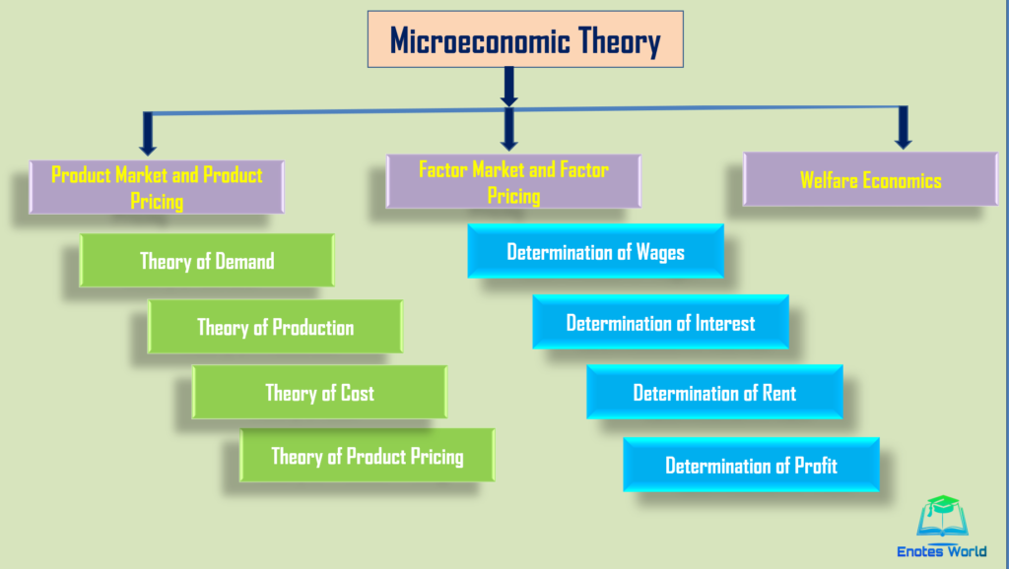
Macroeconomics versus Microeconomics
Microeconomics focuses on how decisions are made by individuals and firms and the consequences of those decisions.
Example: How much it would cost for a university or college to offer a new course ─ the cost of the instructor’s salary, the classroom facilities, the class materials, and so on.
Having determined the cost, the school can then decide whether to offer the course by weighing the costs and benefits.
5

Slide 6
Macroeconomics versus Microeconomics
In macroeconomics, the behavior of the whole macroeconomy is, indeed, greater than the sum of individual actions and market outcomes.
Example: Paradox of thrift: when families and businesses are worried about the possibility of economic hard times, they prepare by cutting their spending.
This reduction in spending depresses the economy as consumers spend less and businesses react by laying off workers.
As a result, families and businesses may end up worse off than if they hadn’t tried to act responsibly by cutting their spending.
6

Slide 7
Macroeconomics: Theory and Policy
In a self-regulating economy, problems such as unemployment are resolved without government intervention, through the working of the invisible hand.
According to Keynesian economics, economic slumps are caused by inadequate spending and they can be mitigated by government intervention.
Monetary policy uses changes in the quantity of money to alter interest rates and affect overall spending.
Fiscal policy uses changes in government spending and taxes to affect overall spending.
7

Slide 8
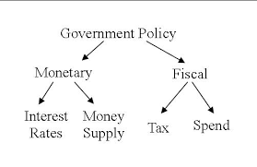
What Macroeconomics Is About
Macroeconomic Policy
Fiscal policy: government spending and taxation
Effects of changes in federal budget
U.S. experience in Fig. 1.6
Relation to trade deficit?
Monetary policy: growth of money supply; determined by central bank; the Fed in U.S.
8

Slide 9
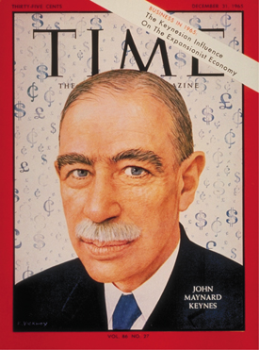
MACROECONOMICS
“The long run is a misleading guide to current affairs. In the long run we are all dead. Economists set themselves too easy, too useless a task if in tempestuous seasons they can only tell us that when the storm is past the ocean is flat again.”
-John Maynard Keynes, A Tract on Monetary Reform (1923) Ch. 3
9
Notes:
All image credits courtesy of Morgue File and/or FreeImages.com unless otherwise specified

Slide 10
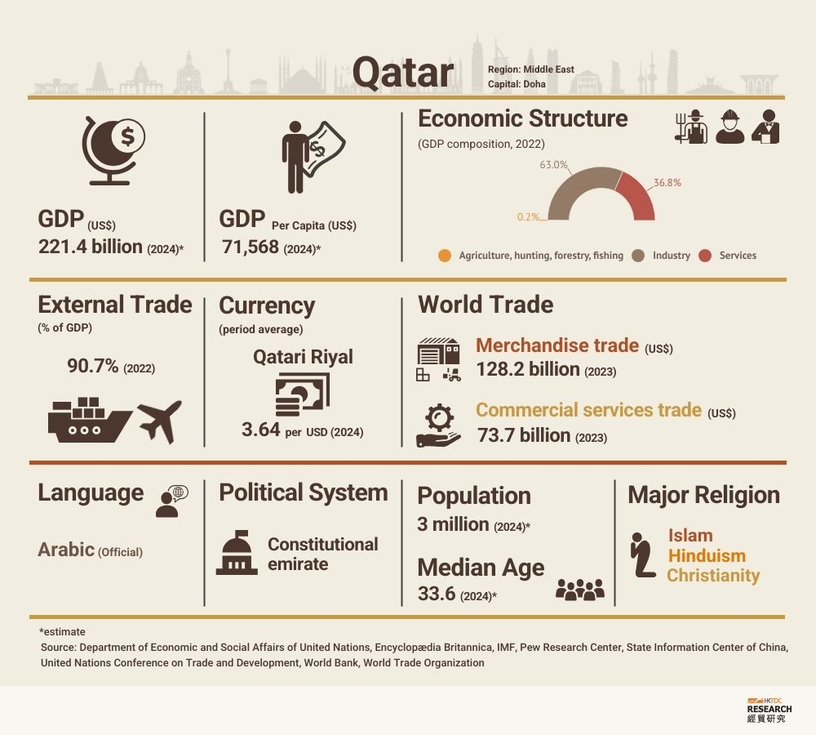
10

Slide 11
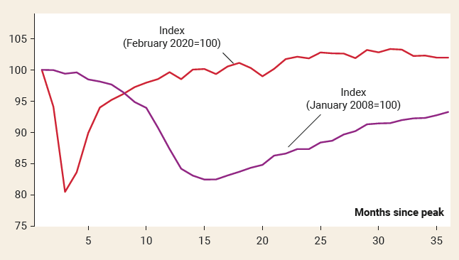
COMPARING TWO SEVERE ECONOMIC SLUMPS
2008 Financial Crisis: policy makers criticized for inadequate policy response.
2020 Coronavirus Pandemic: policy response was huge with the U.S. government aiding families and businesses.
11

Slide 12
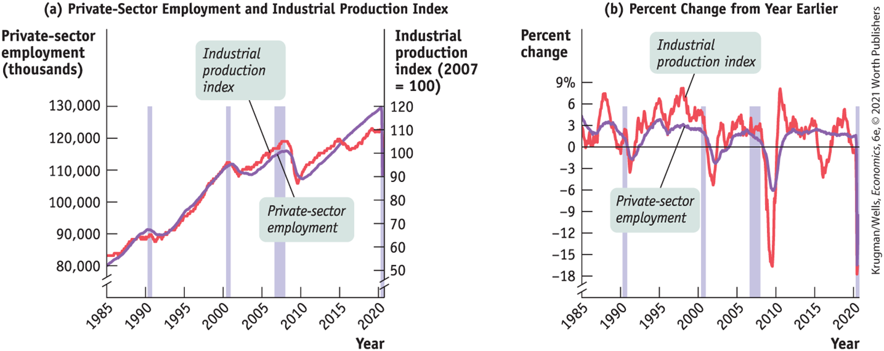
Growth, Interrupted, 1985–2020
12

Slide 13
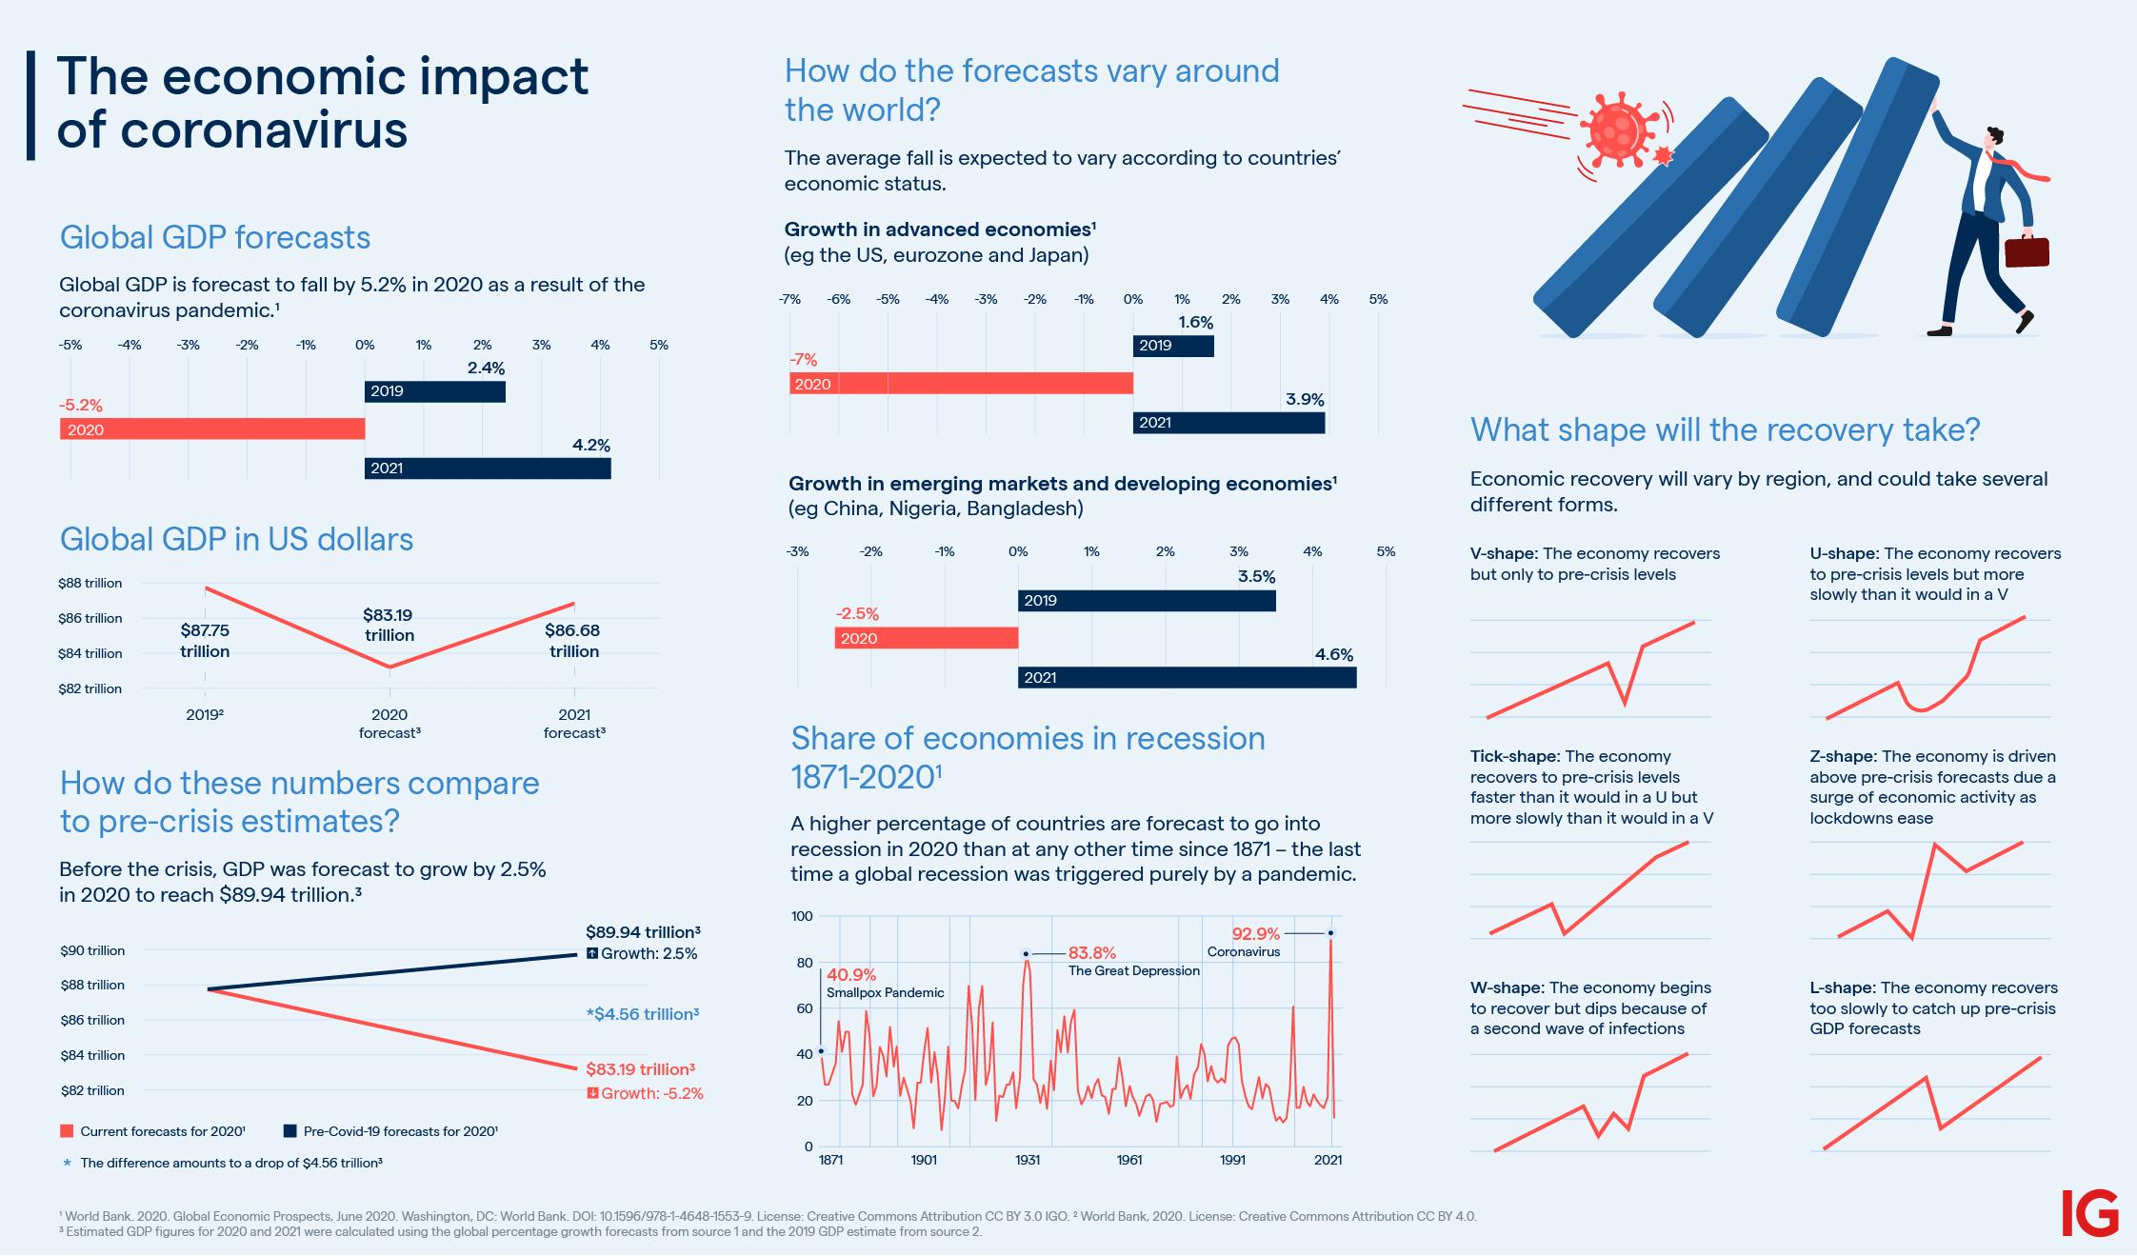

Slide 14
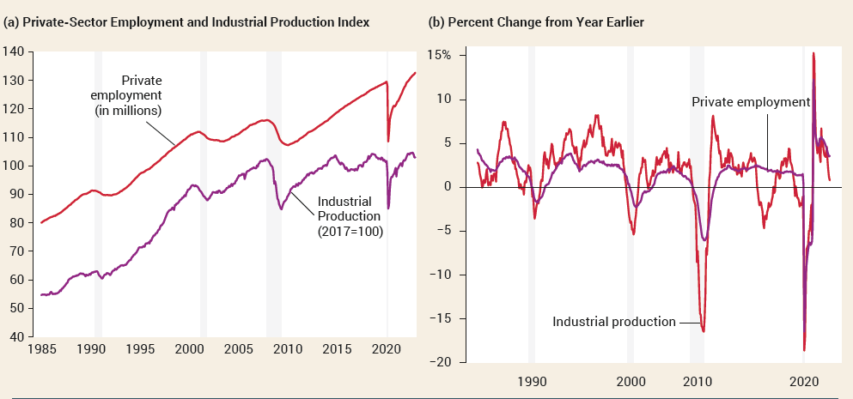
THE BUSINESS CYCLE
Major economic indicators show a strong upward trend.
But they didn’t rise steadily. There were downturns in the early 1990s, the early 2000s, 2007, and 2020.
14

Slide 15
The Business Cycle
The business cycle is the short-run alternation between economic downturns and economic upturns.
A depression is a very deep and prolonged downturn.
Recessions are periods of economic downturns when output and employment are falling.
Expansions, sometimes called recoveries, are periods of economic upturns when output and employment are rising.
The point at which the economy turns from expansion to recession is a business-cycle peak.
The point at which the economy turns from recession to expansion is a business-cycle trough.
15

Slide 16
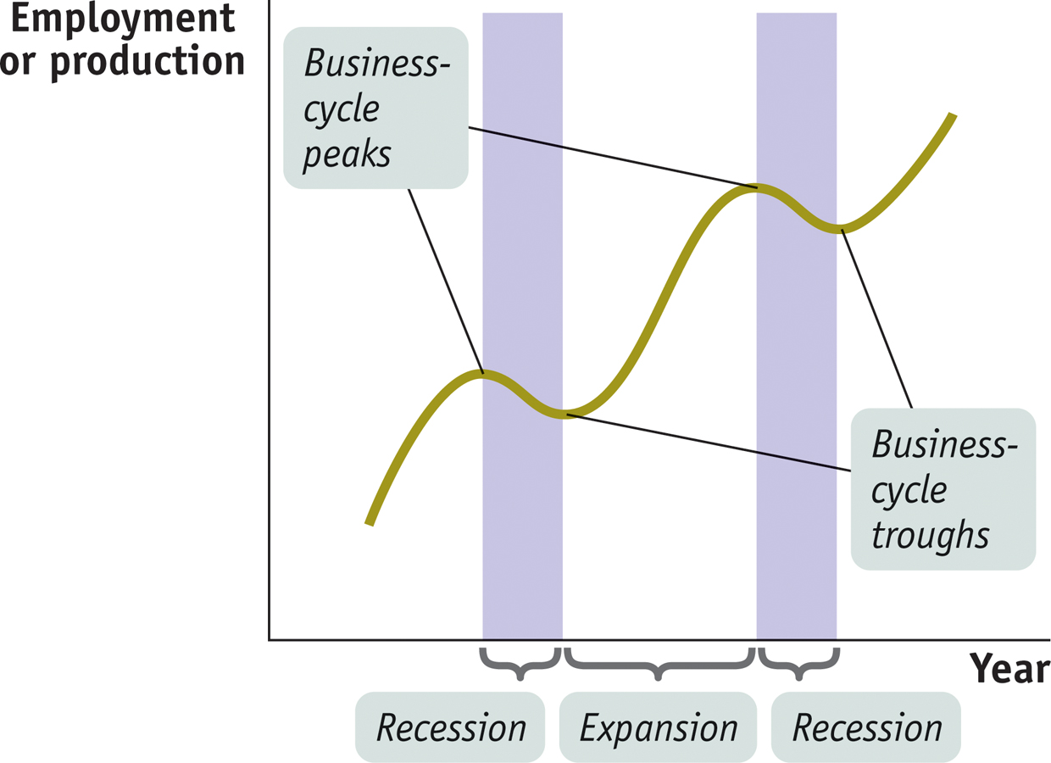
The Business Cycle
What happens during a business cycle, and what can be done about it?
The effects of recessions and expansions on unemployment
The effects on aggregate output
The possible role of government policy
16
Notes:
16

Slide 17
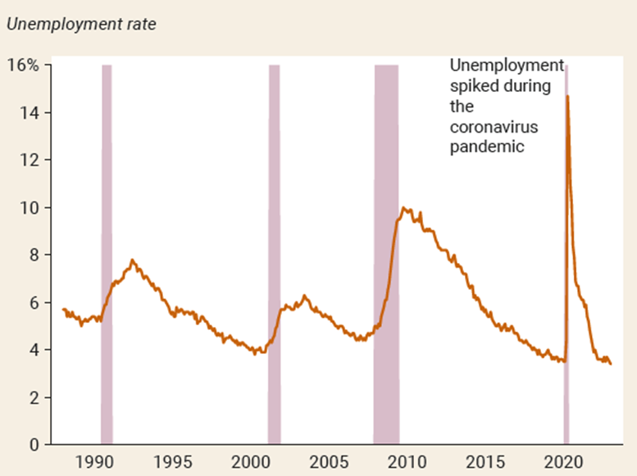
The Business Cycle
What happens during a business cycle, and what can be done about it?
The effects of recessions and expansions on unemployment
The effects on aggregate output
The possible role of government policy
17

Slide 18
Taming the Business Cycle
The business cycle is a main concern of modern policy makers: they try to smooth out the business cycle. They haven’t been completely successful.
Policy efforts undertaken to reduce the severity of recessions are called stabilization policies.
One type of stabilization policy is monetary policy: changes in the quantity of money or the interest rate.
The second type of stabilization policy is fiscal policy: changes in tax policy or government spending, or both.
18

Slide 19
LEARN BY DOING: PRACTICE QUESTION 1
The use of taxes and government spending to change the overall level of spending in an economy is called:
monetary policy.
fiscal policy.
either monetary or fiscal policy, depending on what is happening to the interest rate.
19

Slide 20
LEARN BY DOING: PRACTICE QUESTION 1 (Answer)
The use of taxes and government spending to change the overall level of spending in an economy is called:
monetary policy.
fiscal policy. (correct answer)
either monetary or fiscal policy, depending on what is happening to the interest rate.
20

Slide 21
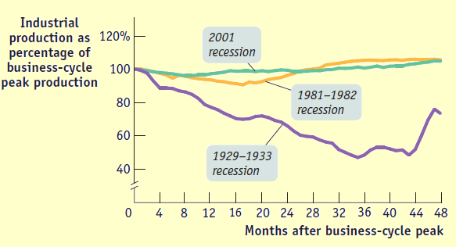
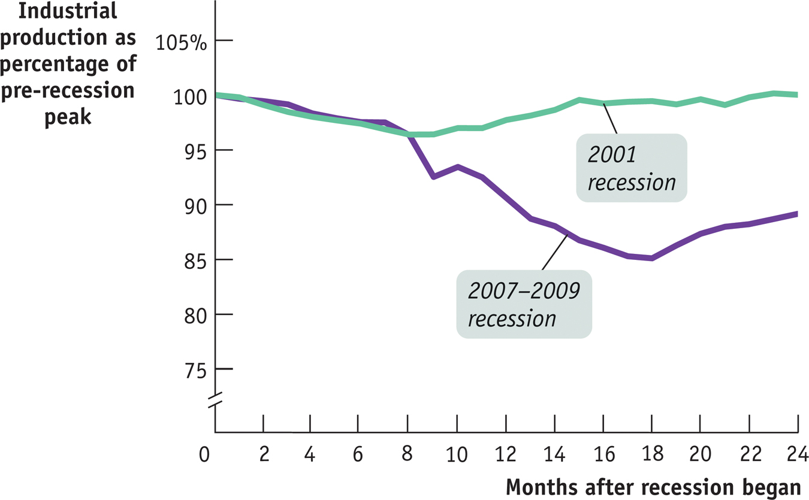
Comparing Recessions
21
Notes:
Figure Caption: Figure 6(21)-5: Recessions
Some recessions are worse than others. This figure shows the path of industrial production in three recessions, in each case measured as a percentage of production at the business-cycle peak just before the recession started. The 2001 recession was relatively brief and mild compared with the recession of 1981–1982. And that recession was nothing compared with the gigantic, prolonged drop that marked the beginning of the Great Depression.
Source: Federal Reserve Bank of St. Louis.
21

Slide 22
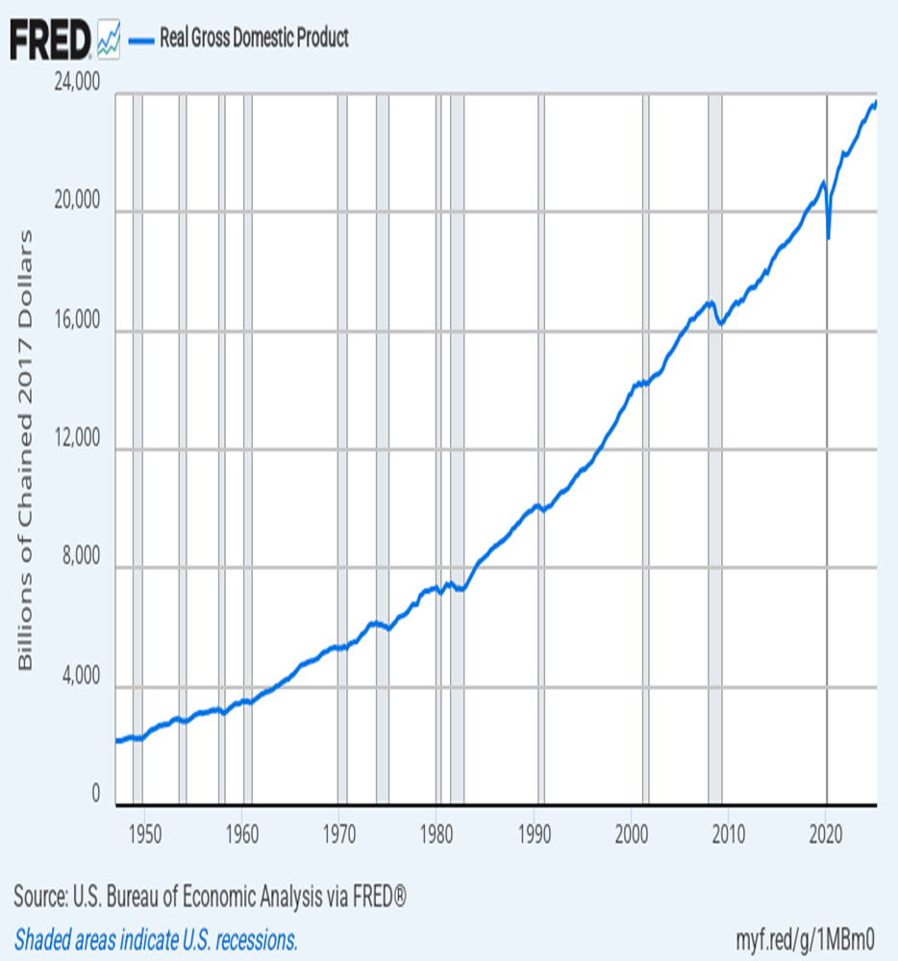
Long Run Growth in U.S.
22

Slide 23
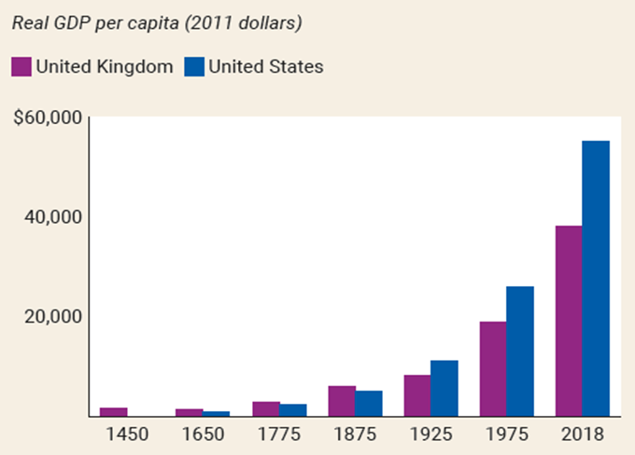
Long-Run Economic Growth
Long-run economic growth is the sustained upward trend in the economy’s output over time. A country can achieve a permanent increase in the standard of living of its citizens only through long-run growth. A central concern of macroeconomics is what determines long-run economic growth.
23

Slide 24
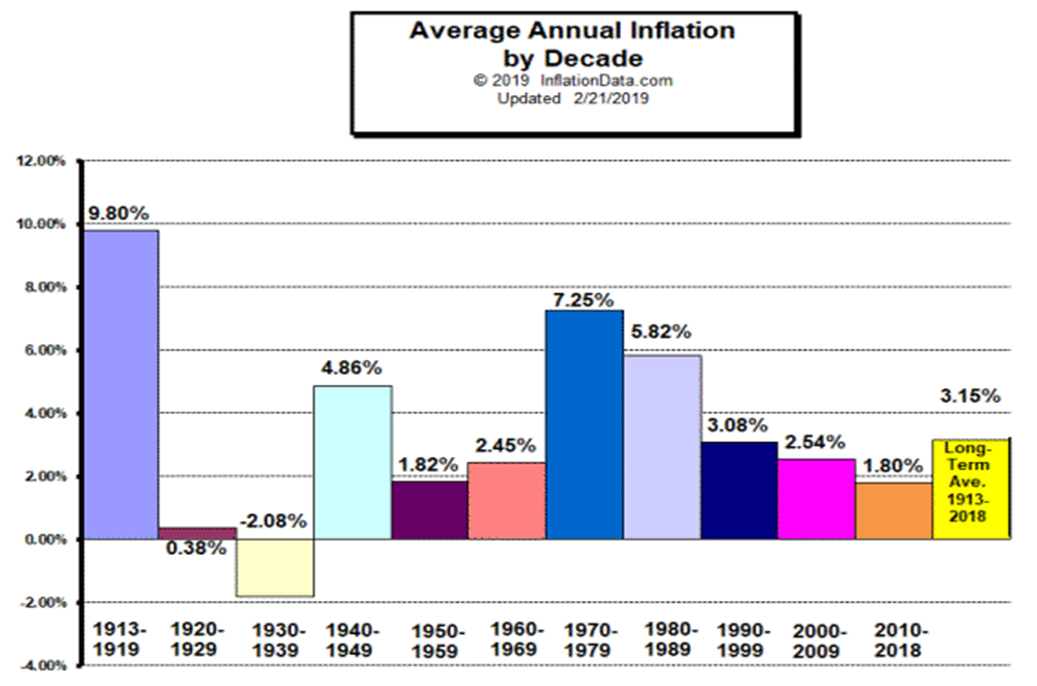
Inflation and Deflation
A rising aggregate price level is inflation.
A falling aggregate price level is deflation.
The inflation rate is the annual percent change in the aggregate price level.
The economy has price stability when the aggregate price level is changing only slowly.
24

Slide 25

International Imbalances
An open economy is an economy that trades goods and services with other countries.
A country runs a trade deficit when the value of goods and services bought from foreigners is more than the value of goods and services it sells to them.
It runs a trade surplus when the value of goods and services bought from foreigners is less than the value of the goods and services it sells to them.
25

Slide 26
LEARN BY DOING: PRACTICE QUESTION 2
This year the value of a country’s imports is equal to $1.2 billion, and the value of its exports is equal to $1.3 billion. This country is running a:
trade surplus.
trade deficit.
26

Slide 27
LEARN BY DOING: PRACTICE QUESTION 2 (Answer)
This year the value of a country’s imports is equal to $1.2 billion, and the value of its exports is equal to $1.3 billion. This country is running a:
trade surplus. (correct answer)
trade deficit.
27

Slide 28
Why Macroeconomists Disagree
Classicals vs. Keynesians
The classical approach
The economy works well on its own
The “invisible hand”: the idea that if there are free markets and individuals conduct their economic affairs in their own best interests, the overall economy will work well
Wages and prices adjust rapidly to get to equilibrium
Equilibrium: a situation in which the quantities demanded and supplied are equal
Changes in wages and prices are signals that coordinate people’s actions
Result: Government should have only a limited role in the economy
28

Slide 29
Why Macroeconomists Disagree
Classicals vs. Keynesians
The Keynesian approach
The Great Depression: Classical theory failed because high unemployment was persistent
Keynes: Persistent unemployment occurs because wages and prices adjust slowly, so markets remain out of equilibrium for long periods
Conclusion: Government should intervene to restore full employment
The evolution of the classical-Keynesian debate
Keynesians dominated from WWII to 1970
Stagflation led to a classical comeback in the 1970s
Last 30 years: excellent research with both approaches
29

Slide 30
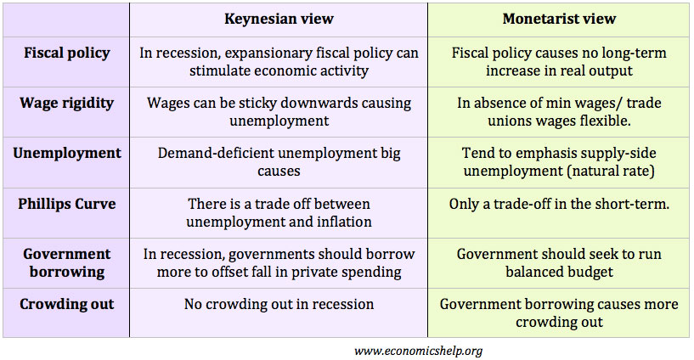
30

Slide 31
Major Economic Problems
Rank the importance to them of the following economic issues:
Unemployment
inflation
economic growth
stagnant incomes
the trade deficit
Social Security
the government budget
income inequality.
What are some other issues?
31

Slide 32
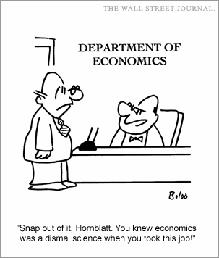
32

