Slide 1
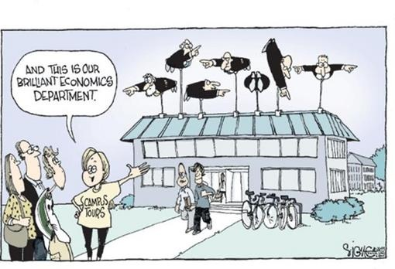
CHAPTER 17 LECTURE - MACROECONOMICS:
EVENTS AND IDEAS

Slide 2
WHAT YOU WILL LEARN IN THIS CHAPTER
Why was classical macroeconomics inadequate for the problems posed by the Great Depression?
How did John Maynard Keynes and the experience of the Great Depression legitimize macroeconomic policy activism?
What is monetarism and why did monetarists claim there are limits to the use of discretionary monetary policy?
How did challenges lead to a revision of Keynesian economics and the emergence of the new classical macroeconomics?
Why was the Great Moderation consensus undermined by the 2008 financial crisis, leading to fierce debates among economists emergence of two post–Great Recession viewpoints?

Slide 3
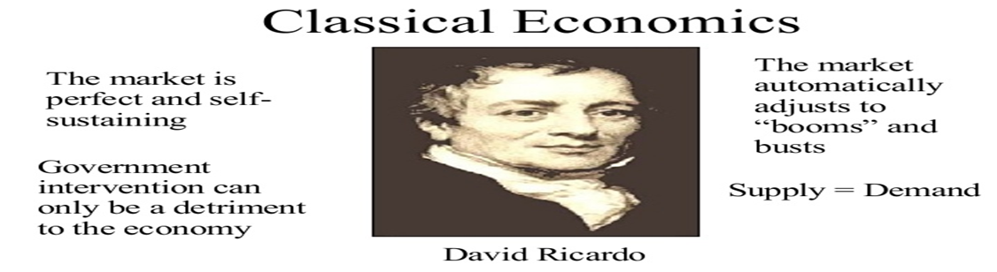
CLASSICAL MACROECONOMICS
Ye olde economics:
Before the Great Depression “classical” macroeconomics reigned.
Main ideas:
  The short run was unimportant.
  Prices were assumed to be flexible, so the aggregate supply curve was vertical even in the short run.

Slide 4
THE GREAT DEPRESSION AND THE KEYNESIAN REVOLUTION (1 of 2)
The Great Depression demonstrated that economists cannot safely ignore the short run.
  The disastrous effects of the international depression helped Adolf Hitler’s rise in Germany.
Economists were conflicted in analysis and prognosis.
  Classical economists advocated waiting it out, but as the depression deepened, this approach was rejected.
  Some thought capitalism had failed and only a government takeover could end the slump.
  Some thought the slump could be cured without giving up the basic market economy.

Slide 5
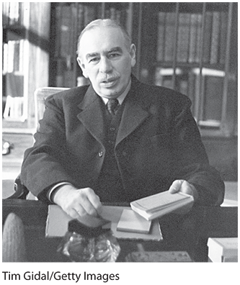
KEYNES’S THEORY
In 1936, Keynes published The General Theory of Employment, Interest, and Money, one of the most influential books on economics ever written.

Slide 6
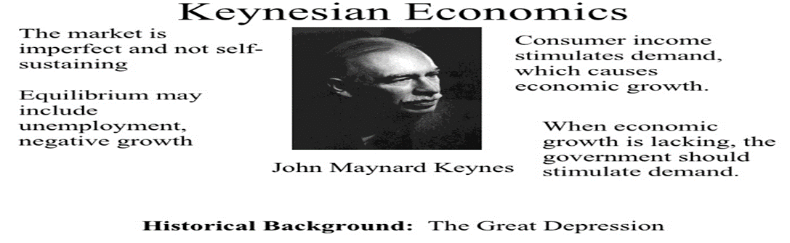
THE GREAT DEPRESSION AND THE KEYNESIAN REVOLUTION (2 of 2)
Keynesian economics rests on two main tenets:
  Changes in aggregate demand affect aggregate output, employment, and prices.
  Changes in business confidence cause the business cycle.
    Keynes’s term for business confidence: “animal spirits”

Slide 7
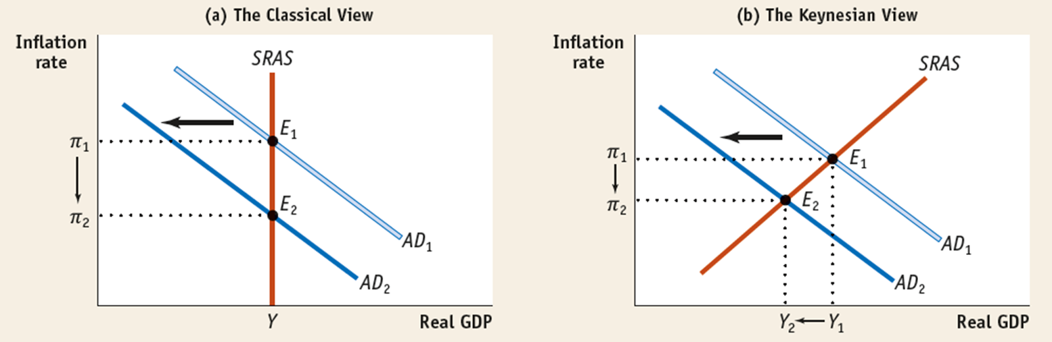
THE CLASSICAL VS. THE KEYNESIAN VIEW
Classical view: flexible prices and focus on the long run mean a vertical SRAS; shifts in AD affect only aggregate price level
Keynesian view: sticky prices and upward-sloping SRAS curve; shifts in AD affect the price level and output

Slide 8
THE POLITICS OF KEYNES
Be careful not to confuse Keynes with socialism.
  Keynes himself was no socialist and not much of a leftist.
When The General Theory was published, many intellectuals believed the capitalist system was dying.
Keynes, in contrast, argued that all the system needed was a narrow technical fix.
  In that sense, his ideas were pro-capitalist and politically conservative.

Slide 9
LEARN BY DOING: PRACTICE QUESTION 1
For each of the following statements, indicate if it’s classical or Keynesian.
  Prices and wages quickly adjust to economic conditions.
  Business confidence affects spending decisions by firms and households.
  An increase in the money supply leads to an equal proportional rise in the aggregate price level, with no effect on aggregate output.
  An increase in the money supply would affect both the aggregate price level and the aggregate output.
  Expansionary monetary and fiscal policies can only worsen an economic slump.
  “In the long run, we are all dead.”

Slide 10
LEARN BY DOING: PRACTICE QUESTION 1
(ANSWER)
For each of the following statements, indicate if it’s classical or Keynesian.
  Prices and wages quickly adjust to economic conditions. classical
  Business confidence affects spending decisions by firms and households. Keynesian (“animal spirits”)
  An increase in the money supply leads to an equal proportional rise in the aggregate price level, with no effect on aggregate output. classical
  An increase in the money supply would affect both the aggregate price level and the aggregate output. Keynesian
  Expansionary monetary and fiscal policies can only worsen an economic slump. classical
  “In the long run, we are all dead.” Keynesian

Slide 11
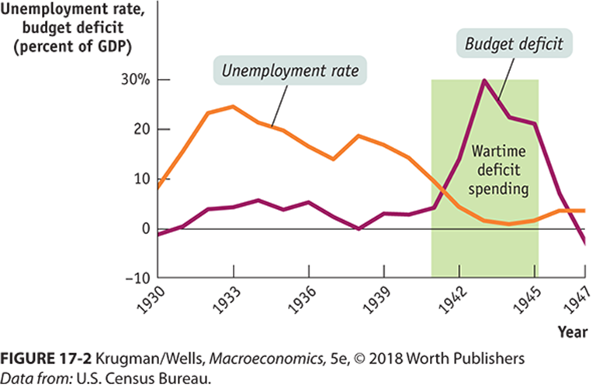
POLICY TO FIGHT RECESSIONS
The main consequence of Keynes’s work was that it legitimized macroeconomic policy activism.
Macroeconomic policy activism: the use of monetary and fiscal policy to smooth out the business cycle
The basic message young economists took from Keynes in the 1930s was that economic recovery requires aggressive fiscal expansion to create jobs. Policy makers weren’t convinced…
until World War II deficit spending created economic growth.

Slide 12
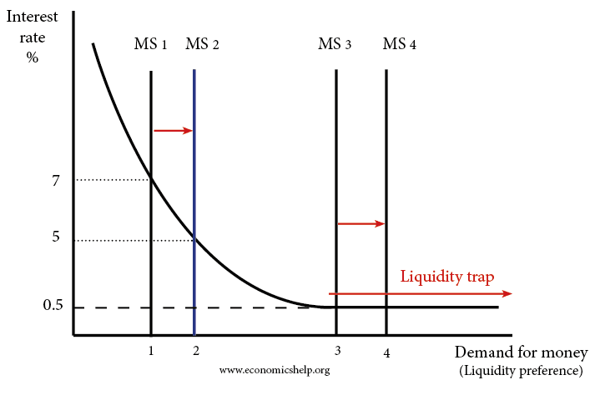
CHALLENGES TO KEYNESIAN ECONOMICS
Keynes’s ideas did not go unchallenged, especially his assertion that monetary policy was ineffective during recessions.
  (Recall the liquidity trap, in which monetary policy is ineffective because the interest rate is down against the zero bound.

Slide 13
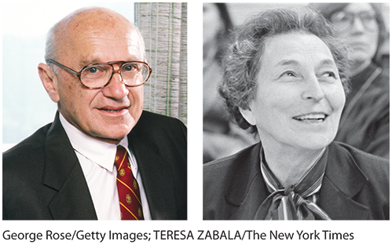
MONETARISM (1 of 3)
In 1963, Milton Friedman and Anna Schwartz published A Monetary History of the United States, 1867–1960.
They argued that business cycles were historically associated with fluctuations in the money supply. In other words, monetary policy mattered, especially in the Great Depression.

Slide 14
MONETARISM (2 of 3)
A provocative idea emerged:
The burden of managing the economy could be shifted away from fiscal policy…
  …and economic management could largely be taken out of the hands of politicians.
This could make macroeconomics a more technical and less political issue.

Slide 15
MONETARISM (3 of 3)
Milton Friedman led the monetarism movement, which sought to eliminate macroeconomic policy activism while maintaining the importance of monetary policy.
Monetarists asserted that:
  attempts to stabilize the economy with fiscal OR monetary policy would make things worse.
  GDP would grow steadily if the money supply grew steadily.
Friedman didn’t favor activist monetary policy either; he favored an autopilot approach.
A monetary policy rule is a formula that determines the central bank’s actions.

Slide 16
RATIONAL EXPECTATIONS AND NEW CLASSICAL ECONOMICS (1/4)
In the 1970s and 1980s, the classical view evolved into new classical macroeconomics:
  Rational expectations
  Real business cycle theory

Slide 17
RATIONAL EXPECTATIONS AND NEW CLASSICAL ECONOMICS (2/4)
Rational expectations: individuals and firms make decisions optimally, using all available information.
  The original hypothesis: a government attempt to push unemployment below the natural rate would work in the short run but will eventually fail.
  Rational expectations: a government attempt to push unemployment down will immediately fail.
  When workers and employers bargain over wage contracts, they use all available information to account for future inflation.
  Robert Lucas: monetary policy can change output and unemployment only if it comes as a surprise to the public.

Slide 18
RATIONAL EXPECTATIONS AND NEW CLASSICAL ECONOMICS (3/4)
Real business cycle theory: business cycles are caused by fluctuations in the rate of growth of productivity, not by demand shocks.
  Economic data indicate that demand shocks do play a role in business cycle.

Slide 19
RATIONAL EXPECTATIONS AND NEW CLASSICAL ECONOMICS (4/4)
New Keynesian economics became influential in the 1990s.
It argues that market imperfections make many prices in the economy temporarily sticky. And with sticky prices, expected inflation can’t rise quickly enough to offset activist macroeconomic policy.

Slide 20
INFLATION AND THE NATURAL RATE OF UNEMPLOYMENT (1 of 2)
In the 1960s, economists began to worry that expansionary policies could cause inflation problems.
1968: Milton Friedman and Edmund Phelps argued that there is a natural rate of unemployment.
Since the government can’t keep unemployment below its natural rate, it should just try to keep it stable.
And if inflation gets embedded in the public’s expectations, it will continue even if unemployment is high.

Slide 21
INFLATION AND THE NATURAL RATE OF UNEMPLOYMENT (2 of 2)
The natural rate of unemployment is also the NAIRU (nonaccelerating inflation rate of unemployment).
The natural rate hypothesis: because inflation is embedded in expectations, to avoid accelerating inflation over time the unemployment rate must be high enough that the actual inflation rate equals the expected inflation rate

Slide 22

THE POLITICAL BUSINESS CYCLE
The final challenge to Keynes: Macroeconomic policy activism lends itself to political manipulation.
An obvious temptation for politicians: Pump up the economy in an election year and pay the price in higher inflation and/or higher unemployment later.
A political business cycle: political use of macroeconomic policy to serve political ends.
  Richard Nixon’s expansionary fiscal and monetary policy led to rapid growth just before the 1972 election and a sharp acceleration in inflation after the election.
  Kenneth Rogoff proclaimed Nixon “the all-time hero of political business cycles.”

Slide 23
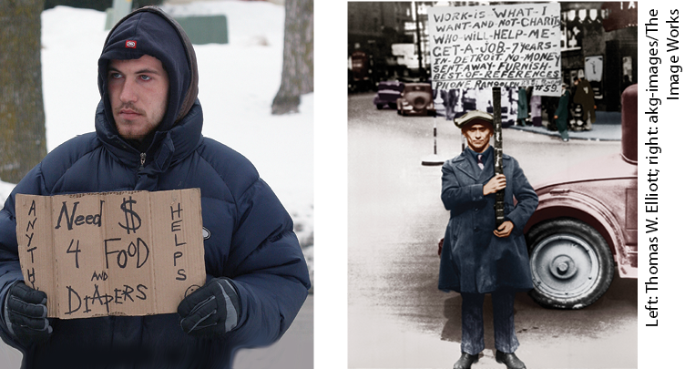
FROM GREAT MODERATION TO SECULAR STAGNATION
After the stormy 1970s, things settled down: the recession of 1990–1991 was mild, and the inflation rate stayed below 4%.
The Great Moderation is the period from 1985 to 2007 when the U.S. economy experienced relatively small fluctuations and low inflation. It led to widespread belief that monetary policy could stabilize the economy.
The crisis of 2008 undermined any sense that central banks had things under control and brought economists back to a more traditional Keynesian view.

Slide 24
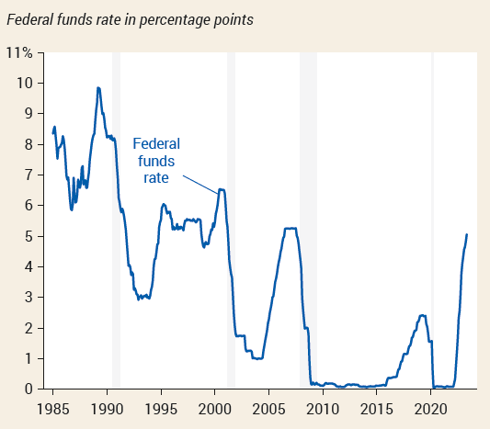
THE LIMITS OF MONETARY POLICY
During the Great Moderation, economists and policy makers believed that monetary policy was highly effective and that the Fed could keep the economy stable.
In 2008, however, cutting the federal funds rate all the way to zero wasn’t enough to prevent a severe recession—and recovery from that recession was disappointingly slow.
Conventional monetary policy didn’t seem to work, and even unconventional monetary policy seemed to fall short.

Slide 25
THE REVIVAL OF FISCAL POLICY
Events after 2008 showed that monetary policy wasn’t as reliable as many had believed.
This led to a revival of interest in fiscal policy, especially expansionary fiscal policy, or fiscal stimulus.
In 2010–2013, a few countries conducted austerity policies—attempts to reduce their budget deficits by cutting spending and raising taxes.
Data shows that the deeper the budget cuts, the worse the economic performance.
  Each dollar of budget cuts reduced GDP by around $1.50.
Expansionary fiscal policy means higher budget deficits. Shouldn’t this be a source of concern?

Slide 26
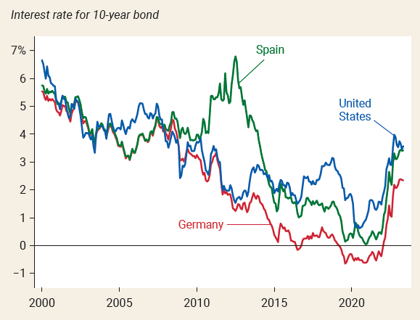
POLICY IN A LOW-INTEREST-RATE WORLD
(1/3)
During the 2008 financial crisis, the Fed cut interest rates all the way to zero. The Fed kept rates close to zero for many years, then raised them only slightly, and began cutting again in 2019.
The persistence of low interest rates wasn’t just a U.S. phenomenon.

Slide 27
POLICY IN A LOW-INTEREST-RATE WORLD
(2/3)
Why are interest rates so low?
Declining population growth and slow technological progress had put the world’s major economies on the edge of secular stagnation, a state in which the interest rate that is needed to achieve full employment is consistently close to zero.
If low interest rates are the new normal,
  We shouldn’t worry much about debt, and
  We should worry a lot about fiscal responses to downturns.
Old view: Higher debt leads to high interest payments, which lead to higher deficits, which increase debt, leading to higher interest payments…

Slide 28
POLICY IN A LOW-INTEREST-RATE WORLD
(3/3)
New view: What matters is not the debt but the debt to GDP ratio. Since interest rates are below the economy’s growth rate, the ratio tends to shrink over time.
Low interest rates also mean that the central banks don’t have enough room to cut.
It means that we should strengthen the economy’s automatic stabilizers, the tax and spending responses that help fight recessions even without new legislation.

Slide 29
LEARN BY DOING: DISCUSSION QUESTION 1
If the economy is in a recession and the president invites three economists—a Keynesian, a monetarist, and a new classical—to offer explanation and policy options, what would each say (in two sentences or less)?

Slide 30
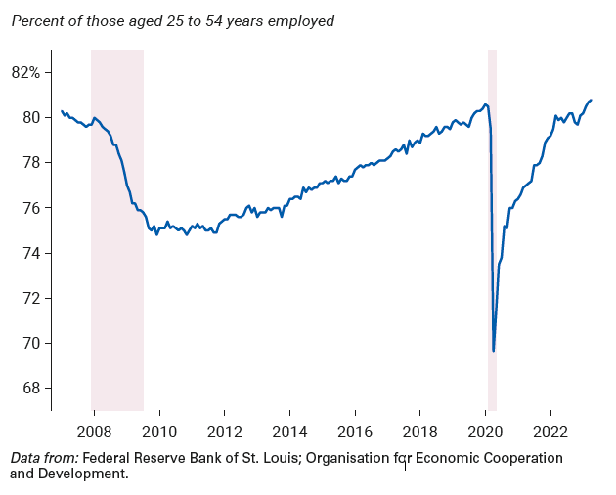
THE CORONAVIRUS PANDEMIC AND THE ECONOMICS OF DISRUPTION (1/2)
In February 2020, the U.S. economy entered a recession that was both very severe and very short.
The employed share of adults in their prime working years plunged.

Slide 31
THE CORONAVIRUS PANDEMIC AND THE ECONOMICS OF DISRUPTION (2/2)
The 2020 slump wasn’t a normal recession.
  It was brought on by the pandemic and the public health response.
  Many activities were banned or restricted.
  The pandemic caused large disruptions in the supply and demand for goods whose prices are usually stable.
  Lifting of restrictions and vaccines caused employment to quickly returned to normal.
  The rapid recovery was accompanied by a surge in inflation.
The main change in macroeconomic thinking was that the economy isn’t as flexible as we might like, at least in the short run.
Although the recession was not normal, few were calling the basic aggregate supply-aggregate demand framework into question.

Slide 32
