Slide 1

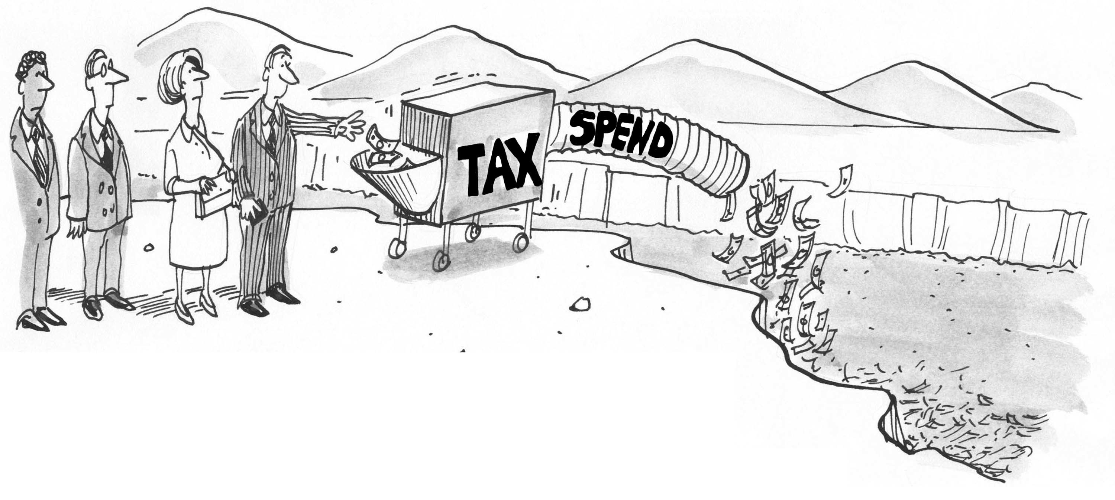
CHAPTER 13 LECTURE - FISCAL POLICY

Slide 2
WHAT YOU WILL LEARN IN THIS CHAPTER
What is fiscal policy and why is it an essential tool in managing economic fluctuations?
Which policies constitute an expansionary fiscal policy and which constitute a contractionary fiscal policy?
Why does fiscal policy have a multiplier effect and how is this effect influenced by automatic stabilizers?
Why do governments calculate the cyclically adjusted budget balance?
Why can a large public debt and implicit liabilities of the government also be a cause for concern?

Slide 3
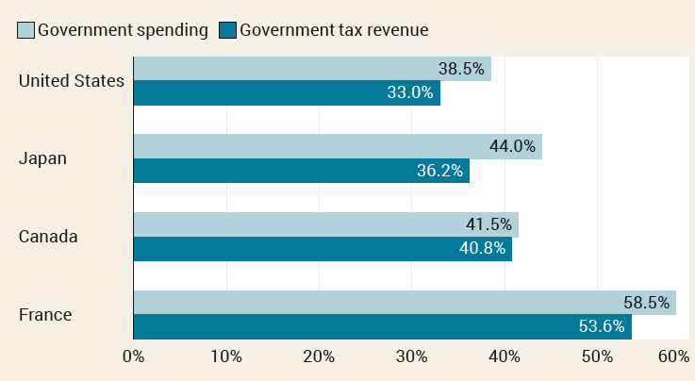
FISCAL POLICY: THE BASICS
Government spending and tax revenue for selected high-income countries in 2022

Slide 4
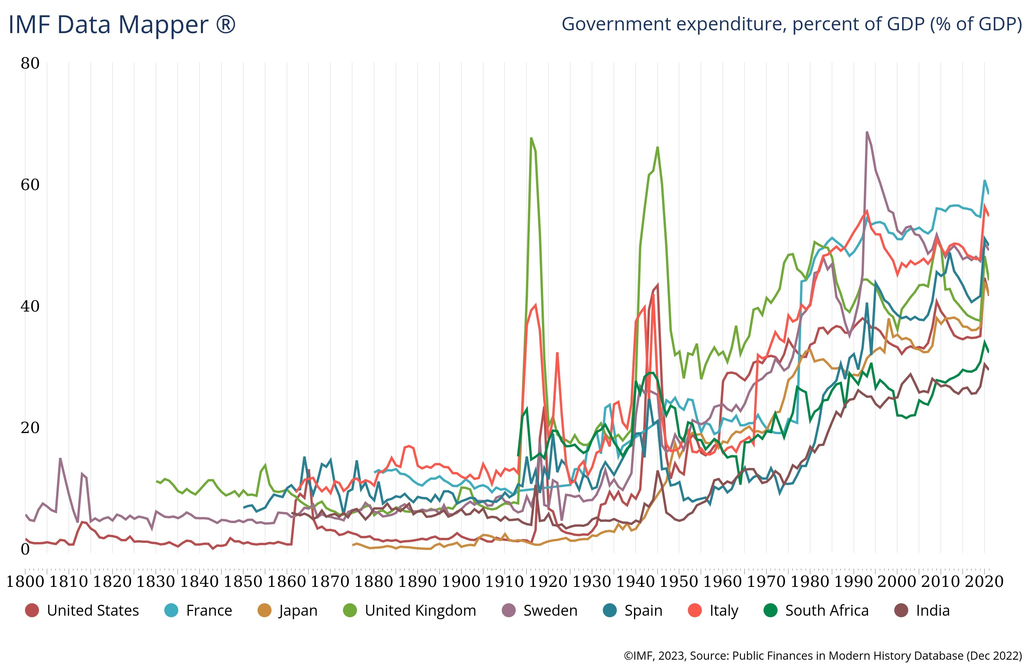
FISCAL POLICY: THE BASICS (1 of 2)
Government spending and tax revenue for some high-income countries in 2019:

Slide 5
FISCAL POLICY: THE BASICS (2 of 2)
The government funds many programs through tax revenues.
Some important terms:
Government transfers: payments by the government to households for which no good or service is provided in return
Social insurance programs: government programs (transfer payments) intended to protect families against economic hardship
Social Security
Medicare
Medicaid
Government purchases: national defense and education are the biggest categories

Slide 6
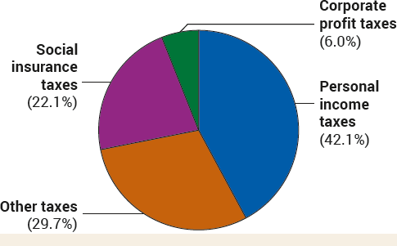
SOURCES OF TAX REVENUE IN THE UNITED STATES, 2022
Personal income taxes, taxes on corporate profits, and social insurance taxes account for most government tax revenue.
The rest is a mix of property taxes, sales taxes, and other sources of revenue.
6

Slide 7
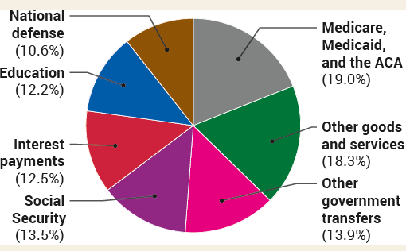
GOVERNMENT SPENDING IN THE UNITED STATES, 2022
Government purchases: National defense and education are the biggest categories.
Government transfers: Social Security, Medicare, and Medicaid are the biggest programs.
7

Slide 8
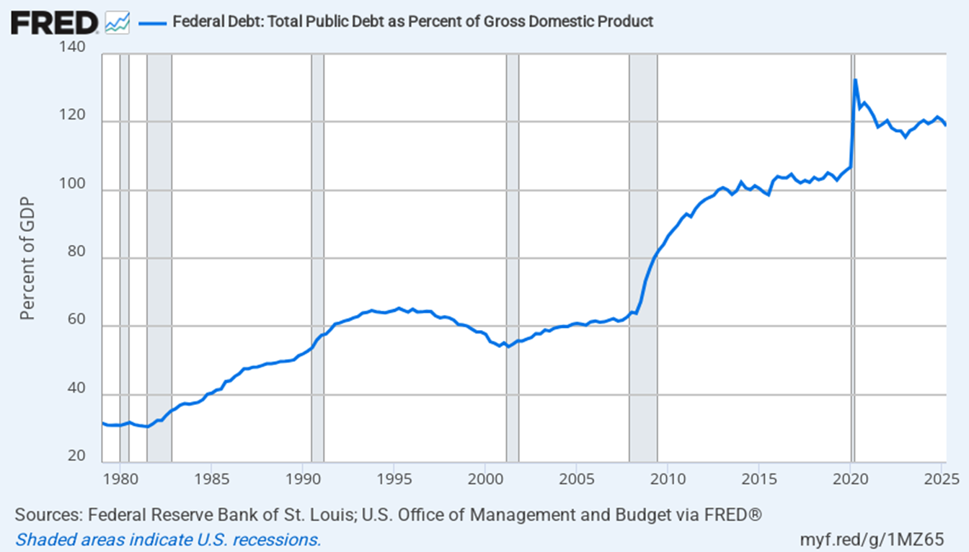

Slide 9
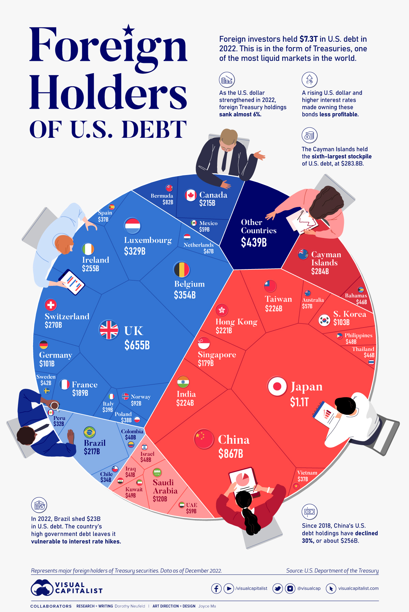

Slide 10
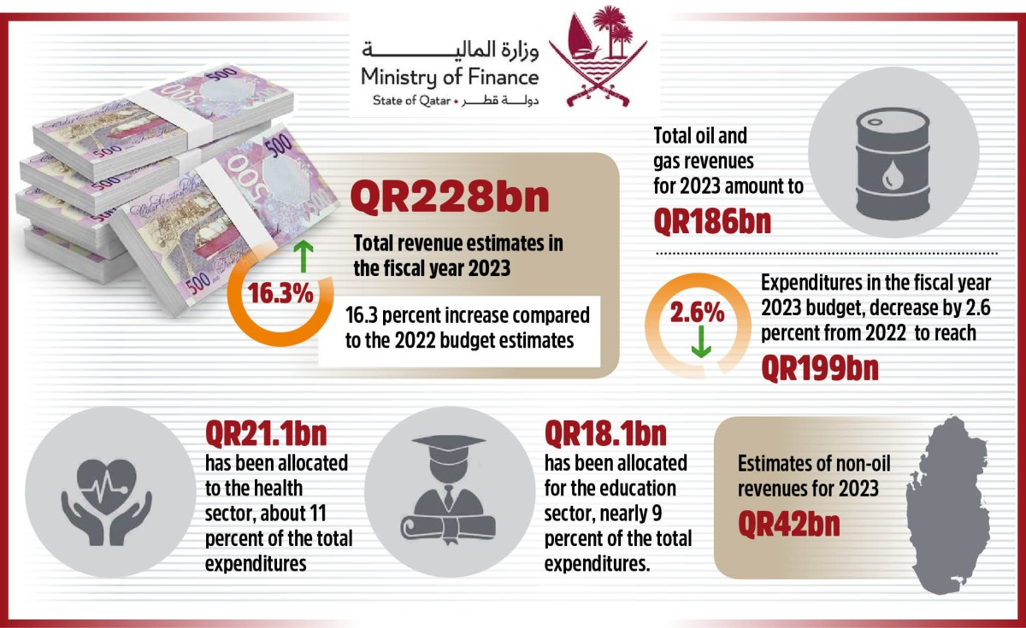
QATAR

Slide 11
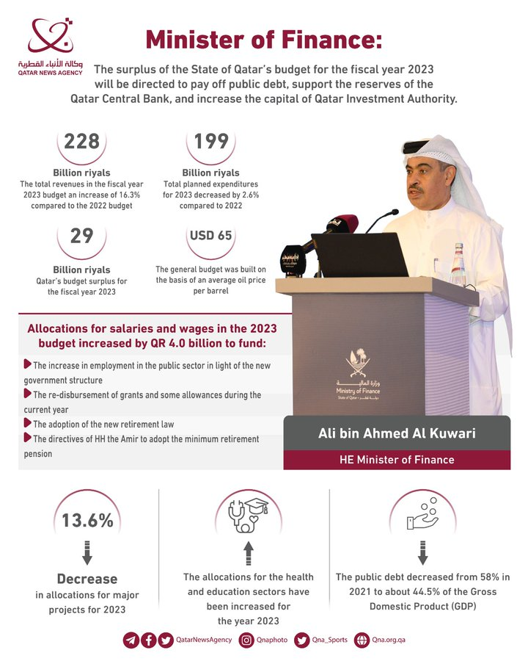

Slide 12
THE GOVERNMENT BUDGET AND TOTAL SPENDING
Recall the formula for GDP:
GDP = C + I + G + X – IM
The government directly controls G and indirectly affects C and I.
How?
Disposable income is the income that households receive from wages, dividends, interest, and rent, minus taxes, plus government transfers.
Changes in taxes or government transfers change disposable income, which changes consumer spending.
The government affects business investment by taxes and regulations.
Because the government can affect spending by consumers and firms, the government can shift the aggregate demand curve.

Slide 13
EXPANSIONARY FISCAL POLICY
FISCAL POLICY
Fiscal policy: the use of taxes, government transfers, or government purchases of goods and services to shift the aggregate demand curve
Expansionary fiscal policy: fiscal policy that increases aggregate demand
an increase in government purchases of goods and services
a cut in taxes
an increase in government transfers
Expansionary fiscal policy is extra fuel for the economy.

Slide 14
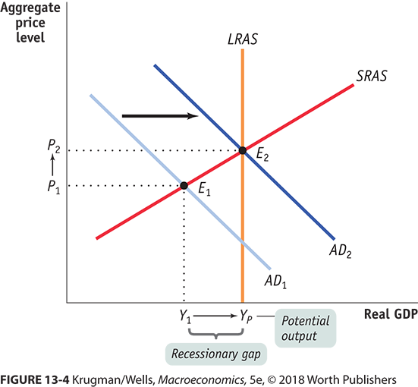
EXPANSIONARY FISCAL POLICY CAN CLOSE A RECESSIONARY GAP

Slide 15
CONTRACTIONARY FISCAL POLICY
Contractionary fiscal policy: fiscal policy that decreases aggregate demand
a reduction in government purchases of goods and services
an increase in taxes
a reduction in government transfers
Contractionary fiscal policy = brakes for the economy

Slide 16
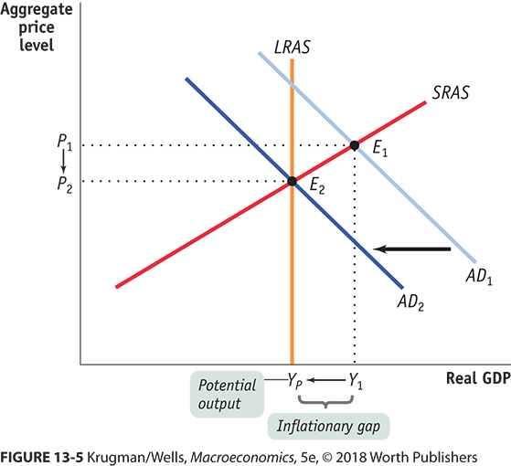
CONTRACTIONARY FISCAL POLICY CAN CLOSE AN INFLATIONARY GAP

Slide 17
LEARN BY DOING PRACTICE QUESTION 1
LEARN BY DOING DISCUSSION QUESTION 1
Suggest arguments in favor and against the government massive spending during recessions.
Suppose that there’s a recessionary gap, and the country wishes to produce its potential output. Which of these policy initiatives might help it reach this goal?
The government initiates policies that encourage private investment spending.
The government increases taxes on consumers and corporations.
The government cuts spending programs.

Slide 18
LEARN BY DOING PRACTICE QUESTION 1 (Answer)
Suppose that there’s a recessionary gap, and the country wishes to produce its potential output. Which of these policy initiatives might help it reach this goal?
The government initiates policies that encourage private investment spending. (correct answer)
The government increases taxes on consumers and corporations.
The government cuts spending programs.

Slide 19
LEARN BY DOING DISCUSSION QUESTION 2
Suppose that there’s an inflationary gap, and the country wishes to produce its potential output. Which of these policy initiatives might help it reach this goal?
The government initiates policies that encourage private investment spending.
The government increases taxes on consumers and corporations.
The government authorizes new spending programs.
Notes:
Any policy initiative that shifts AD to the left will help the country move toward its potential output level. Answers (a) and (c) will both shift AD to the right: government policies that stimulate private investment spending lead to higher levels of aggregate spending and a rightward shift in AD; and new spending by government will also lead to higher levels of aggregate spending and a rightward shift in AD. Answer (b) will cause the AD to shift to the left because it will reduce disposable income and lead to lower levels of aggregate spending.

Slide 20
LEARN BY DOING DISCUSSION QUESTION 2 (Answer)
Suppose that there’s an inflationary gap, and the country wishes to produce its potential output. Which of these policy initiatives might help it reach this goal?
The government initiates policies that encourage private investment spending.
The government increases taxes on consumers and corporations. (correct answer)
The government authorizes new spending programs.

Slide 21
CAN EXPANSIONARY FISCAL POLICY ACTUALLY WORK?
There are critics who argue:
“Government spending always crowds out private spending.”
“Government borrowing always crowds out private investment spending.”
“Government budget deficits reduce private spending.”

Slide 22
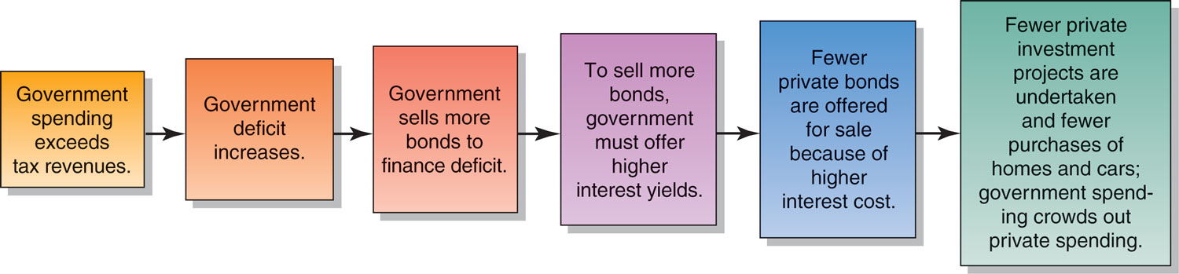
The Crowding-Out Effect, Step by Step

Slide 23
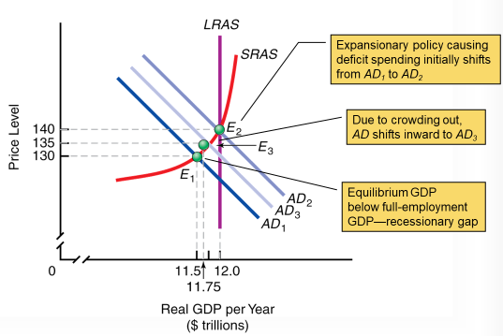
The Crowding-Out Effect

Slide 24
EXAMINING CRITIQUE #1
Claim 1: “Government spending always crowds out private spending.”
The statement is wrong because it assumes a zero-sum game in which the aggregate income earned in the economy is always a fixed sum—which isn’t true. It also assumes that resources in the economy are always fully employed—and the only way to increase government spending is at firms’ expense.
You’re squeezed only if the hot tub is full.

Slide 25
EXAMINING CRITIQUE #2
Claim 2: “Government borrowing always crowds out private investment spending.”
This is true only part of the time: It depends upon whether the economy is depressed.
If it is, a fiscal expansion will lead to higher incomes, which lead to increased savings.
The Recovery Act of 2009 was a case in point: Despite high levels of government borrowing, U.S. interest rates stayed near historic lows.

Slide 26
EXAMINING CRITIQUE #3
Claim 3: “Government budget deficits reduce private spending.”
This is known as “Ricardian equivalence” (after the nineteenth-century economist David Ricardo).
It assumes that consumers, seeing the higher debt levels, will cut their spending today to save for inevitable increases in future tax rates necessary to pay down the debt.
Does this give too much credit to consumers’ foresight and budgeting discipline? Probably.

Slide 27
LEARN BY DOING PRACTICE QUESTION 2
Contractionary fiscal policy:
is most helpful for restoring an economy to the potential output level of production when there is a recessionary gap.
shifts the AD curve to the right, restoring the equilibrium level of output to the potential output level for the economy.
often causes inflation or an increase in the aggregate price level.
if effective, shifts AD to the left, resulting in a reduction in the aggregate output and the inflation rate for a given short-run aggregate supply curve (SRAS).

Slide 28
LEARN BY DOING PRACTICE QUESTION 2 (Answer)
Contractionary fiscal policy:
is most helpful for restoring an economy to the potential output level of production when there is a recessionary gap.
shifts the AD curve to the right, restoring the equilibrium level of output to the potential output level for the economy.
often causes inflation or an increase in the aggregate price level.
if effective, shifts AD to the left, resulting in a reduction in the aggregate output and the inflation rate for a given short-run aggregate supply curve (SRAS). (correct answer)

Slide 29
LEARN BY DOING PRACTICE QUESTION 3
Holding everything else constant, which of these statements is true?
An economy can eliminate an inflationary gap by increasing government spending.
Expansionary fiscal policy refers to an increase in taxes.
When potential output is greater than actual aggregate output, the economy faces a recessionary gap.
When SRAS intersects AD to the right of the long-run aggregate supply (LRAS) curve, the economy faces a recessionary gap.

Slide 30
LEARN BY DOING PRACTICE QUESTION 3 (Answer)
Holding everything else constant, which of these statements is true?
An economy can eliminate an inflationary gap by increasing government spending.
Expansionary fiscal policy refers to an increase in taxes.
When potential output is greater than actual aggregate output, the economy faces a recessionary gap (correct answer).
When SRAS intersects AD to the right of the long-run aggregate supply (LRAS) curve, the economy faces a recessionary gap.

Slide 31
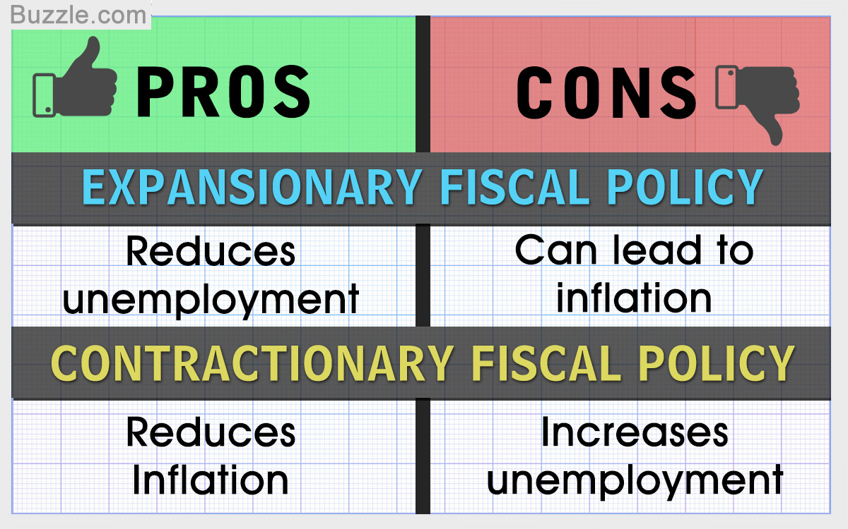
Pros and Cons of Using Expansionary and Contractionary Fiscal Policy

Slide 32
A CAUTIONARY NOTE: LAGS IN FISCAL POLICY
In the case of fiscal policy, there is an important reason for caution: There are significant lags in its use.
It takes time to:
realize the recessionary or inflationary gap by collecting and analyzing economic data.
develop a plan.
implement the action plan (spending the money).

Slide 33
Inside and Outside Lags
Time Lags
The use of discretionary fiscal policy is seriously hampered by three time lags:
Inside Lags - The time it takes to formulate a policy. We can break this down into the:
Recognition lag—the time it takes to figure out that fiscal policy action is needed.
Law-making lag—the time it takes Congress to pass the laws needed to change taxes or spending.
Outside lags (Effect or Operational lag) - The time it takes for the policy to actually work.
Impact lag—the time it takes from passing a tax or spending change to its effect on real GDP being felt

Slide 34

THE MULTIPLIER
Recall: The multiplier idea was introduced by Keynes.
The multiplier magnifies new spending into greater levels of income and output because each round of spending becomes income for someone else.

Slide 35
FISCAL POLICY AND THE MULTIPLIER
Multiplier effects of an increase in government purchases of goods and services:
Recall that (if we assume a simple case with no taxes or international trade),
the multiplier is 1/(1 − MPC)
Example: if MPC = 0.5, the multiplier would be
1/(1 − 0.5)= 2.
So, $50 billion of new government spending would create ($50 billion) × 2 = $100 billion increase in real GDP.

Slide 36
FISCAL POLICY AND THE MULTIPLIER IN ACTION (1 of 2)
Multiplier effects of changes in government transfers and taxes
Will a $50 billion tax cut (or increase in transfers) have the same effect as a $50 billion increase in government purchases?
No. Example: If the MPS = 0.5, a change in tax or transfers is smaller than an equivalent change in government purchases from the outset.

Slide 37
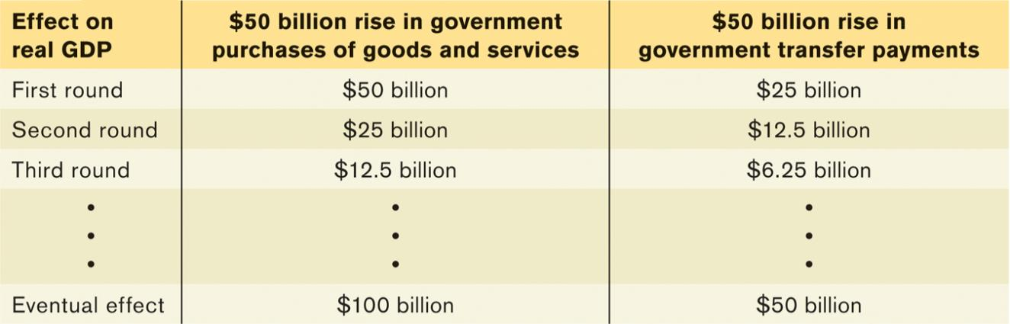
FISCAL POLICY AND THE MULTIPLIER IN ACTION (2 of 2)
TABLE 13-1 Hypothetical Effects of a Fiscal Policy When MPC = 0.5
Effect on real GDP | $50 billion rise in government purchases of goods and services | $50 billion rise in government transfer payments
First round | $50 billion | $25 billion
Second round | $25 billion | $12.5 billion
Third round | $12.5 billion | $6.25 billion
∙ ∙ ∙ | ∙ ∙ ∙ | ∙ ∙ ∙
Total effect | $100 billion | $50 billion
Total effect in terms of multiplier | ΔY = ΔG x 1/(1 - MPC) | ΔY = ΔTR x MPC x 1/(1 - MPC)

Slide 38
LEARN BY DOING PRACTICE QUESTION 4
Holding everything else constant, the multiplier effect for taxes or transfers:
is the same as the multiplier effect for changes in autonomous aggregate spending.
is smaller than the multiplier effect for changes in autonomous aggregate spending.
is larger than the multiplier effect for changes in autonomous aggregate spending.
may be smaller than, larger than, or equal to the multiplier effect for changes in autonomous aggregate spending.

Slide 39
LEARN BY DOING PRACTICE QUESTION 4 (Answer)
Holding everything else constant, the multiplier effect for taxes or transfers:
is the same as the multiplier effect for changes in autonomous aggregate spending.
is smaller than the multiplier effect for changes in autonomous aggregate spending. (correct answer)
is larger than the multiplier effect for changes in autonomous aggregate spending.
may be smaller than, larger than, or equal to the multiplier effect for changes in autonomous aggregate spending.

Slide 40
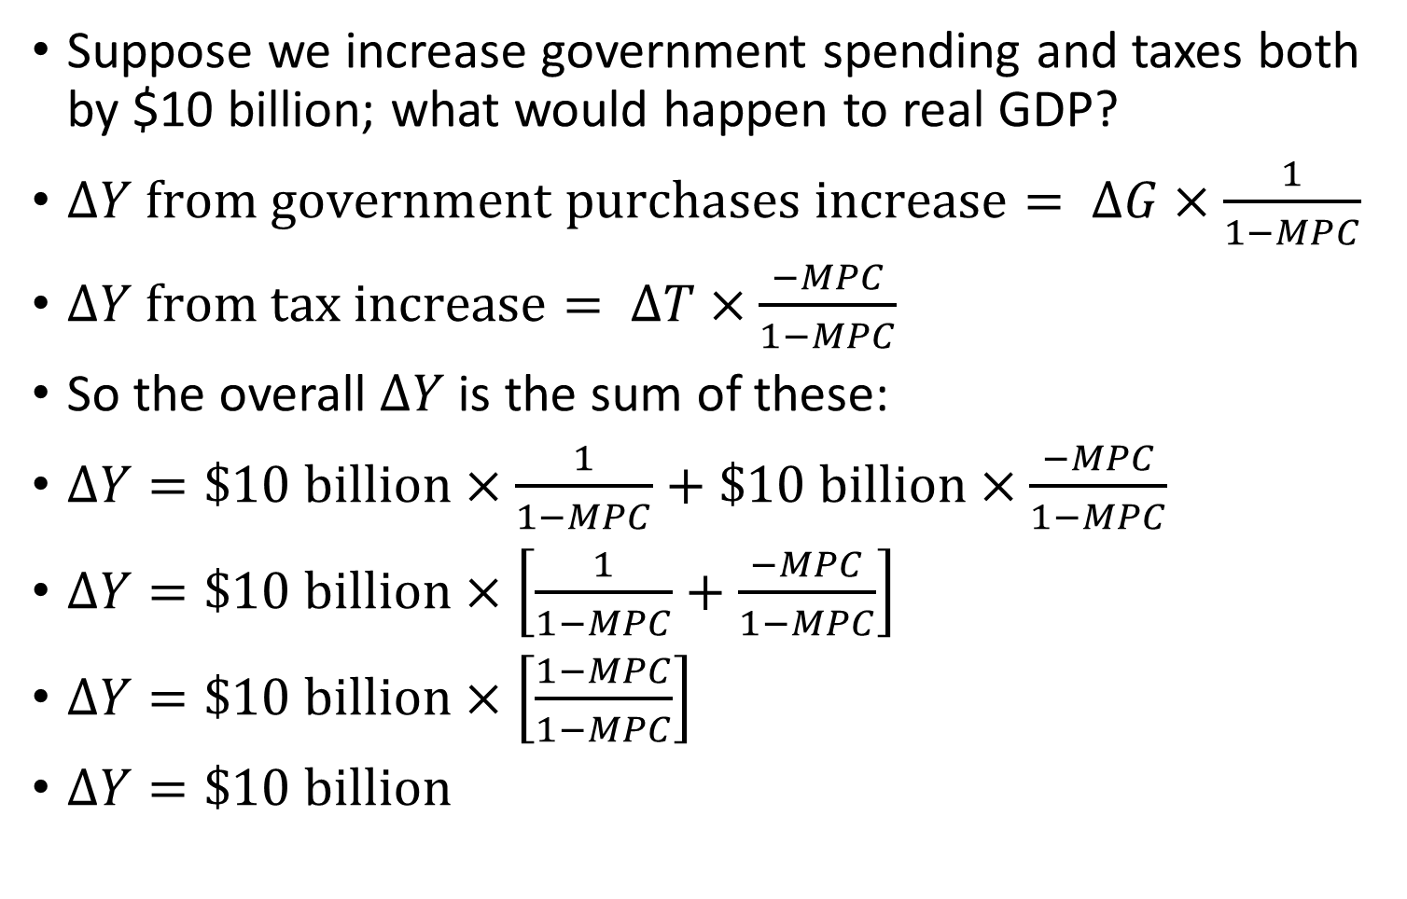
The “Balanced Budget” multiplier
The “Balanced Budget” multiplier
Suppose we increase government spending and taxes both by $10 billion; what would happen to real GDP?
$∆Y from government purchases increase= ∆G×\frac{1}{1−MPC}$
$∆Y from tax increase= ∆T×\frac{−MPC}{1−MPC}$
So the overall $∆Y$is the sum of these:
$∆Y=\$10 billion×\frac{1}{1−MPC}+\$10 billion×\frac{−MPC}{1−MPC}$
$∆Y=\$10 billion×\left[\frac{1}{1−MPC}+\frac{−MPC}{1−MPC}\right]$
$∆Y=\$10 billion×\left[\frac{1−MPC}{1−MPC}\right]$
$∆Y=\$10 billion$

Slide 41
TAXES AND THE MULTIPLIER
The size of the shift of the aggregate demand curve depends on the type of fiscal policy.
Changes in government purchases have a more powerful effect on the economy than equal-sized changes in taxes or transfers.
A few notes:
It’s actually more complicated, because (unlike most real tax policy) we use simple lump-sum taxes: taxes that do not depend on the taxpayer’s income.
If it’s not a lump-sum tax, the tax revenue will depend on the level of real GDP (and reduce the size of the multiplier).

Slide 42
TYPES OF FISCAL POLICY
Automatic stabilizers: government spending and taxation rules that cause fiscal policy to be automatically expansionary when the economy contracts and automatically contractionary when the economy expands (unemployment insurance)
In contrast, discretionary fiscal policy arises from deliberate actions by policy makers rather than rules (the Obama stimulus).

Slide 43
Built-In Stability - Automatic Stabilizers
Automatic Stabilizer: an element of fiscal policy that changes automatically as income changes.
Progressive Taxes: a tax whose rate rises as income rises
U.S. income taxes currently range from a rate of 10% to 30% depending upon annual income.
Transfer Payments: a payment to one person that is funded by taxing others
Employees and employers in the U.S. pay a 7.65% Social Security tax to fund a variety of benefits administered through the Social Security program

Slide 44
THE BUDGET BALANCE MEASURES FISCAL POLICY
S_{Government} = T − G − TR
Government saving (Surplus) = tax revenues (T) – government purchases (G) and transfers (TR)
A budget surplus is a positive budget balance, and a budget deficit is a negative budget balance.
Other things equal, discretionary expansionary fiscal policies reduce the budget balance for that year.
Other things equal, discretionary contractionary fiscal policies increase the budget balance for that year.

Slide 45
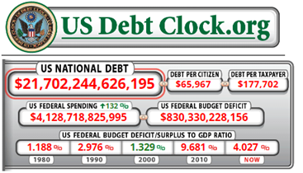
THE BUDGET BALANCE
How do surpluses and deficits fit into the analysis of fiscal policy?
Are deficits ever a good thing and surpluses a bad thing?
(And what’s the difference between deficit and debt?)
http://www.usdebtclock.org/

Slide 46
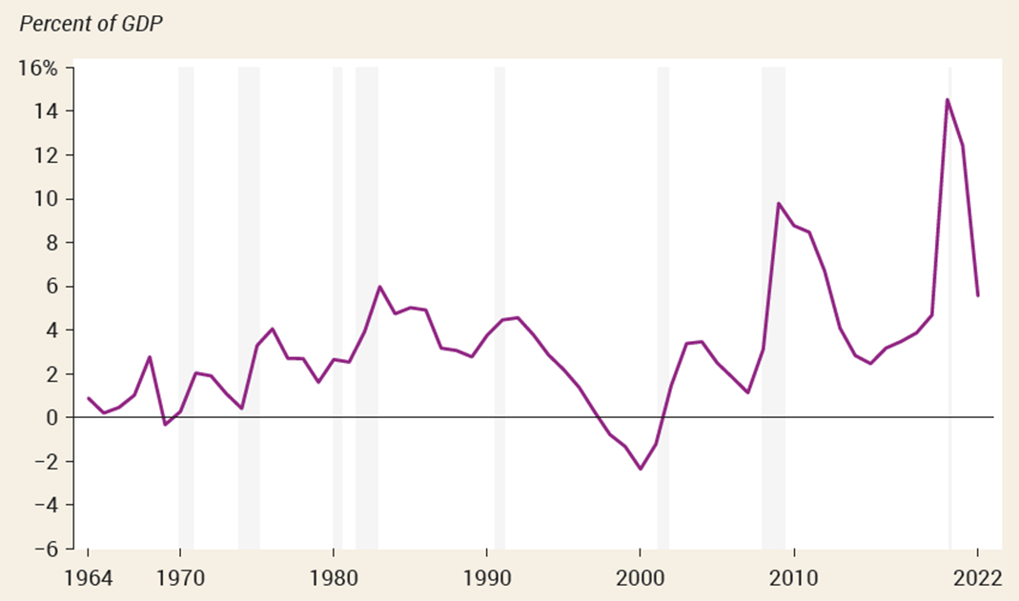
THE BUDGET BALANCE AND THE BUSINESS CYCLE
The budget tends to move into deficit when the economy is in a recession (look at the shaded areas), but deficits tend to get smaller or even turn into surpluses when the economy is expanding.
Figure 13-8

Slide 47
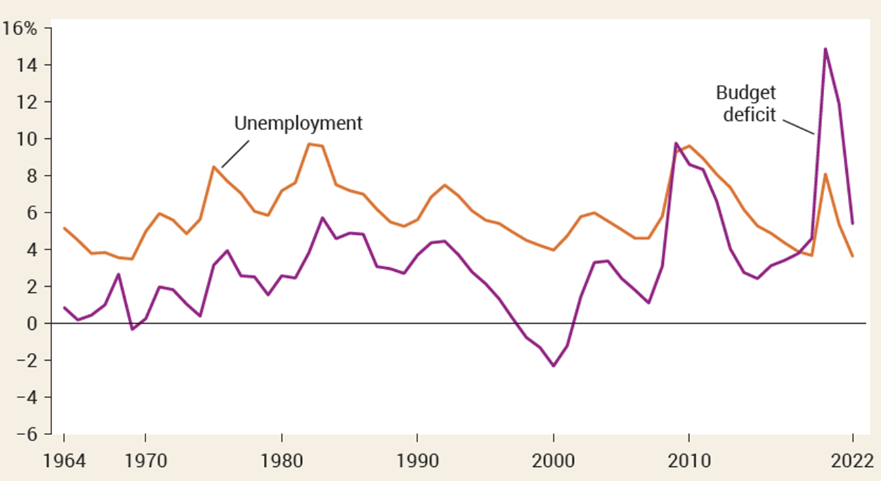
THE BUDGET BALANCE AND UNEMPLOYMENT
The budget deficit rises when the unemployment rate rises and falls when the unemployment rate falls.
Figure 13-9

Slide 48
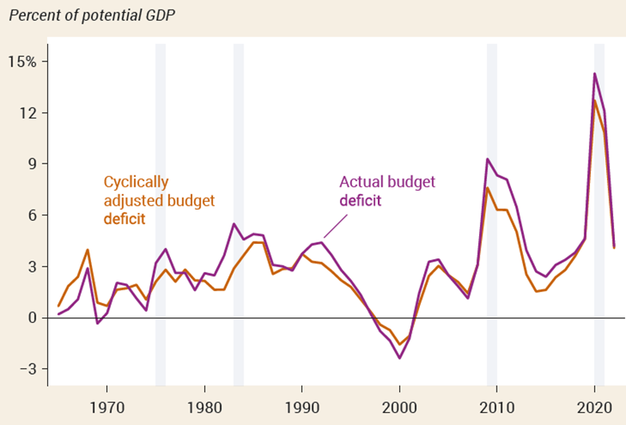
THE BUSINESS CYCLE AND THE CYCLICALLY ADJUSTED BUDGET BALANCE
To separate the effects of the business cycle from the effects of discretionary fiscal policy, governments estimate the cyclically adjusted budget balance (an estimate of the budget balance if GDP equaled potential output).
Years of large budget deficits tend to be years when the economy has a large recessionary gap.

Slide 49
SHOULD THE BUDGET BE BALANCED?
Most economists don’t think so.
They believe that the government should only balance its budget on average—that it is okay to run deficits in bad years, offset by surpluses in good years.
The government should be forced to run a balanced budget every year because this would undermine the role of taxes and transfers as automatic stabilizers.

Slide 50
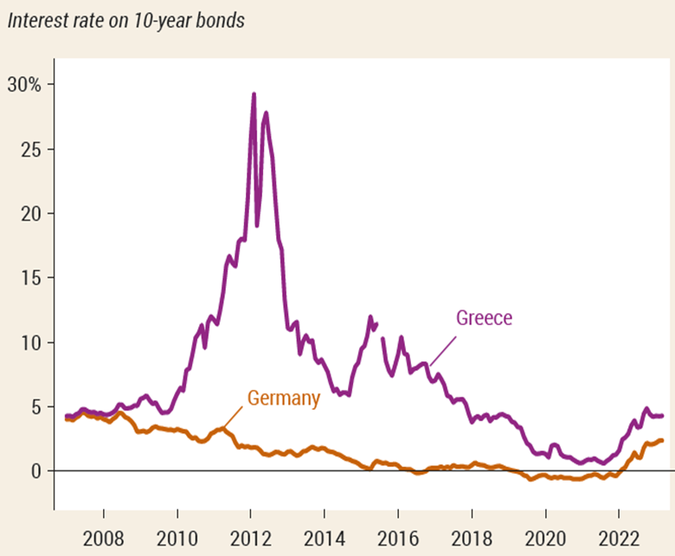
LONG-RUN IMPLICATIONS OF FISCAL POLICY
Persistent budget deficits have long-run consequences because they lead to an increase in public debt.
In 2008, the government of Greece could borrow at interest rates barely higher than those of Germany (widely considered a very safe borrower). Things changed in 2009…

Slide 51
DEFICITS VS. DEBT
A deficit is the difference between the amount of money a government spends and the amount it receives in taxes over a given period.
A debt is the sum of money a government owes at a particular time.
Deficits and debt are linked, because government debt grows when governments run deficits. But they aren’t the same thing, and they can tell different stories.

Slide 52
DANGERS POSED BY RISING GOVERNMENT DEBT
Crowding out: the government’s borrowing may crowd out private investments, raising interest rates and reducing the economy’s long-run growth.
Financial pressure and default:
Deficits place financial pressure on future budgets.
A government paying large sums in interest must raise taxes, cut spending—or it must borrow even more. If it borrows to pay the interest, it pushes itself even deeper into debt—the debt spiral. The debt spiral may end up in a default when the government stops paying what it owes, resulting in economic and financial turmoil.
Can’t a government that has trouble borrowing just print money to pay its bills?
Yes, it can, but this leads to another problem: inflation. More on this in a later chapter…

Slide 53
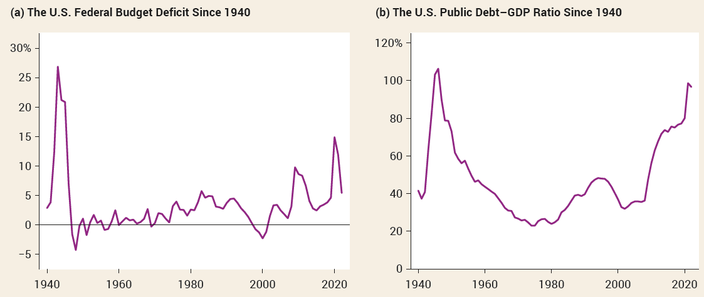
DEFICITS AND DEBT IN PRACTICE
To assess the government’s ability to pay its debt, we use the debt–GDP ratio.
Panel (a): The U.S. government ran huge deficits during World War II and has run smaller deficits ever since.
Panel (b): The debt–GDP ratio has declined despite government deficits.
53

Slide 54
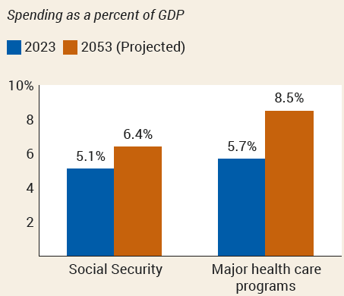
IMPLICIT LIABILITIES (1/2)
Experts on long-run budget issues view the situation of the United States (and other countries such as Japan and Italy) with alarm.
The reason is implicit liabilities: spending promises made by governments that are effectively a debt despite the fact that they are not included in the usual debt statistics. The aging population and rising health care costs will soon pose real problems for the federal budget.
54

Slide 55
IMPLICIT LIABILITIES (2/2)
Social Security and part of Medicare are supported by dedicated taxes (special taxes on wages). At times, these dedicated taxes yield more revenue than is needed to pay current benefits.
Since the mid-1980s the Social Security system has been taking in more revenue than it needs. This surplus has been used to accumulate a Social Security trust fund, which was $2.8 trillion at the end of fiscal 2022.

Slide 56
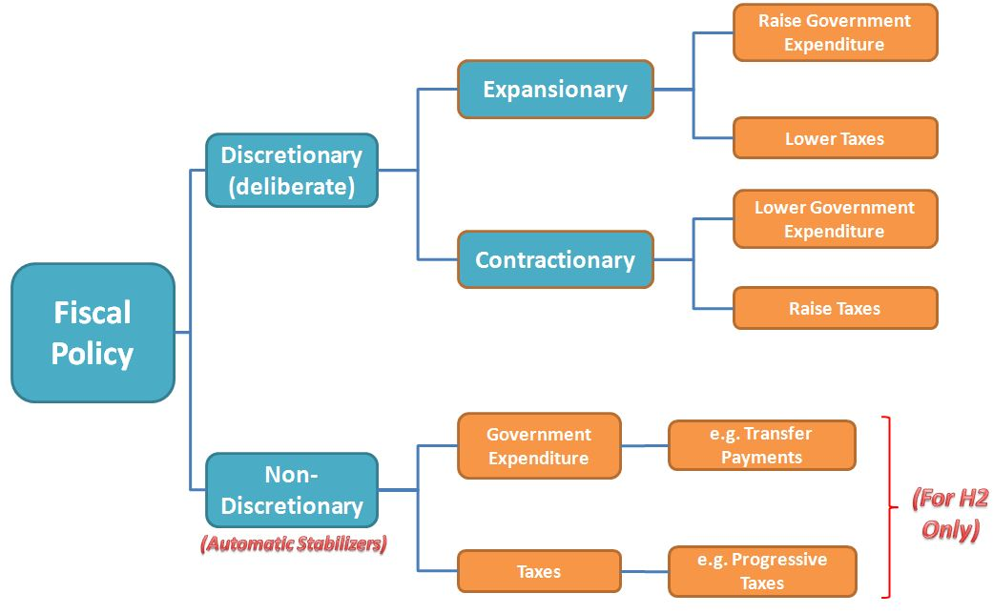
Review

