Slide 1
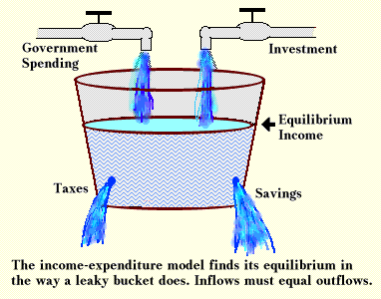
CHAPTER 11 LECTURE -INCOME AND EXPENDITURE

Slide 2
WHAT YOU WILL LEARN IN THIS CHAPTER
What is the importance of the multiplier, which summarizes how initial changes in spending lead to further changes?
What is the aggregate consumption function?
How do expected future income and aggregate wealth affect consumer spending?
What determines investment spending and why do we need to distinguish between planned investment spending and unplanned inventory investment?
How does the inventory adjustment process move the economy to a new equilibrium after a change in demand?
Why is investment spending considered a leading indicator of the future state of the economy?

Slide 3
THE MULTIPLIER: AN INFORMAL INTRODUCTION
Since households and firms are mutually interdependent (recall the circular flow), booms and busts involve chain reactions.
The multiplier helps us understand the extent of the chain reactions.
Basically, we want to understand how much extra income and spending are created from an initial change in spending.
Example: If construction spending rises by $100 billion, how much does this affect the economy?

Slide 4
FOUR SIMPLIFYING ASSUMPTIONS FOR NOW
(TO BE RECONSIDERED LATER)
We assume that producers are willing to supply additional output at a fixed price.
Changes in aggregate spending translate into changes in aggregate output (NOT PRICES)
We take the interest rate as given.
We assume that there is no government spending and no taxes.
We assume that exports and imports are zero.

Slide 5
THE MPC
A lot depends on how much consumers spend when they receive more income
Marginal propensity to consumer, or MPC
MPC = Δ consumer spending
Δ disposable income(whe
re Δ = change)
For example, if consumer spending goes up by $8 and disposable income (Income after tax) goes up by $10,
MPC = $8/10 = 0.8
Whatever is not spent is saved, so:
Marginal propensity to save, or MPS = the fraction of an additional dollar of disposable income that is saved.
MPS = 1 − MPC

Slide 6
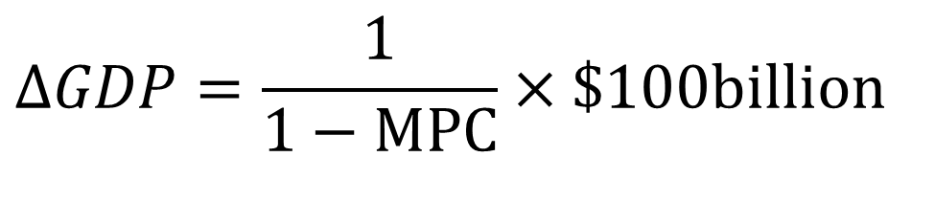
THE MULTIPLIER EFFECT
Each $1 increase in aggregate spending raises both real GDP and disposable income by $1—and causes people to spend money. How much?
If investment spending rises by $100 billion, this will lead to a second-round increase of MPC × $100 billion. It is followed by a third-round increase in consumer spending of MPC × MPC × $100 billion, and so on up to:
Total increase in real GDP = (1 + MPC + MPC² + MPC³ + . . .) × $100 billion, OR
Total increase in real GDP from a $100 billion rise is Investment, fore example is:
$$ΔGDP=\frac{1}{1−MPC}×\$100billion$$

Slide 7
EXAMPLE
If ΔAAS = autonomous change in aggregate spending and
ΔY = change in real GDP
Let MPC = 0.8 and ΔAAS = 100

Slide 8
LEARN BY DOING DISCUSSION QUESTION
With a partner, answer the following:
Suppose that the marginal propensity to save in an economy is equal to 0.2. Suppose that the level of investment spending increases by $200 this year.
Trace out the total increase in real GDP, showing the increase in consumer spending for at least the second, third, and fourth round of spending and the overall increase in real GDP.
(Assume that in this economy there is no government sector, no taxes, and no transfers and that the aggregate price level and the interest rate are fixed.)

Slide 9
LEARN BY DOING DISCUSSION QUESTION (Answer)
With a partner, answer the following:
Suppose that the marginal propensity to save in an economy is equal to 0.2. Suppose that the level of investment spending increases by $200 this year.
Trace out the total increase in real GDP, showing the increase in consumer spending for at least the second, third, and fourth round of spending and the overall increase in real GDP.
$200+$160+$128+$102.4+…
The total spending increase by $1,000 (correct answer)

Slide 10
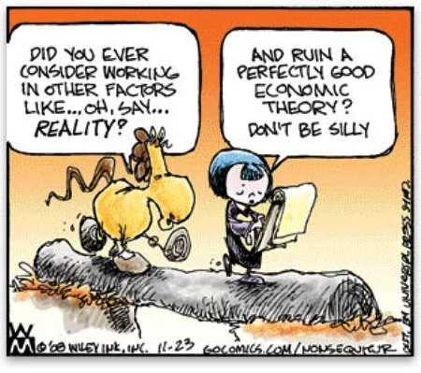
Refer to Handout: 11CHAPTER 11 LECTUREB-UNDERSTANDING THE MULTIPLIER

Slide 11
LEARN BY DOING PRACTICE QUESTION 1
Holding everything else constant in an economy, the larger the MPS, the:
smaller the value of the multiplier.
larger the value of the multiplier.

Slide 12

CONSUMER SPENDING
Consumer spending accounts for two-thirds of total spending on final goods and services.
But what determines how much consumers spend? The most important factor is current disposable income.

Slide 13
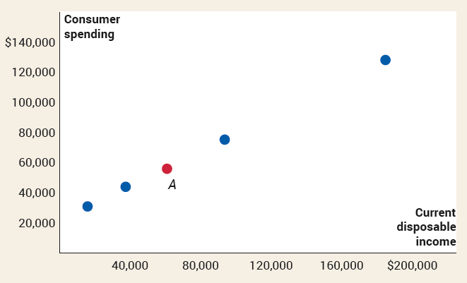
CURRENT DISPOSABLE INCOME AND CONSUMER SPENDING
Current disposable income: income after taxes are paid and government transfers are received
2021 average disposable income = $60,957
2021 average spending = $55,914

Slide 14
THE CONSUMPTION FUNCTION (1 of 3)
Consumption function: an equation showing how an individual household’s consumer spending varies with the household’s disposable income
c = a + MPC × yd
Where
c = a household’s consumer spending
yd = household disposable income
MPC = marginal propensity to consume
a = a constant, autonomous consumer spending—what a family would spend even with zero income

Slide 15
THE CONSUMPTION FUNCTION (2 of 3)
Recall,
MPC = Δc/Δyd
Multiplying both sides of the equation by Δyd, we get:
MPC × Δyd = Δc
In other words, when yd goes up by $1, c goes up by MPC × $1.

Slide 16
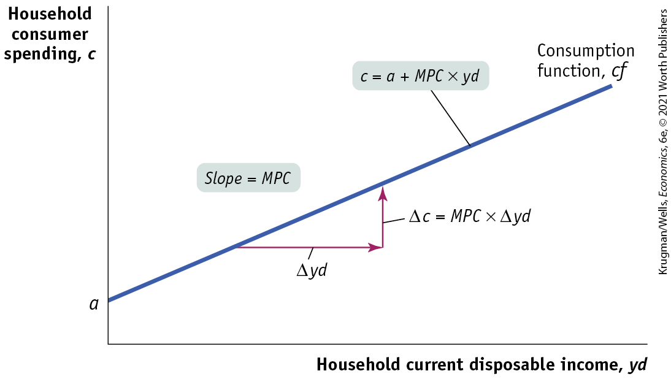
THE CONSUMPTION FUNCTION (3 of 3)
a is an individual household autonomous consumer spending, the value of c when yd is zero—the vertical intercept.
MPC is the slope: rise over run.
Figure 11-3

Slide 17
LEARN BY DOING PRACTICE QUESTION 2
Suppose that when Sue’s disposable income is $10,000, she spends $8,000, and when her disposable income is $20,000, she spends $14,000. Sue’s autonomous consumer spending is equal to $_____ and her MPS is equal to _____.
0; 0.2
2,000; 0.2
0; 0.6
2,000; 0.4

Slide 18
LEARN BY DOING PRACTICE QUESTION 2 (Answer)
Suppose that when Sue’s disposable income is $10,000, she spends $8,000, and when her disposable income is $20,000, she spends $14,000. Sue’s autonomous consumer spending is equal to $_____ and her MPS is equal to _____.
0; 0.2
2,000; 0.2
0; 0.6
2,000; 0.4 (correct answer)

Slide 19
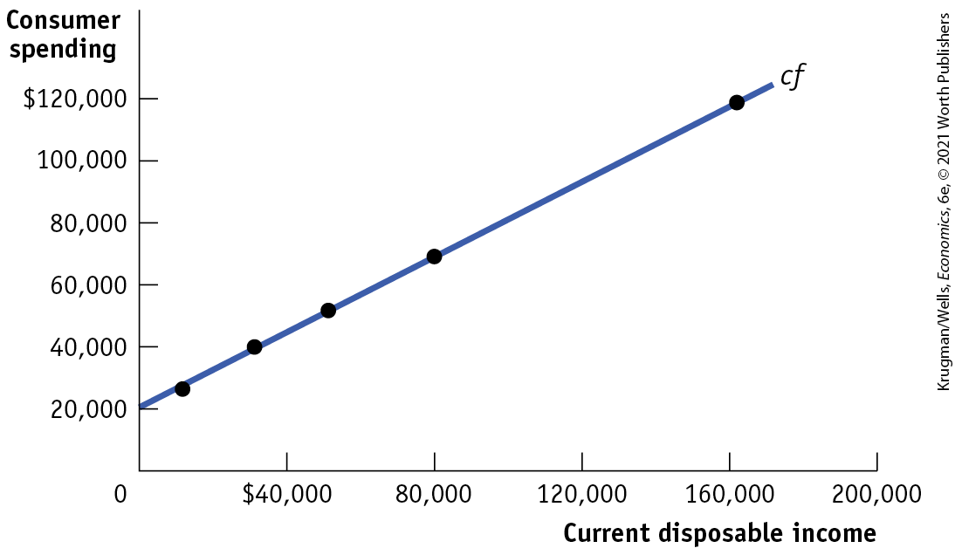
A CONSUMPTION FUNCTION FITTED TO DATA
According to data, autonomous spending is around $20,195 and MPC = 0.60.
The consumption function fitted to the data is:
C = $20,195+0.60 × yd
Figure 11-4

Slide 20
AGGREGATE CONSUMPTION FUNCTION
Aggregate consumption function: the relationship for the economy as a whole between aggregate disposable income and aggregate consumer spending
C = A + MPC × YD
Same form as consumption function, just aggregate.

Slide 21
LEARN BY DOING PRACTICE QUESTION 3
Assume aggregate consumer spending equals $5,000 when aggregate disposable income is zero, and when disposable income increases from $300 to $400, consumer spending increases by $70. What is the equation for the aggregate consumption function?
C = 5,000 + 70YD
C = 500 + 0.7YD
C = 5,000 + 0.7YD
C = 5,000 + 7YD

Slide 22
LEARN BY DOING PRACTICE QUESTION 3 (Answer)
Assume aggregate consumer spending equals $5,000 when aggregate disposable income is zero, and when disposable income increases from $300 to $400, consumer spending increases by $70. What is the equation for the aggregate consumption function?
C = 5,000 + 70YD
C = 500 + 0.7YD
C = 5,000 + 0.7YD (correct answer)
C = 5,000 + 7YD

Slide 23
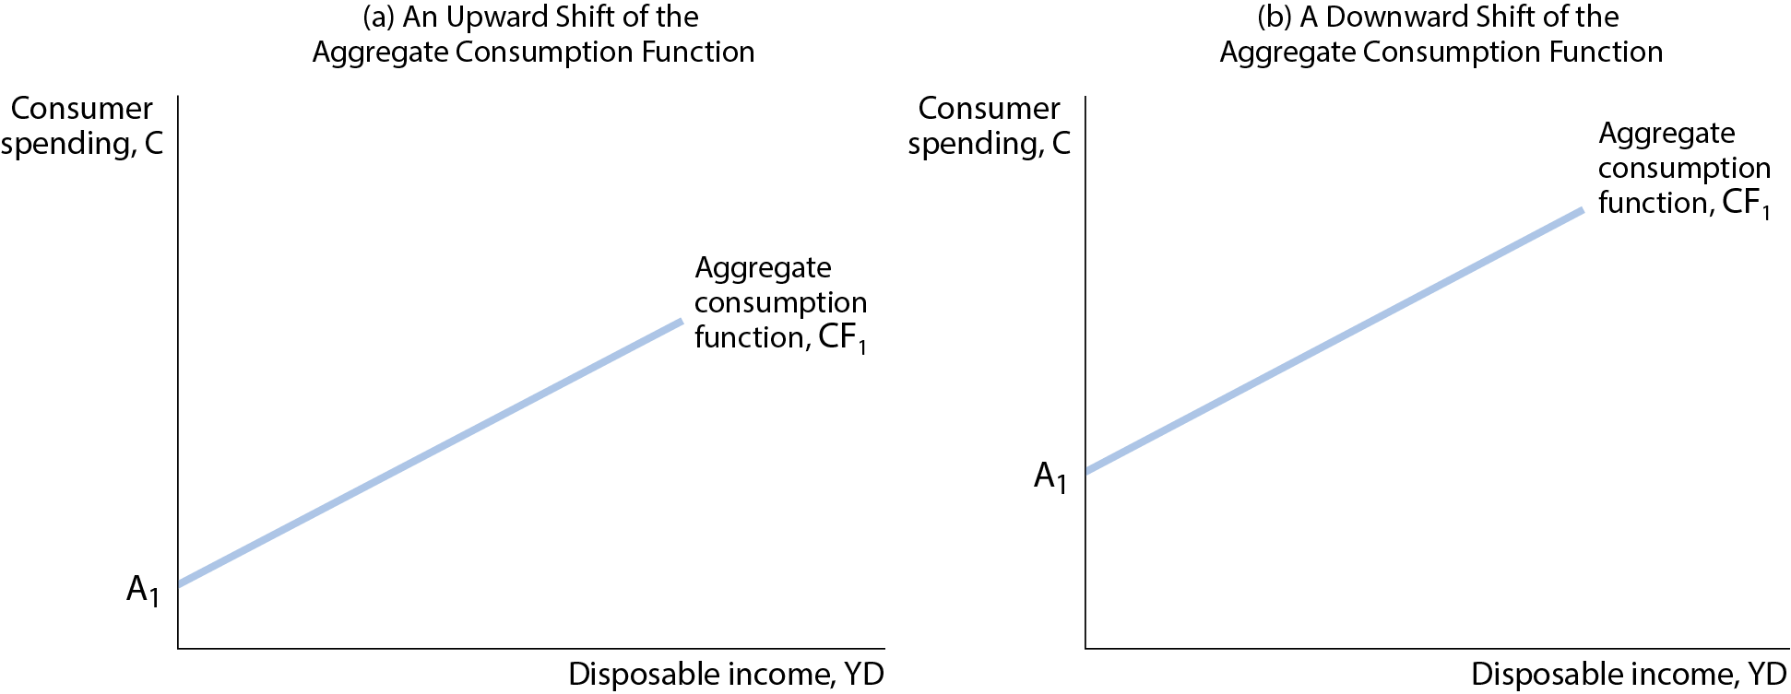
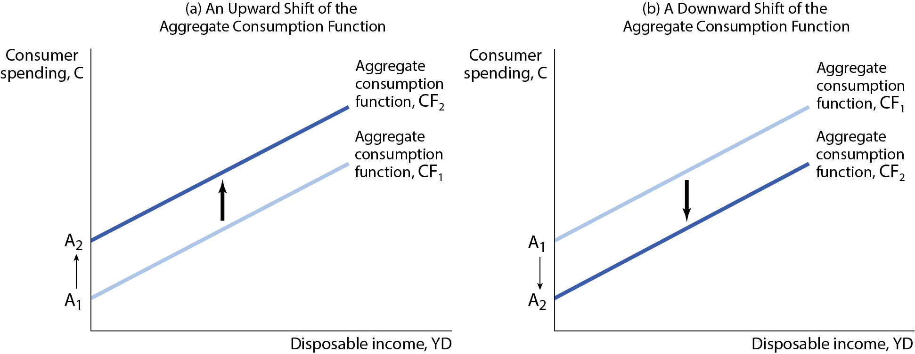
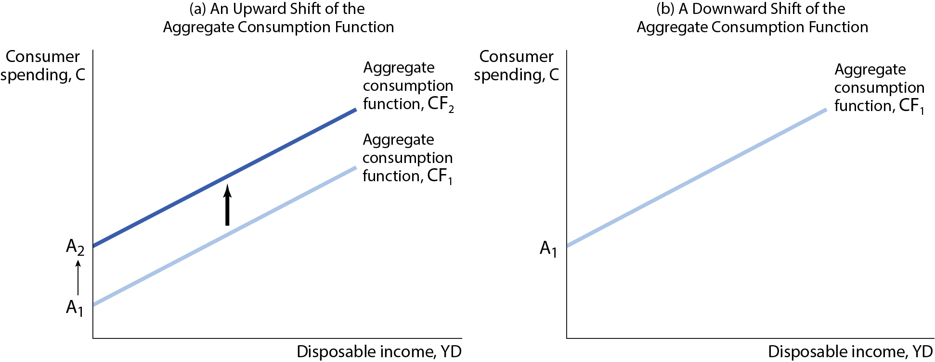
SHIFTS OF THE AGGREGATE CONSUMPTION FUNCTION (1 of 3)
The aggregate consumption function shows the relationship between disposable income and consumer spending, other things equal.
When “other things” change, the aggregate consumption function shifts.
Figure 11-5

Slide 24
SHIFTS OF THE AGGREGATE CONSUMPTION FUNCTION (2 of 3)
What causes shifts?
Changes in Expected Future Disposable Income: Consumer spending depends on the income people expect to have over the long term rather than on their current income: the permanent income hypothesis.
For example, expectations of higher incomes lead consumers to spend more, shifting the aggregate consumption function up.
Changes in Aggregate Wealth: consumers plan their spending— they try to smooth their consumption—over their lifetimes: the life-cycle hypothesis.
For example, a rise in aggregate wealth—say, because of a booming stock market—increases aggregate autonomous consumer spending, shifting the aggregate consumption function up.

Slide 25
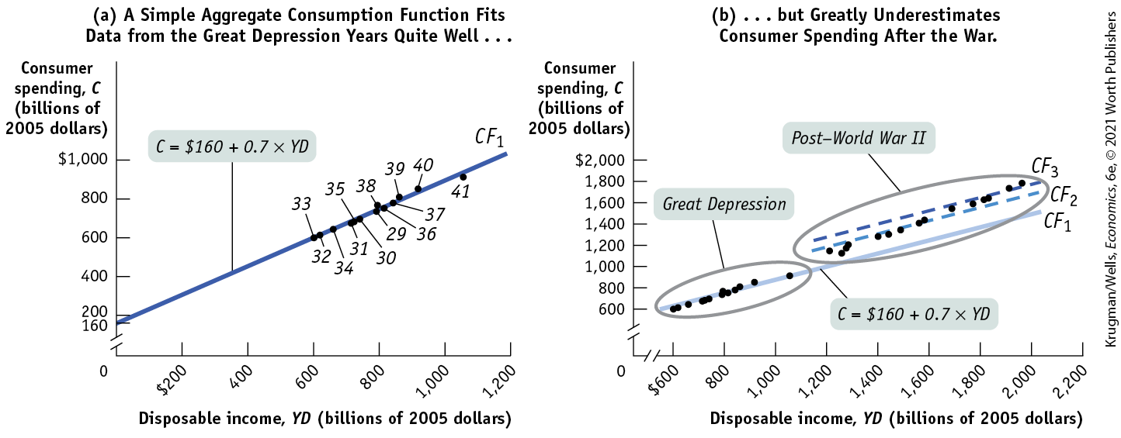
SHIFTS OF THE AGGREGATE CONSUMPTION FUNCTION (3 of 3)
Panel (a) shows aggregate data on disposable income and consumer spending from 1929 to 1941 when a simple linear consumption function, CF₁, fitted the data well.
Panel (b) shows that the aggregate consumption function shifted up after World War II because consumers grew increasingly confident that economic boom would continue, and wealth was steadily increasing.
Figure 11-6

Slide 26
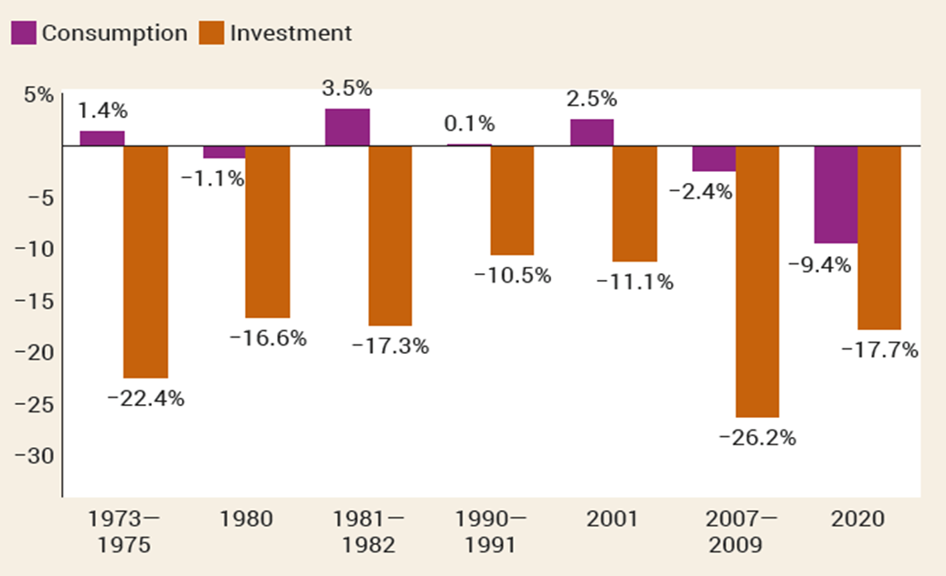
INVESTMENT SPENDING
Small yet powerful: Although much smaller than consumer spending, investment spending tends to drive the booms and busts in the business cycle. (Shown here: seven recent recessions)

Slide 27
WHAT DRIVES (PLANNED) INVESTMENT SPENDING?
Planned investment spending: the investment spending that businesses intend to undertake during a given period
It depends on:
Interest rate
Expected future real GDP
Current level of production capacity

Slide 28
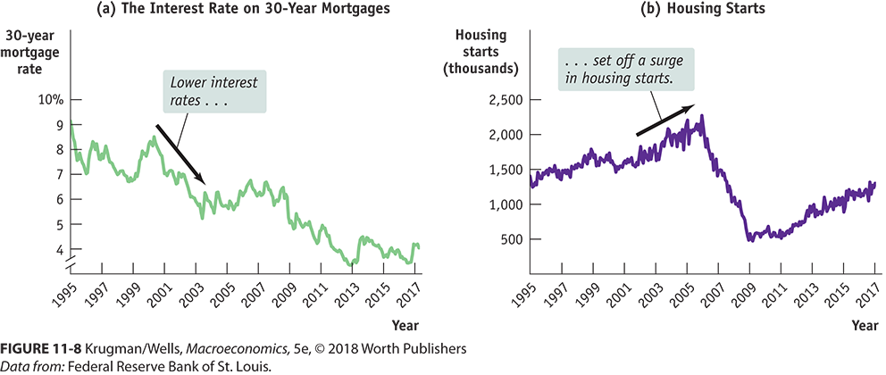
THE INTEREST RATE AND INVESTMENT SPENDING
Interest rates are often the cost of investment projects.
When interest rates are low, more loans are undertaken and investment rises (other things equal).

Slide 29
EXPECTED FUTURE REAL GDP, PRODUCTION CAPACITY, AND INVESTMENT SPENDING
If your firm has extra capacity and doesn’t expect sales to increase, its investment will be lower.
According to the accelerator principle:
A higher rate of growth in real GDP leads to higher planned investment spending.
A lower growth rate of real GDP leads to lower planned investment spending.

Slide 30
INVENTORIES AND UNPLANNED INVESTMENT SPENDING
Inventories: stocks of goods held to satisfy future sales
Inventory investment: the value of the change in total inventories held in the economy during a given period
Unplanned inventory investment: unplanned changes in inventories that occur when actual sales are more or less than businesses expected
Actual investment spending: the sum of planned investment spending and unplanned inventory investment
So, in any period: I = I_{Unplanned} + I_{Planned}

Slide 31
AGGREGATE INVESTMENT SCHEDULE
Investment spending is autonomous (independent) of income.
INVESTMENT SPENDING (I)
I₀
I
1
2
3
4
5
6
INCOME (Y)
SLIDE 31

Slide 32

THE INCOME–EXPENDITURE MODEL
Let’s take a more detailed look at how changes in spending get multiplied.
We’ll see that the multiple rounds of changes in real GDP are accomplished through changes in the amount of output produced by firms—changes they make in response to changes in inventories.

Slide 33
THE INCOME–EXPENDITURE MODEL: ASSUMPTIONS
Recall the assumptions underlying the multiplier process:
Changes in overall spending lead to changes in aggregate output.
The interest rate is fixed.
Taxes, government transfers, and government purchases are all zero.
Exports and imports are both zero.
(Future chapters loosen these assumptions.)

Slide 34
PLANNED AGGREGATE SPENDING AND REAL GDP (1 of 2)
Since we assume that there are no taxes or transfers,
GDP = C + I and
YD = GDP
and our aggregate consumption function is
C = A + MPC × YD
and we assume I_{planned} is fixed, so
AE_{Planned} = C + I_{Planned}
where AE_{Planned}, planned aggregate spending, is the total amount of planned spending in the economy.

Slide 35
PLANNED AGGREGATE SPENDING AND REAL GDP (2 of 2)
Example: If C = 300 + 0.6 × YD, then
TABLE 2 Equilibrium When Real GDP = YD = AE_{Planned}
Real GDP (billions of dollars) | YD (billions of dollars) | C (billions of dollars) | I_{Planned} (billions of dollars) | AE_{Planned} (billions of dollars)
$0 | $0 | $300 | $500 | $800
500 | 500 | 600 | 500 | 1,100
1,000 | 1,000 | 900 | 500 | 1,400
1,500 | 1,500 | 1,200 | 500 | 1,700
2,000 | 2,000 | 1,500 | 500 | 2,000
2,500 | 2,500 | 1,800 | 500 | 2,300
3,000 | 3,000 | 2,100 | 500 | 2,600
3,500 | 3,500 | 2,400 | 500 | 2,900

Slide 36
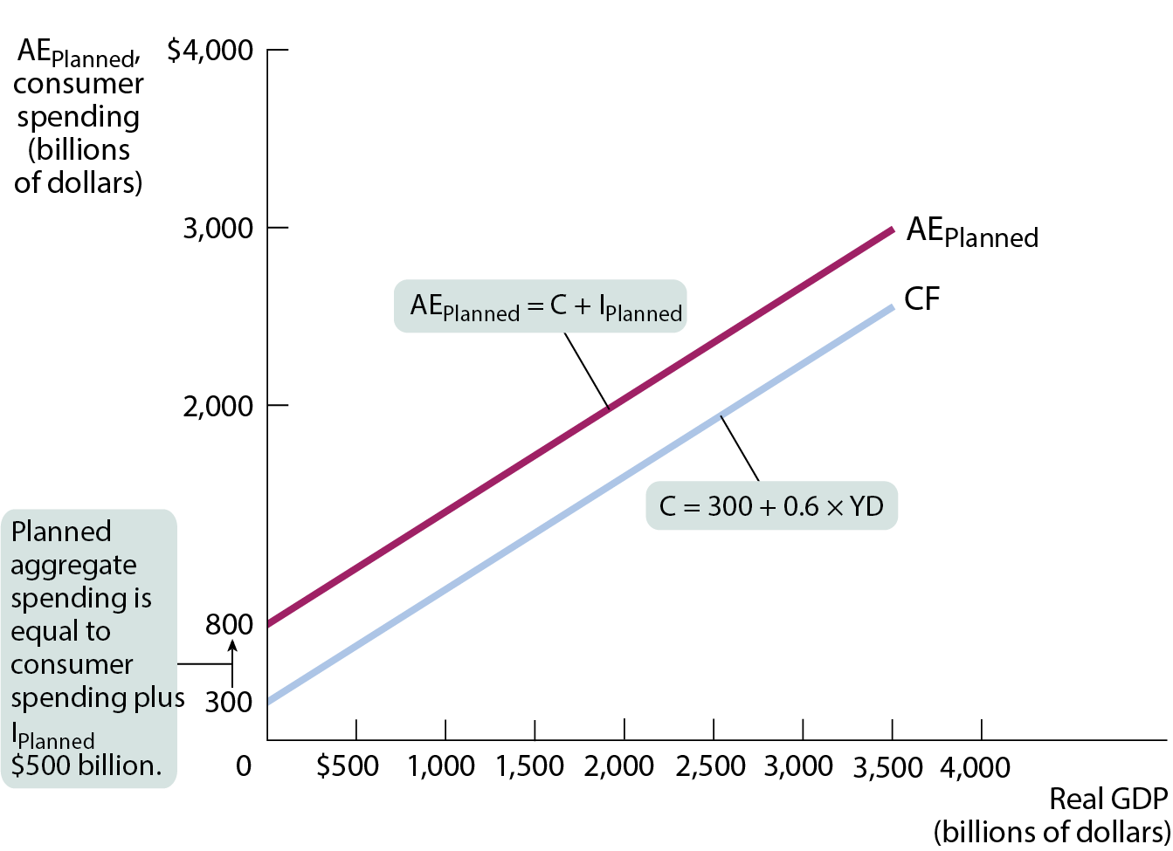
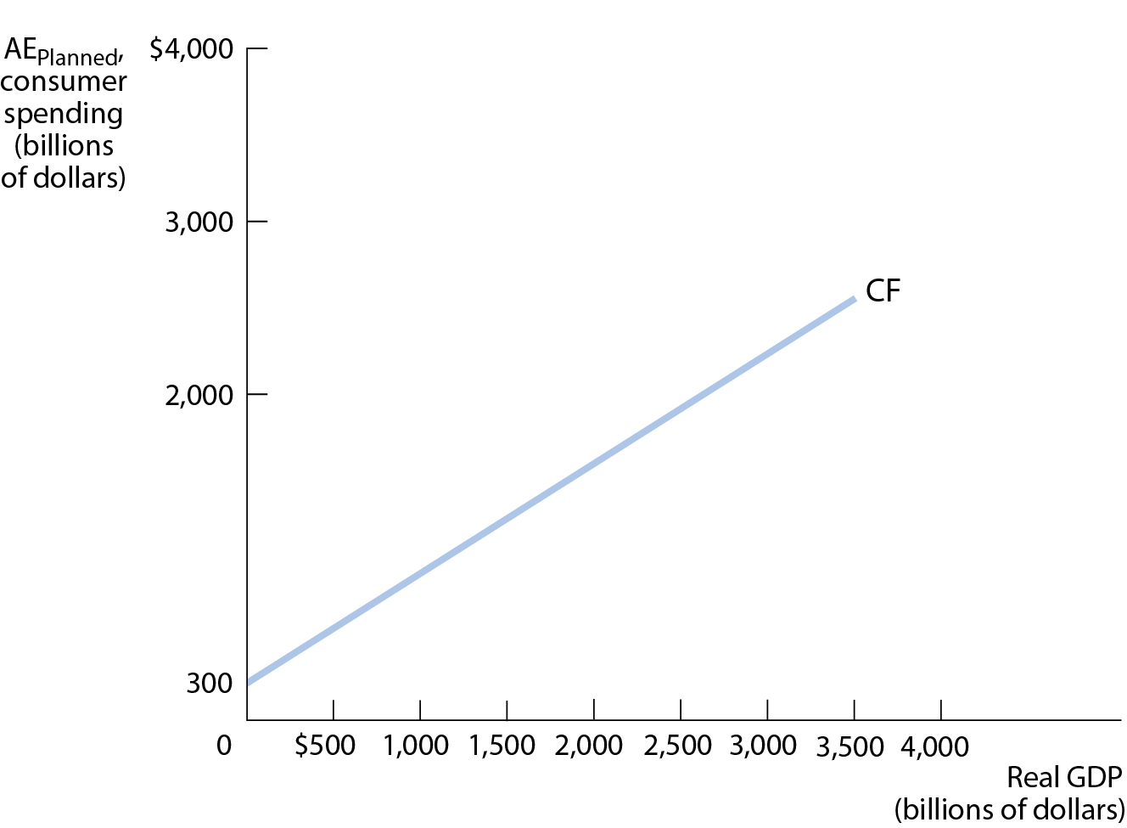
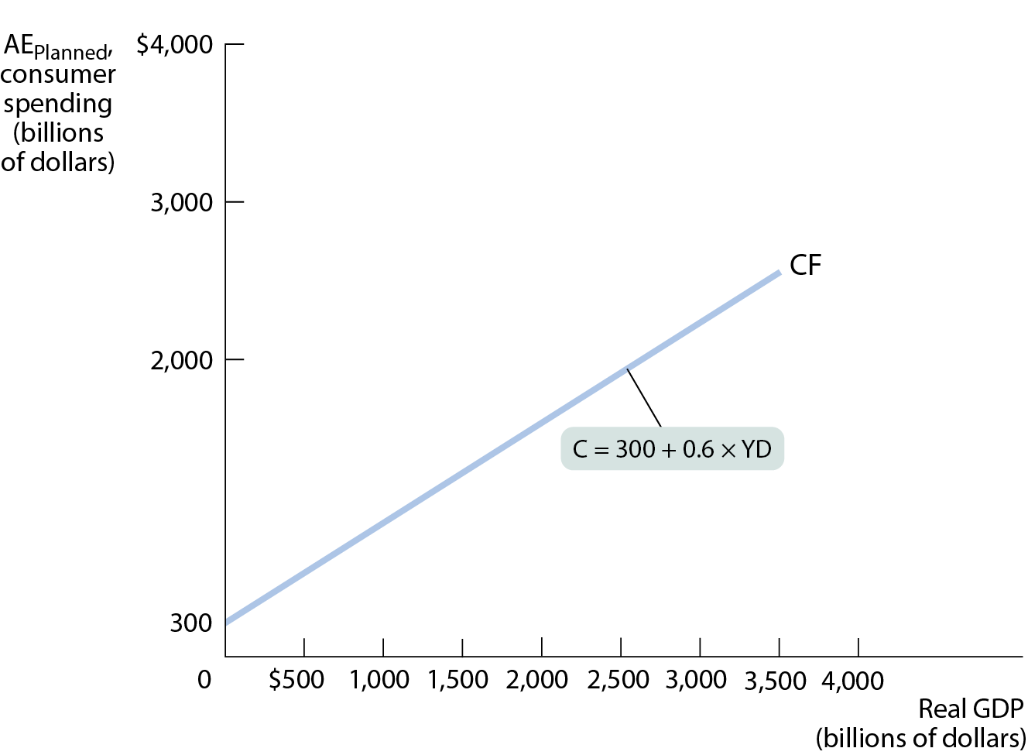
THE AGGREGATE CONSUMPTION FUNCTION AND PLANNED AGGREGATE SPENDING
Figure 9
The lower line, CF, is the aggregate consumption function constructed from Table 2.
The upper line, AE_{Planned}, is the planned aggregate spending line, also constructed from Table 2.

Slide 37
INCOME–EXPENDITURE EQUILIBRIUM (1 of 4)
The economy moves to a situation in which there is no unplanned inventory investment: the income–expenditure equilibrium.
Table 3: Equilibrium When I_{Unplanned} = 0
Real GDP | AE_{Planned} | I_{Unplanned}
 | (billions of dollars)
$0 | $800 | −$800
500 | 1,100 | −600
1,000 | 1,400 | −400
1,500 | 1,700 | −200
2,000 | 2,000 | 0
2,500 | 2,300 | 200
3,000 | 2,600 | 400
3,500 | 2,900 | 600

Slide 38
INCOME–EXPENDITURE EQUILIBRIUM LOGIC
(2 of 4)
Planned aggregate spending can be different from real GDP only if there is unplanned inventory investment, I_{Unplanned}, in the economy.
If firms have underestimated sales and produced too little, there will be unintended drops in inventories (and I_{Unplanned} will be negative).
If firms have overestimated sales and produced too much, there will be unintended additions to inventories (and I_{Unplanned} will be positive).

Slide 39
LEARN BY DOING PRACTICE QUESTION 4
Suppose the level of planned aggregate expenditure in an economy is $500 and real GDP is $600. According to our model:
unplanned increases in inventories are occurring.
unplanned decreases in inventories are occurring.
inventories will be unaffected and will remain at the planned inventory level.
excess production will continue, since there is no mechanism to restore the level of production to the level of spending.

Slide 40
LEARN BY DOING PRACTICE QUESTION 4 (Answer)
Suppose the level of planned aggregate expenditure in an economy is $500 and real GDP is $600. According to our model:
unplanned increases in inventories are occurring. (correct answer)
unplanned decreases in inventories are occurring.
inventories will be unaffected and will remain at the planned inventory level.
excess production will continue, since there is no mechanism to restore the level of production to the level of spending.

Slide 41
INCOME–EXPENDITURE EQUILIBRIUM EQUATION
(3 of 4)
GDP = C + I
= C + I_{Planned} + I_{Unplanned}
= AE_{Planned} + I_{unplanned}
Whenever real GDP exceeds AE_{Planned}, I_{Unplanned} is positive.
Whenever real GDP is less than AE_{Planned}, I_{Unplanned} is negative.
(But firms will act to correct their mistakes by producing more or less accordingly.)

Slide 42
INCOME–EXPENDITURE EQUILIBRIUM (4 of 4)
The economy is in income–expenditure equilibrium when aggregate output (real GDP) is equal to planned aggregate spending.
Income–expenditure equilibrium GDP (Y*): the level of real GDP at which real GDP equals planned aggregate spending.

Slide 43
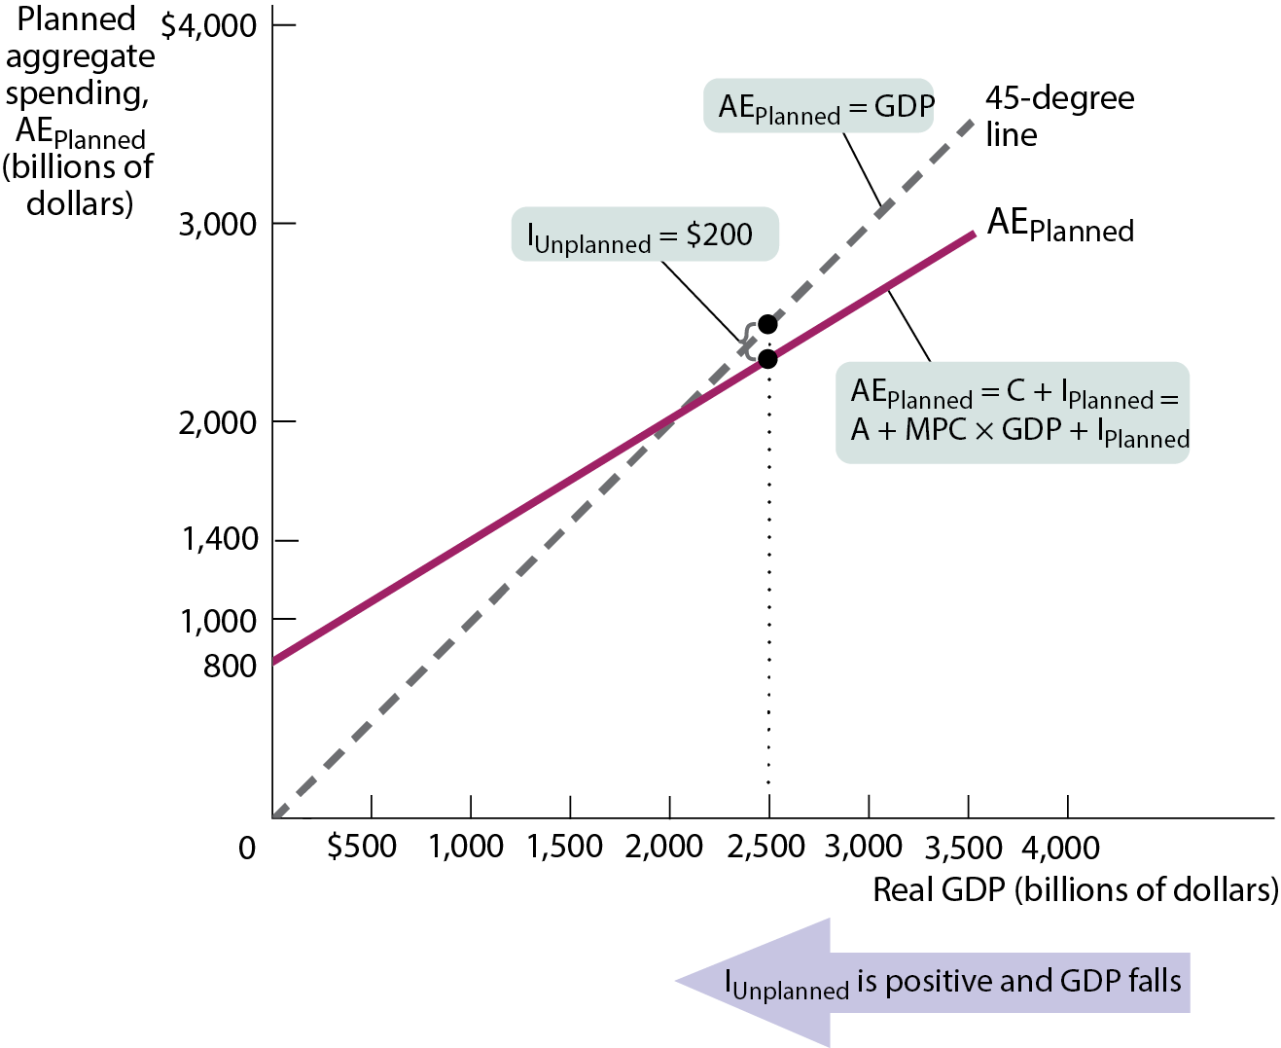
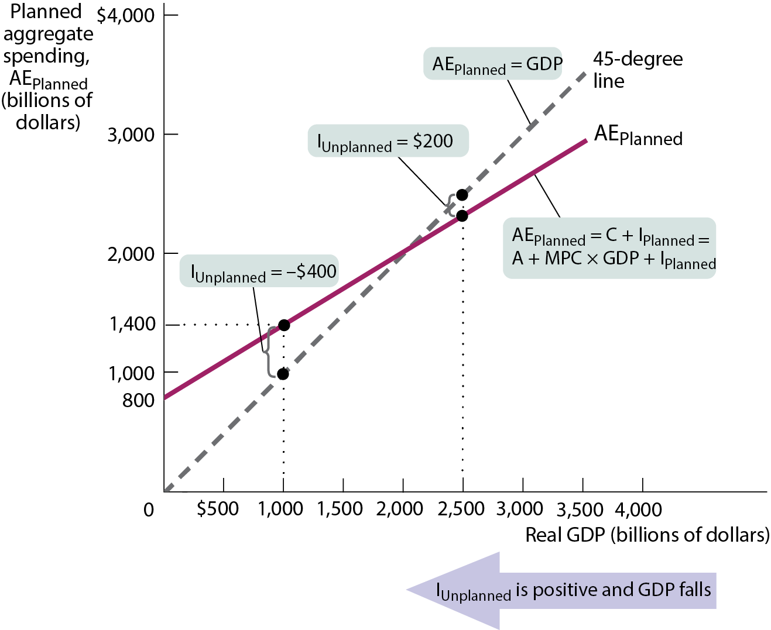
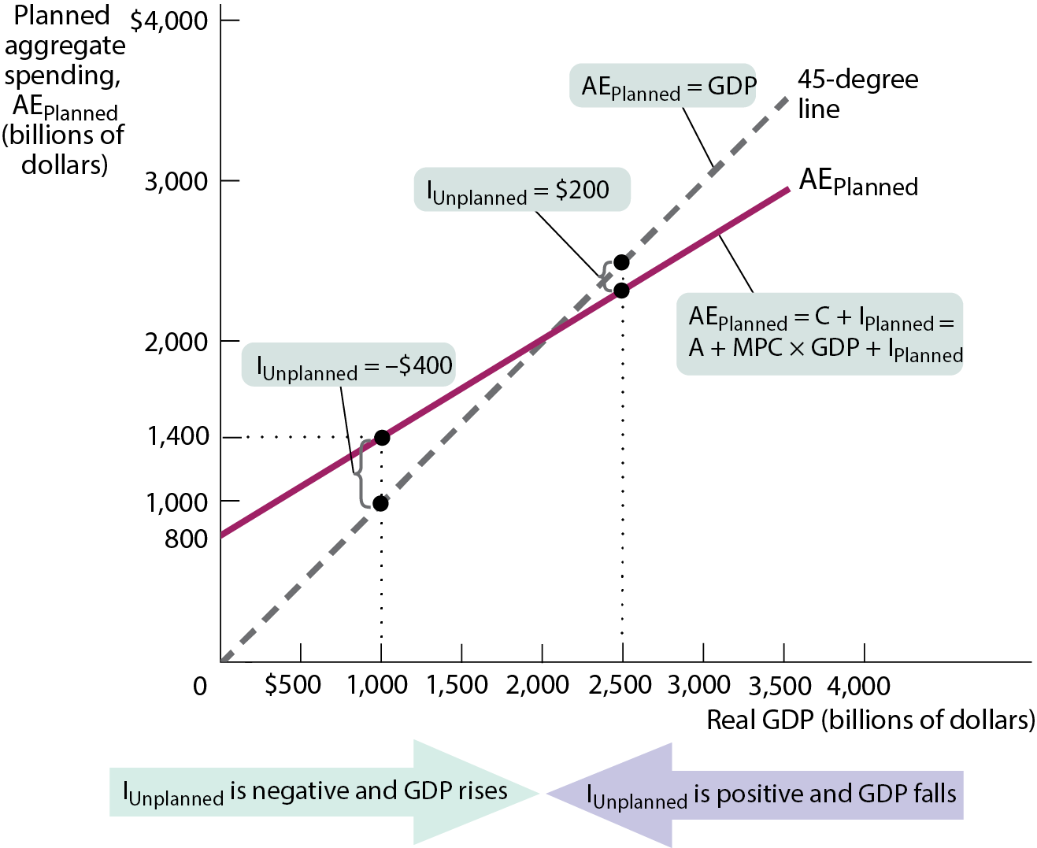

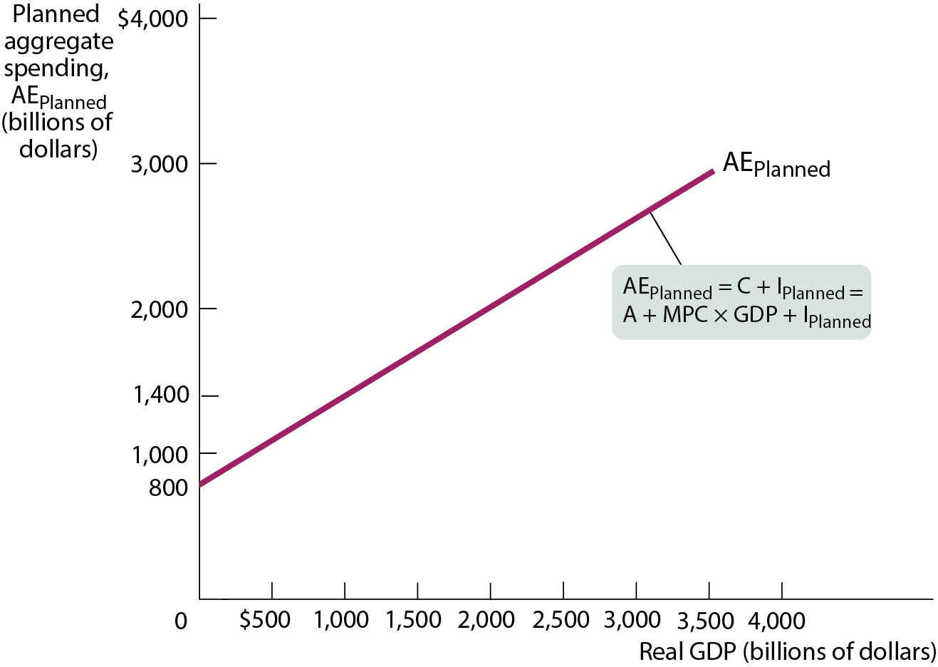
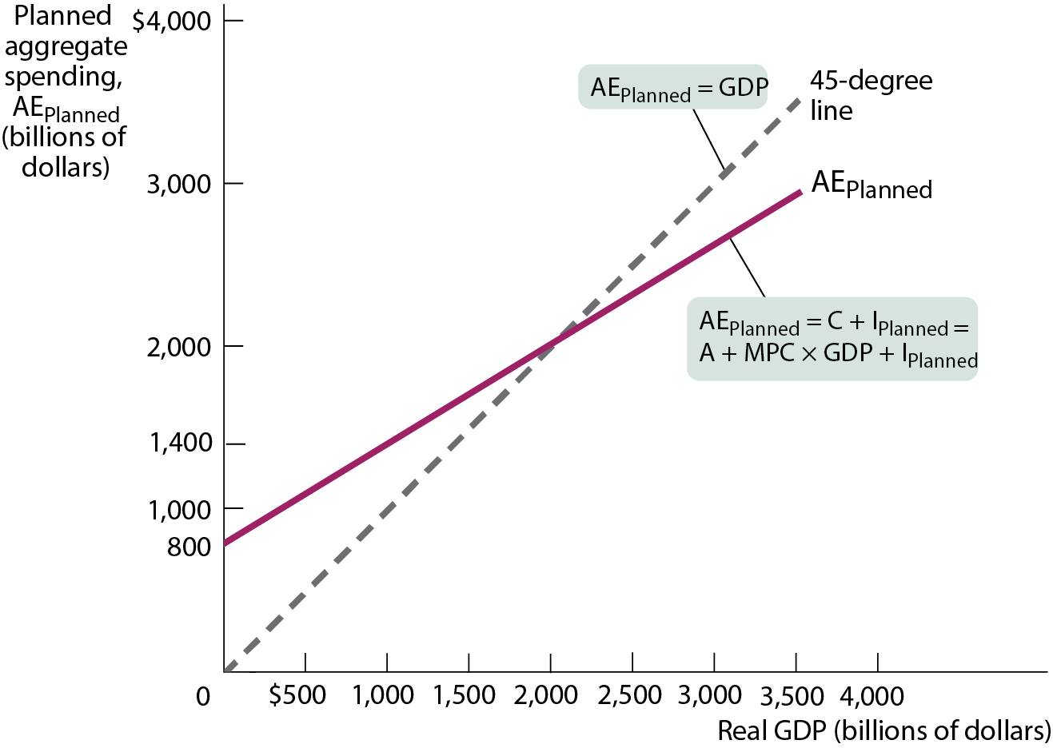
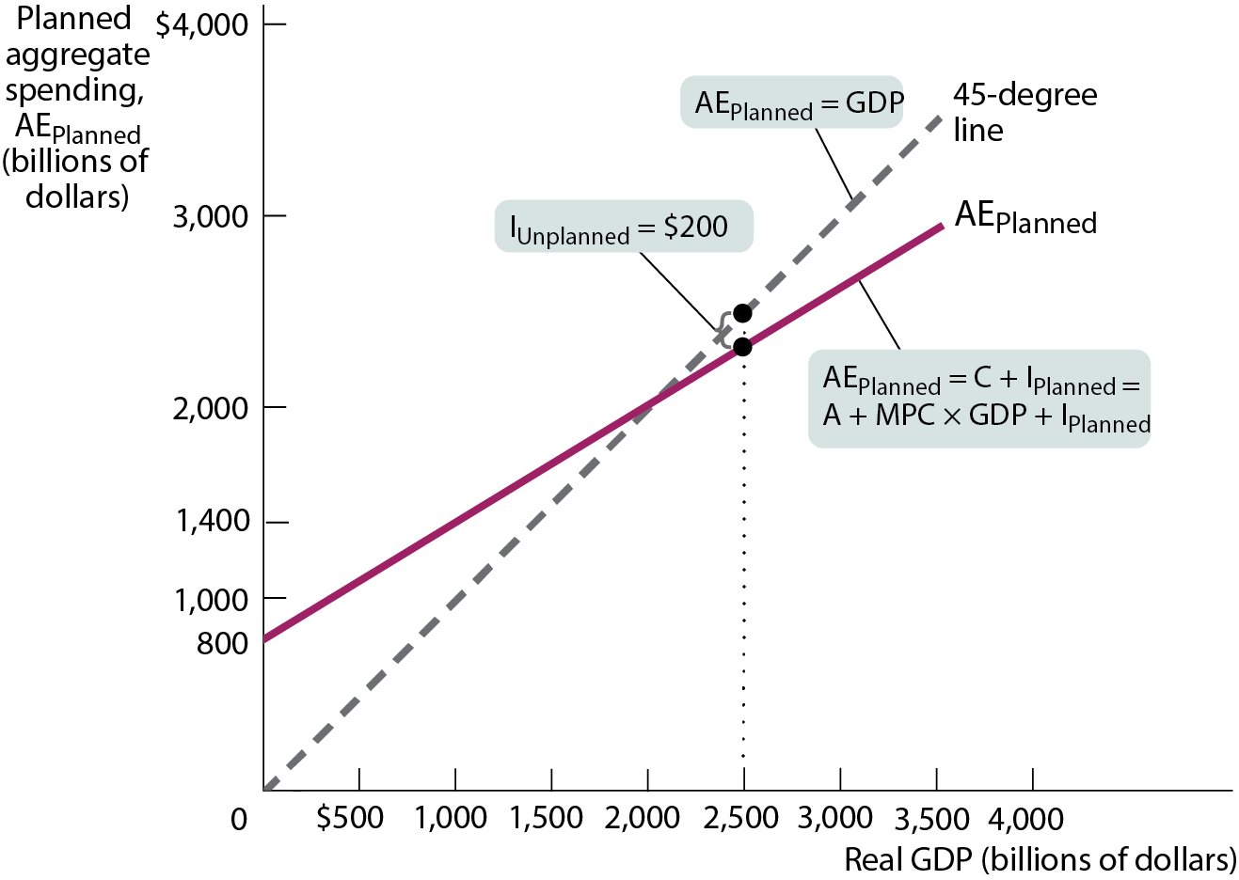
FIGURE 10: INCOME–EXPENDITURE EQUILIBRIUM
Income–expenditure equilibrium occurs at E where AE_{Planned} crosses the 45-degree line.
This type of diagram is known as the Keynesian cross.

Slide 44
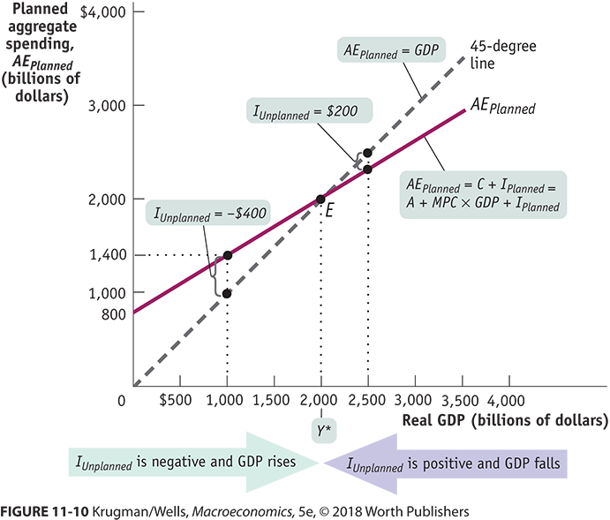
INCOME–EXPENDITURE EQUILIBRIUM GRAPH

Slide 45
LEARN BY DOING DISCUSSION QUESTION 2
Suppose an economy is producing at a point where output is greater than expenditures.
Is this an income–expenditure equilibrium? What evidence might you see in inventory levels?
Describe what will happen to move the economy toward equilibrium.
Notes:
The answer is no, and firms will find their unplanned inventories increasing. The economy will adjust when firms reduce production.

Slide 46
THE MULTIPLIER PROCESS AND INVENTORY ADJUSTMENT (1 of 3)
What happens when there’s a shift of the planned aggregate spending line?
In our simple model, there are only two possible sources of a shift of the planned aggregate spending line:
a change in planned investment spending, I_{Planned},
a shift of the aggregate consumption function, CF.
A change in I_{Planned} can occur because of a change in the interest rate.
A shift of the aggregate consumption function (a change in its vertical intercept, A) can occur because of a change in aggregate wealth—say, due to a rise in house prices.

Slide 47
REAL GDP BEFORE AND AFTER AUTONOMOUS SPENDING INCREASES BY 400 (MPC = 0.6)
Real GDP | AE_{Planned} before autonomous change | AE_{Planned} after autonomous change
 | (billions of dollars)
$0 | $800 | $1,200
500 | 1,100 | 1,500
1,000 | 1,400 | 1,800
1,500 | 1,700 | 2,100
2,000 | 2,000 | 2,400
2,500 | 2,300 | 2,700
3,000 | 2,600 | 3,000
3,500 | 2,900 | 3,300
4,000 | 3,200 | 3,600

Slide 48
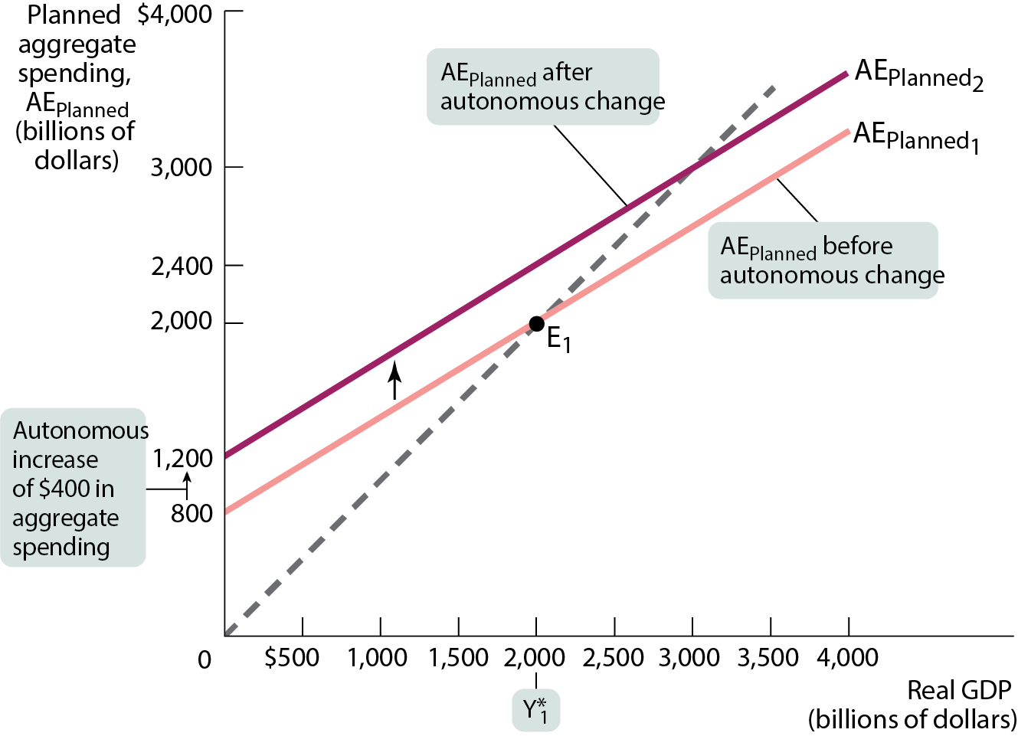
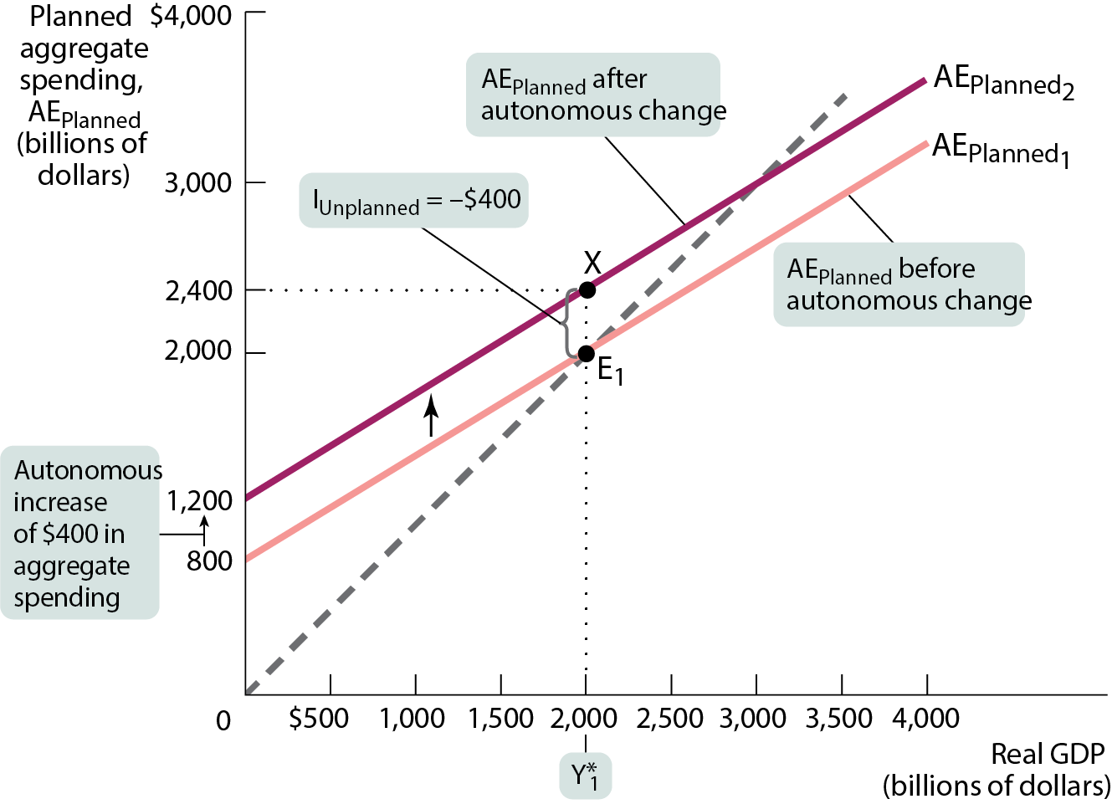
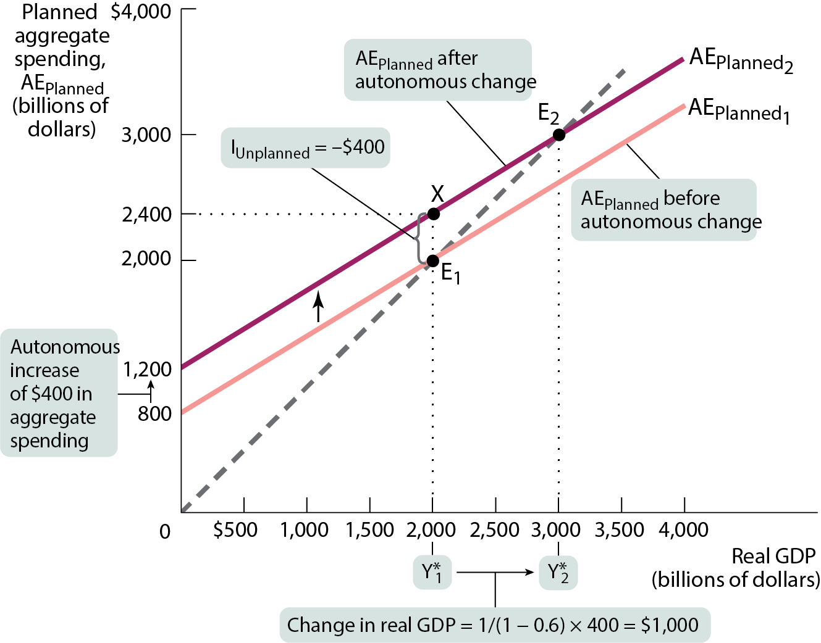
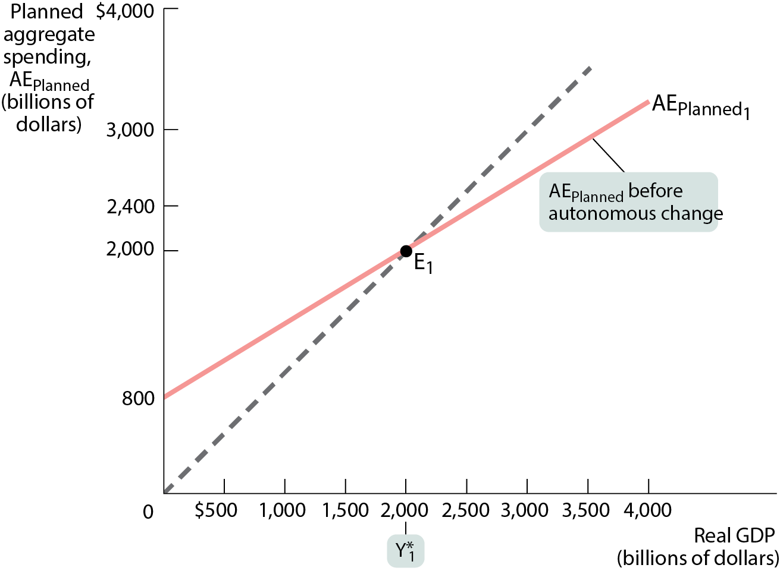
THE MULTIPLIER
The economy is initially at equilibrium point E₁.
An autonomous increase shifts AE_{Planned} upward by 400. The economy is now at point X. I_{Unplanned} = −400. Firms increase production, and the economy reaches a new income–expenditure equilibrium at E₂.

Slide 49
THE MULTIPLIER PROCESS AND INVENTORY ADJUSTMENT (2 of 3)
We can summarize these results in an equation, where ∆AAE_{Planned} represents the autonomous change in AE_{Planned}, and ΔY*=Y*₂ – Y*₁, the subsequent change in income–expenditure equilibrium GDP:
Since MPC < 1, each round of increases in disposable income leaks out into savings. As a result, increases in real GDP diminish from one round to the next. At some point, the increase in real GDP is negligible, and the economy converges to a new income–expenditure equilibrium GDP.

Slide 50
THE MULTIPLIER PROCESS AND INVENTORY ADJUSTMENT (3 of 3)
When planned spending does not equal the aggregate output, this difference shows up in changes in inventories.
Firms respond to inventory changes and move real GDP to the point at which real GDP and planned aggregate spending are equal.
That’s why changes in inventories are a leading indicator of future economic activity.

Slide 51

THE PARADOX OF THRIFT
The outcome of many individual actions can generate a result that is different from and worse than the simple sum of those individual actions.
The multiplier shows how it unfolds. Suppose there is a slump in investment spending (e.g., the one before 2007). This causes a fall in income–expenditure equilibrium GDP that is several times larger than the original fall in spending. It leaves consumers and producers worse off than they would have been if they hadn’t cut their spending.

Slide 52
WHAT ABOUT EXPORTS AND IMPORTS? (1 of 2)
In the real world, countries have international trade. How do we deal with exports and imports in our model?
Exports are like an increase in autonomous spending because income earned from exports is a source of spending on domestically produced goods and services.
Foreign trade makes the multiplier process weaker: When consumer spending changes, part of that change leaks to imports, which reduces the multiplier. The extent to which the multiplier falls depends on the marginal propensity to import (how much of an additional dollar of spending falls on imports rather than domestic goods).
Notes:
Economic

Slide 53
WHAT ABOUT EXPORTS AND IMPORTS? (2 of 2)
Economic interdependence: Trade links between economies are one reason business cycles are often international in scope. Many countries tend to have recessions and recoveries at the same time.

Slide 54
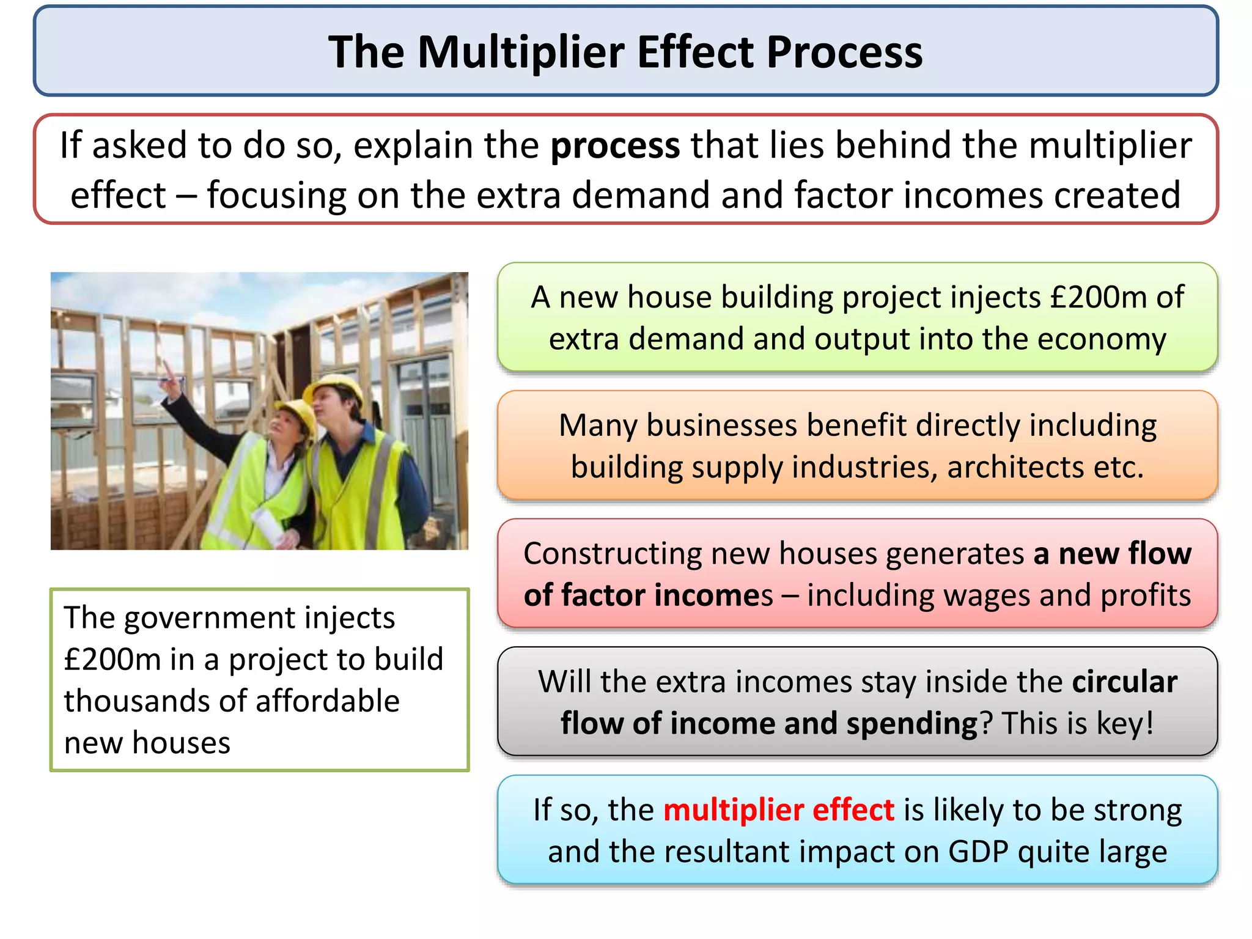
https://www.slideshare.net/mattbentley34/the-multiplier-effect-explained

Slide 55
RECESSIONARY GAP
THE INCREASE IN AGGREGATE SPENDING NECESSARY TO BRING A DEPRESSED ECONOMY BACK TO FULL EMPLOYMENT
This is not the total deficiency in GDP, which is called the GDP gap. The recessionary gap is the spending needed to close the GDP gap when boosted by the multiplier.
INFLATIONARY GAP
THE DECREASE IN AGGREGATE SPENDING NECESSARY TO BRING AN OVERHEATED ECONOMY BACK TO FULL EMPLOYMENT
Inflationary pressures occur when an economy produces output above full employment. Excess spending results in higher prices, which can lead to other economic problems
SLIDE 55

Slide 56
